Slide 1
Chapter 7: Respiratory System
7.1 Structures

Slide 2
Goals for this Chapter:
Explain how the upper respiratory tract filters, moistens, and directs air.
Describe the composition, structure, and function of the lower respiratory system.
Describe how the mechanical action of breathing moves gases into and out of the lungs.
Explain how gases are exchanged between the respiratory system and the environment.

Slide 3
7.1 – Structures of the Respiratory System
Respiration actually involves a 4-stage process:

Slide 4
Respiratory Structures

Slide 5
Respiratory Structures
Air enters via the nasal cavities and mouth
The nasal cavities contain hairs and mucus that traps particles and keeps cells moist
At the same time, the large number of blood vessels inside the nose also warm the incoming air
The air then travels through the pharynx, which separates the trachea (windpipe) and the esophagus

Slide 6
Interesting Fact:
Why do men's jackets have buttons on the cuffs (besides the ones to do them up)?
  To stop people wiping their nose on them. The most accepted designer of this accessory was George Washington, whose army fought and caught colds, and were added to stop them using them to wipe their noses.

Slide 7
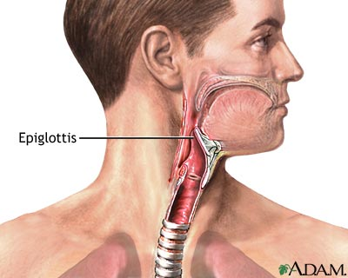
When eating, an enlarged flap of cartilage called the epiglottis covers the trachea to prevent food from entering
The glottis lies just after the epiglottis, just before the start of the larynx. This spot is where your Adam's Apple (also called Thyroid cartilage) is located.

Slide 8
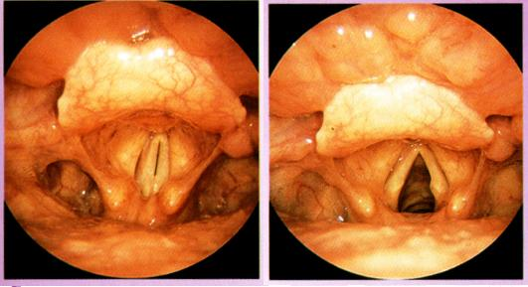
Voice Box
Beyond the pharynx is the larynx, which is composed of thin sheets of elastic ligaments
When air passes past the larynx, sounds are produced (these are the vocal cords)
During speech, muscles contract and move these cords closer together

Slide 9
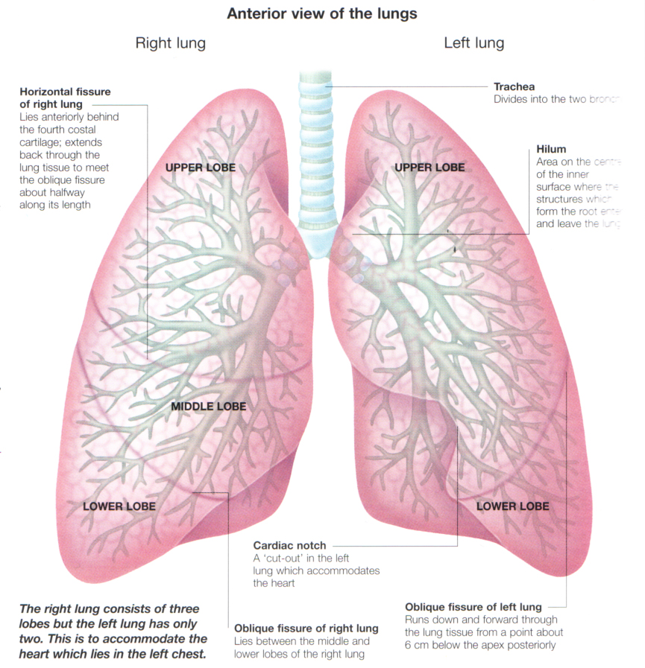
The lungs are surrounded by the pleural membrane, which attaches the lungs to the thoracic cavity
The trachea branches into two bronchi, one for each lung
These bronchi then continue to branch into bronchioles
The bronchioles, unlike the bronchi and trachea, lack rings of cartilage
Smooth muscle can change the diameter of the bronchioles

Slide 10
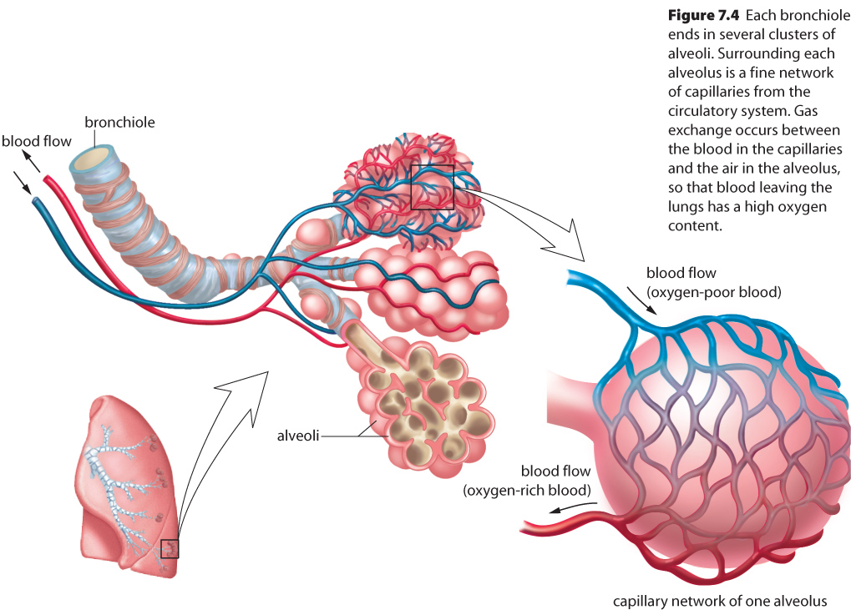
Alveoli

Slide 11
Breathing Movements
Pressure differences between the atmosphere and the chest cavity determine the movement of air into and out of the lungs
Inspiration – pressure inside the lungs is less than the atmosphere
Expiration – pressure inside the lungs is greater than the atmosphere

Slide 12
Interesting Fact:
What are hiccups?
  An irritation of the diaphragm causes air to become trapped in the respiratory tract and the diaphragm experiences a muscular spasm.
  How do you get rid of hiccups?

Slide 13
Home made lung Activity

