Slide 1
Muscles

Slide 2
Three Types of Muscles
Lining of organs – stomach,
esophagus, uterus, walls of
blood vessels.
Involuntary muscle contraction
and relaxation.
Attached to bones – allow to walk
talk and hit a baseball. Muscles
are attached by tendons.
Voluntary – contraction/shorten
relaxation/lengthen
Antagonistic Muscles – pairs that
work in opposition of each other
Flexor and Extensor (Bicep and
Tricep)
Cardiac muscles are
found only in the heart
and are the muscles that
make the heart beat.
Involuntary muscle
contraction and relaxation

Slide 3
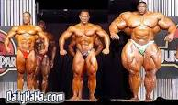
Origin is where the muscle attaches to
stationary bone; Insertion is where it attaches
to the moving bone.
CNS – ensures that muscles don’t work agains
each other.

Slide 4
Demonstration

Slide 5
Skeletal Muscle
80% of energy is used in skeletal muscles
Containing many nuclei in each muscle cell
Fibres enclosed by sarcolemma
Two myofilaments – Thin are composed of actin, and Thick are composed of myosin. Overlap to produce striated appearance.
Length of muscle fibre defined by Z line that anchors actin fibres. The distance in between is sarcomere. Dark A band are formed by the thick myosin filaments, Light I bands are formed by thin actin filaments

Slide 6
Sliding Filament Theory
Working Model theory
Muscles move by shortening – Actin filaments slide over
the myosin filaments
Knob-like projection on Myosin filaments forms
cross-bridges on receptor sites of Actin filaments
Energy comes from ATP – without ATP cross-bridges
detach and muscle becomes rigid – can last up to 60hrs
after death
Transmitter Chemical – Endoplasmic Reticulum – Ca release
Ca²⁺ bind to sites along actin filaments to form cross-
bridges with myosin - Contraction
ATP taken up and muscle relaxes

Slide 7
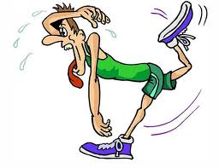
Muscle Fatigue
Energy demand is met by aerobic
respiration since muscles cannot store ATP
Glucose – Enzymes – Oxidation – ATP, CO2, H2O
Creatine Phosphate ensures ATP remains high – provides P to ADP
O2 + cellular respiration allows filaments to be drawn together
Energy > ATP – lactic acid accumulates causing pain and fatigue = Oxygen Debt
fluid around muscle becomes acidic preventing the muscle from contracting

Slide 8
Filament Theory and ATP Usage
Myofilament contraction
Breakdown of ATP

Slide 9
Muscle Contraction
Normal
Summation
Tetanus

Slide 10
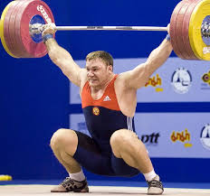
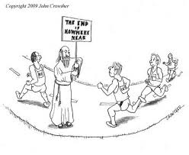
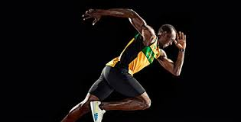
Fast and Slow Twitch Muscle Fibres
Sprinters have large amount of Fast Twitch muscle fibres – Thick Myosin Fibres
Isomers – Type I, IIa, IIx
Type IIa
Fast muscle twitch
Break down ATP slowly but
inefficently
Anaerobic respiration
White muscle fibres – little
myoglobin – energy from glycogen
Type IIx
Fast muscle twitch
Break down ATP slowly
Anaerobic respiration
White muscle fiber
Tye I
Slow muscle twitch
Break down ATP slowly
Aerobic metabolism
Red muscle fibres – lots of
myoglobin – energy from O2

Slide 11
Muscle Distribution

Slide 12
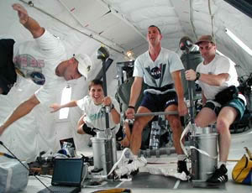
Motor System Injuries
Require regular exercise to
maintain healthy muscles
Heavy work or exercise doesn’t
help – torn muscles, stretched
tendons, torn ligaments, joint sprains, joint dislocations
Arthroscopic surgery to repair torn ligaments

