Slide 1
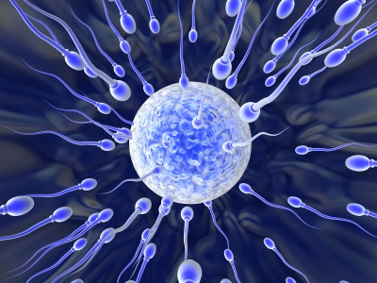
Hormonal Regulation of the Reproductive System

Slide 2
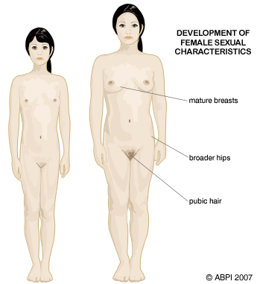
Hormonal Control
Primary sex characteristics (gonads and sperm) are produced while the fetus is still in utero (testes descend into scrotum at third month of development).
Secondary sex characteristics (body/facial hair, growth of larynx, muscle strengthening) occur at puberty due to hormonal changes.

Slide 3
Hormonal Control At Puberty
Hypothalamus
Releases gonadotropic releasing hormone (GnRH)
First released at puberty.
GnRH causes the Pituitary to release:
Pituitary
Follicle Stimulating Hormone (FSH) – Stimulates sperm production in seminiferous tubules.
Lutenizing Hormone (LH) – promotes testosterone production (which then promotes sperm production).

Slide 4
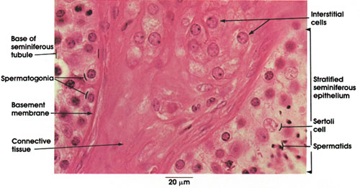
Hormonal Control At Puberty
Interstitial Cells
Interstitial cells in testes produce testosterone when stimulated by LH.
Testosterone stimulates spermatogenesis and development of secondary sex characteristics.

Slide 5
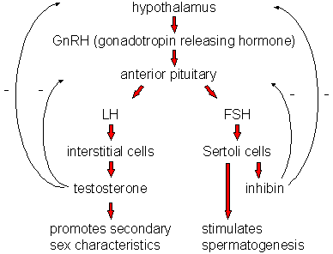
Testosterone & Sperm Production are Controlled by Negative Feedback
Testosterone deactivates the hypothalamus, inhibiting the production of LH by the pituitary.
Sertoli cells inhibit the hypothalamus from secreting GnRH and the pituitary from secreting FSH.

Slide 6
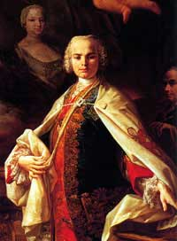
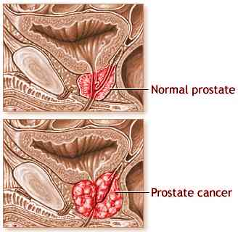
Interesting Facts
Castratis – Male sopranos popular in 17 and 18 Centuries
Prostate cancer is one of the most common cancers in males. (In Canada, 81 Canadian men die from prostate cancer every week). It is detected via blood tests for PSA or through the digital rectal exam. Men over the age of 50 should be examined yearly.

Slide 7
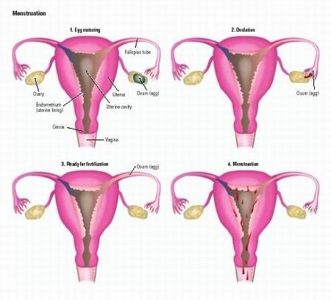
Menstrual Cycle

Slide 8
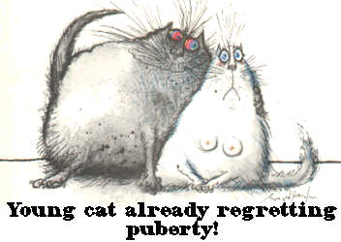
Puberty in Females
Begins when GnRH levels increase
Recognized with first episode of menstrual bleeding

Slide 9
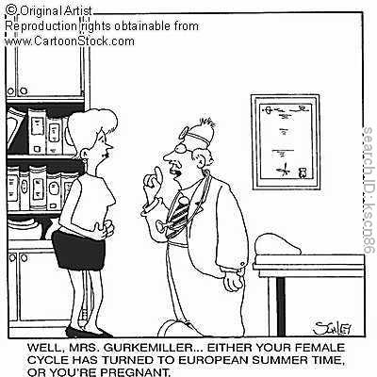
Menstrual Cycle Facts
About 28 days long
Phases
Flow phase
Follicular phase
Ovulation event
Leuteal phase
Amenorrhea: Absence of a menstrual cycle
Menopause: Cessation of menstrual cycles

Slide 10
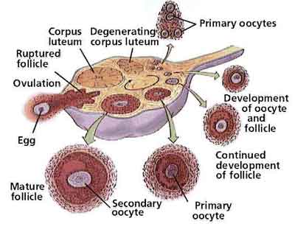
Ovarian cells involved
primary oocyte
becomes ovum for fertilization
granulose or follicle cells
provide nourishment
ovaries undergo continual decline after onset of puberty
500+ follicles start to develop during every cycle, but only a single follicle becomes dominant & reaches maturity.

Slide 11
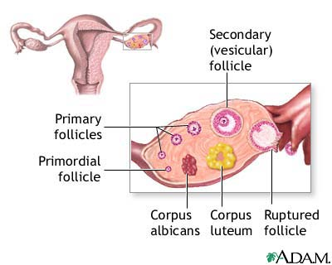
Oogenesis Overview

Slide 12
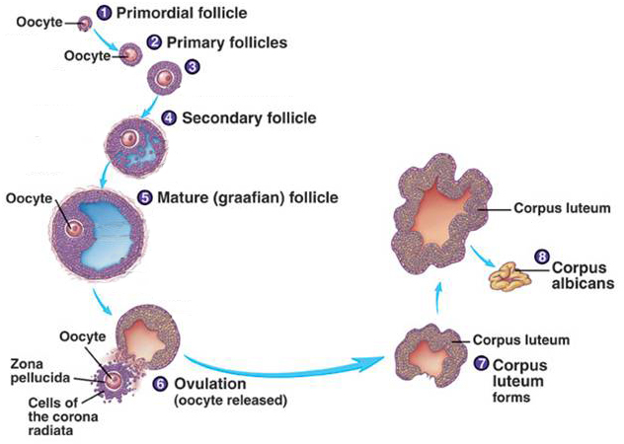
Maturation of Follicle and Oocyte

Slide 13
Controlled by Hormones
Hypothalamus
gonadotropin-releasing hormone (GnRH) targets pituitary.
Pituitary
FSH starts egg maturation.
LH triggers ovulation, and formation of corpus luteum.
Ovary
Granulose cells
Estrogen promotes thickening of endometrium.
Corpus luteum
estrogen and progesterone maintains lining.

Slide 14
Cycle Summary
Flow | Follicular | Ovulation (event) | Luteal
shedding of endometrial lining Day 1 – 5 NO HORMONES | development of follicles within ovary estrogen triggers thickening of endometrium Day 6 – 13 High FSH, then estrogen, ends with LH spike. | Oocyte (egg) bursts from ovary follicle cells become corpus luteum Day 14 Highest LH Point | corpus luteum secretes estrogen and progesterone maintains lining, inhibits ovulation Day 15 – 28 High progesterone and estrogen

Slide 15
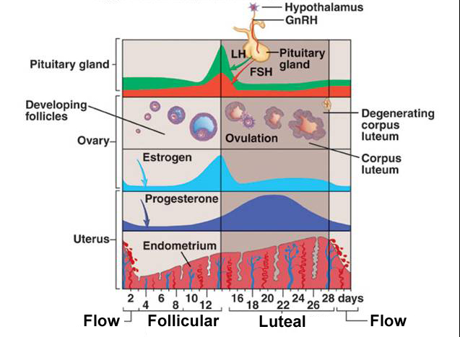
Cycle and Cells

Slide 16
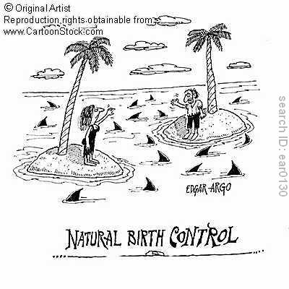
Surgical Birth Control
Tubal Ligation

Slide 17
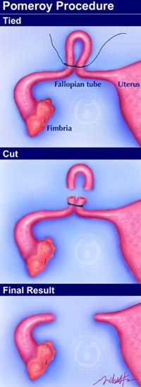
Procedure
fallopian tubes are cut, burned, or blocked with rings, bands or clips.
now under local anaesthesia.

