Slide 2
Cloning
Forming identical offspring from a single cell or tissue in the parent organ. – Asexual reproduction because there is no variation in traits from male and female sex cells.
Identical – 1 egg

Slide 3
Dolly the Sheep
Frederick Stewart – cloned the first carrots
Allows production of strains of plants with predictable
characteristics.
Contains complete complement of chromosomes from parent
It undergoes mitosis to increase in size.
Briggs and King investigated animal cloning.
Nucleus removed from unfertilized egg and nucleus from a frog embryo inserted
Enucleated – cell without a
nucleus

Slide 4
Telomeres
Each time a telomere goes through the cell cycle, it
reduces in length. Potential role in aging and behaviour
of cancer cells. Telomeres are used as a molecular clock
for cellular aging.
Telomerase is an enzyme that helps reactivate telomeres
allowing them to retain their length for a longer period of
time.
This has a potential effect on cloning – Dolly was cloned
from a six year old sheep – suffering arthritis and died of
lung disease much younger than normally seen
Cells undergo mitosis 50-100x. Cancer cells never lose
their ability to divide. Telomerase is reactivated in human
cancer cells – Need to block telomerase?

Slide 5
Meiosis
Cell division involved in the formation of sex cells,
gametes
Human cell contains 46 chromosomes that undergo
meiosis that produce gametes that have 23 chromosomes.
Chromosomes in a gamete – Haploid
Chromosomes in all other cells – Diploid
Paired chromosomes – Homologous chromosomes
similar in shape, size and gene arrangement
23rd paired chromosome determines sex in mammals
Fertilization – a haploid sperm cell unites with a haploid
egg cell to produce a diploid. The fusion of the gametes
restores the diploid chromosome number in the zygote

Slide 6
Stages of Meiosis
Two nuclear divisions that produce four haploid cells. Meiosis I and Meiosis II
Meiosis I – Reduction division: diploid chromosome number is reduced to the
haploid
Meiosis II – Separation of two chromatids (same phase names as mitosis)

Slide 7
Meiosis I
Nuclear membrane begins to dissolve
Centriole splits, and parts move to opposite poles within cells
Spindle fibers are formed
Chromosomes come together in homologous pairs
Whole structure – tetrad (composed of four chromatids)
Process is called synapsis – as the chromosome synapse the chromatids often intertwine.
Exchanging segments called crossing over

Slide 8
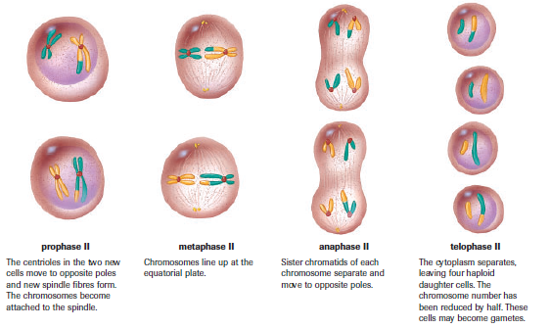
Meiosis II

Slide 9
Crossing over permits the exchange of genetic material – Prophase I
Homologous chromosomes attach to spindle fibers and line up on equatorial plate –
Metaphase I
Homologous chromosomes move toward opposite poles called segregation –
Anaphase I Reduction division occurs here each chromosome consists of two sister
chromatids
Membrane forms around each nucleus – chromosomes are NOT identical (as in
mitosis) because each daughter nuclei contains 1 member of homologous pair –
Telophase I

Slide 10
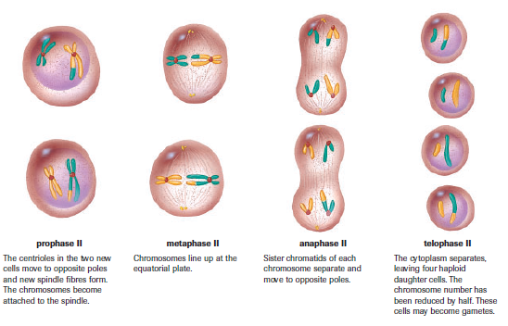
Meiosis occurs at approximately the same time in each haploid daughter cells.
Pairs of chromatids separate and move to opposite poles – No replication of
chromosomes prior to Meiosis II

Slide 11
Same but Different
Mitosis produces two diploid cells from one diploid cell. Meiosis produces four
haploid cells from one diploid cell.
Meiosis explains the variation in traits that is observed in species that reproduce
sexually. In Metaphase I – maternal and paternal chromosomes are randomly
assorted.

