Slide 1
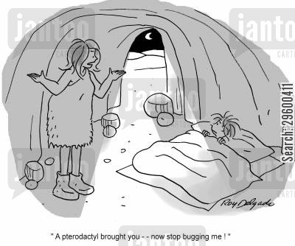
HUMAN REPRODUCTION SYSTEMS

Slide 2
REPRODUCTION AND DEVELOPMENT

Slide 3
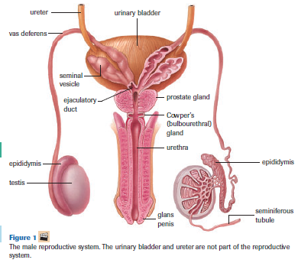
MALE REPRODUCTIVE SYSTEM

Slide 4
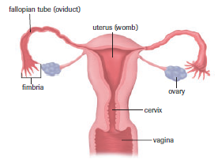
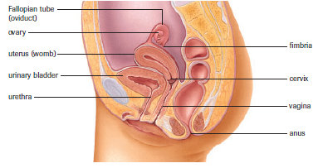
FEMALE REPRODUCTIVE SYSTEM

Slide 5
CRASH COURSE

Slide 6
HOMEWORK
Answer questions in section 16.1 and 16.2

