Slide 1
Gas Exchange and Transport

Slide 2
A little mood music…
Respiratory by One Direction

Slide 3
Gas diffuses from an area of higher pressure to an area of lower pressure.
Partial pressure of O2 differs depending on location in the body – arteries move blood away from the heart while veins bring it back to the heart.
  Largest change in partial pressure is as O2 travels from arteries to capillaries
CO2 is a product of cellular respiration and follows the opposite path. Partial pressure is highest in the tissue and venous blood

Slide 4
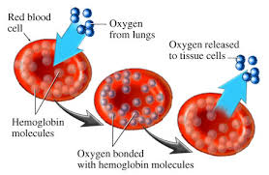
Oxygen Transport
Oxygen travels from atmosphere (high partial pressure) to alveoli (low partial pressure) and through diffusion moves into the blood
Hemoglobin greatly increases O2 carrying capacity of blood.
When O2 dissolves into the plasma, a weak bond between Hemoglobin and O2 is created to form oxyhemoglobin (70 fold!)
As gradient drops it causes
the dissociation of O2 from
the hemoglobin, allowing O2
to diffuse into the tissues

Slide 5
Oxygen-Hemoglobin Dissociation Curve

Slide 6
Carbon Dioxide Transport
While some of the CO2 is transported from tissue to lungs through the plasma, and 27% is carried back on hemoglobin, the remaining combines with water to form carbonic acid.
Carbonic anhydrase allows for a rapid conversion of free CO2 into H2CO3, decreasing the conc. of CO2 in the plasma. This creates a low partial pressure ensuring that CO2 continues to diffuse into the blood.
Carbonic acid dissociates into H+ and HCO3
The H+ helps with removal of O2 from Hemoglobin through bonding, acting as a buffer to the acidic environment
When the H+ and Hb reaches the lungs, O2 releases the H+ where the free hydrogen and HCO3- ions form to produce CO2 and water. Through diffusion the CO2 moves from the blood into the alveoli and is eliminated through exhalation

Slide 7
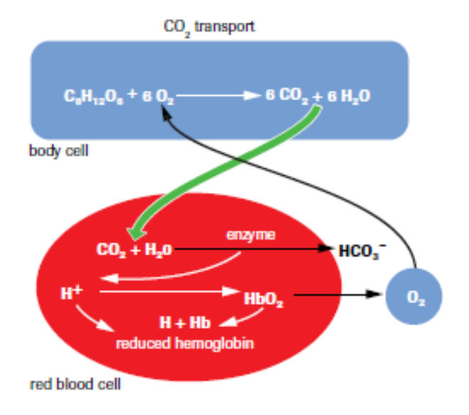

Slide 8
Maintaining Gas Levels
Through the use of chemoreceptors, equilibrium can be maintained
  A chemical receptor ensures that waste CO2 from cellular respiration does not accumulate
  Some chemical receptors respond to stimulus from exercise where CO2 builds up in cells, activating the brain to tell the muscles to increase breathing movements
  Other receptors are in the walls of the carotid artery which detect low levels of O2, stimulating the muscles that control breathing through a message to the brain

Slide 9
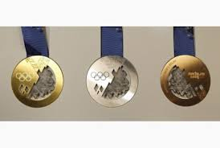
EPO Stimulation
Erythropoietin is a natural hormone promoting red blood cell production
Athletes inject EPO to increase the amount of red blood cells they have = increasing the amount of oxygen being carried per breath = more O2 to tissue
Blood becomes thicker and more difficult to move resulting in stroke, heart attack and heart failure
Now a banned “substance”

Slide 10
Regulation of Breathing Movements

Slide 11
Carbon Dioxide Receptors
Carbon Dioxide receptors are the most
sensitive and are the main regulators of
breathing movements.
When carbonic acid levels are increased , acid
chemoreceptors in medulla oblongata are
triggered
The secondary chemical receptors are sensitive
to low levels of oxygen and are found in the
carotid and aortic arteries

Slide 12
Response of the Respiratory System to Exercise
Ventilation of alveoli can increase 20x with
heavy exercise to keep up with demand
for oxygen supply and CO2 expulsion
Three factors:
1 – decreased O2
2 – Increased CO2
3 – Increased H+

Slide 13
Lower Respiratory Tract Disorders
Bronchitis:
This is an inflammation of the bronchi.
It can be classified as acute (usually a bacterial infection) or chronic (caused by irritants).
During chronic bronchitis, the cilia lining the bronchi can become damaged.
The most common cause of chronic bronchitis is smoking.

Slide 14
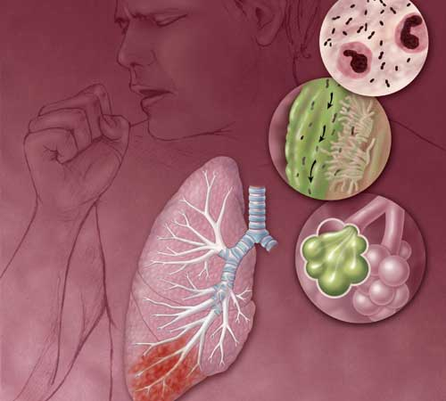
Pneumonia
A condition where the alveoli fill with fluid
Can affect an entire lobe of the lung (lobular), or be found in small patches (bronchial)
Lobular pneumonia is caused by bacteria and is typically more serious than viral pneumonia
There are vaccines for bacterial pneumonia
AIDS patients often die because of a rare bacterial form of pneumonia

Slide 15
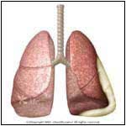
Pleurisy
This is a swelling of the pleura
May be caused by infection, blood clots, or cancer
A common symptom is a localized sharp, stabbing pain
Treatment of pleurisy often focuses on reducing the swelling

Slide 16
Emphysema
Emphysema is a loss of elasticity in the alveoli wall
As a result, the surface area for absorption is reduced
Most cases of emphysema are associated with smoking

Slide 17
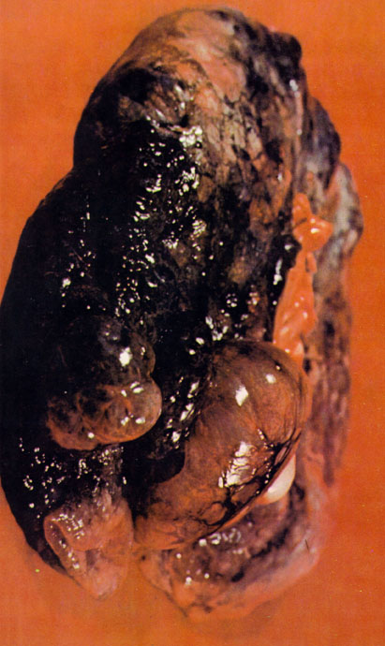
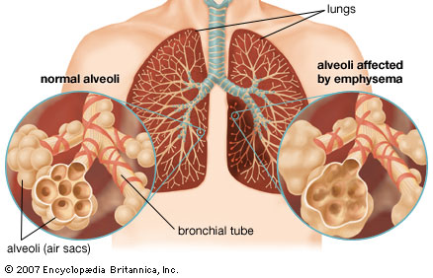
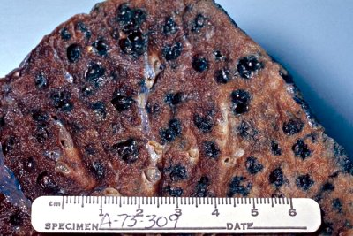

Slide 18
Cystic Fibrosis
Genetic condition that prevents the formation of sodium channels in cell walls
This disrupts the water balance in the lung cells
As a result, the normally runny mucus in the lungs becomes very thick and cannot be expelled

Slide 19
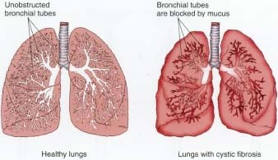
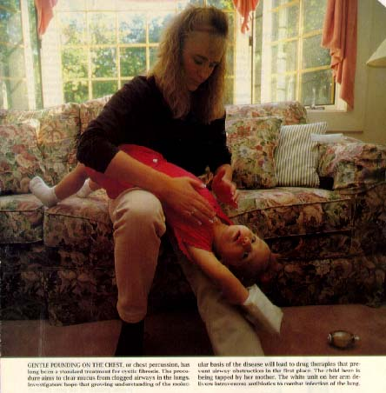
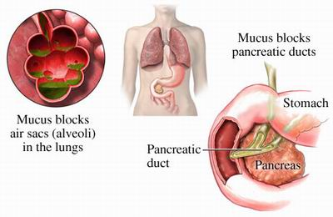

Slide 20
Asthma
This is a chronic obstructive disease which reduces the diameter of the bronchi & bronchioles
Environmental triggers and stress can often cause asthma attacks
Bronchial dilators are used to treat asthma
Most of these drugs are administered through inhalers which produce a mist or fine powder that contains the drug

Slide 21
Exercise Induced Bronchospasm
This condition produces symptoms similar to asthma which are only brought on by exercise
In most cases, dry, dusty and cold environments trigger this condition
Patients with EIB can use bronchial dilators before exercise to avoid symptoms

Slide 22
Lung Cancer
This (like all cancers) is an uncontrolled, abnormal growth of invasive cells
The tumors that form reduce the available volume of the lung for gas exchange
Often carcinogens (chemicals that cause cancer) trigger the production of tumors in the lungs
Carcinogens are found in cigarette smoke, but also include asbestos and radon

Slide 23
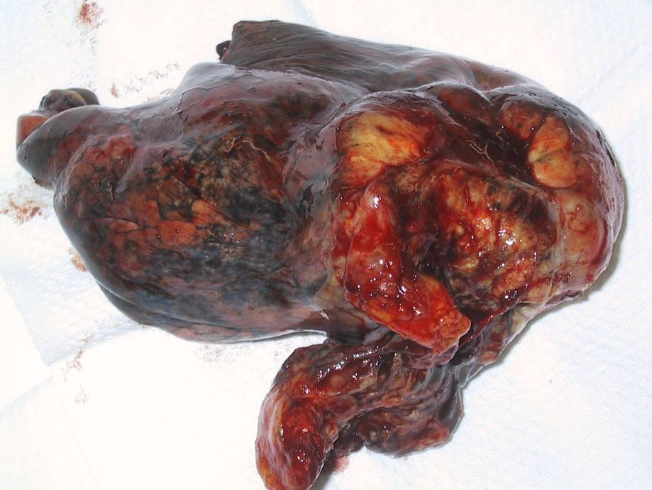
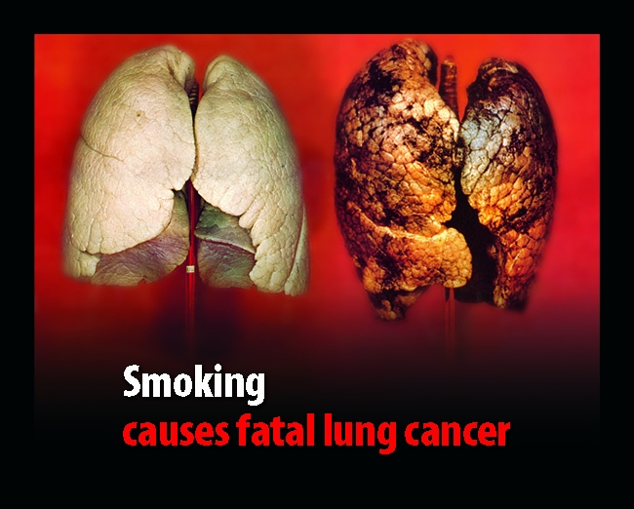
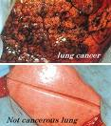

Slide 24
Technologies for Detection and Treatment of Lung Disorders
Diagnosis of disorders such as cancer, and some other infections (such as inhalational anthrax and tuberculosis) are typically done using X-rays and CT scans

Slide 25
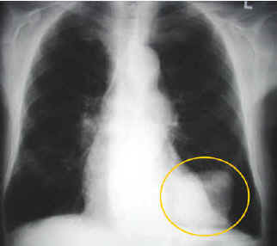
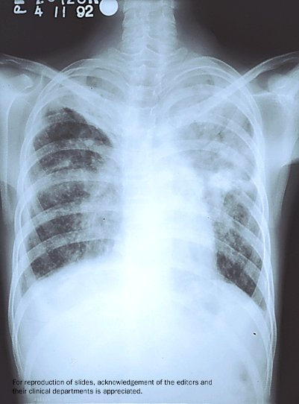
http://www.lakeridgehealth.on.ca
Lung Cancer
http://www.ecosur.mx/tuberculosis/Tuberculosis-4.jpg
Tuberculosis

Slide 26
DNA analysis can be used to identify if genes for cancer are present
Cancers can be treated in several ways, including radiation therapy and chemotherapy
In some cases, liposomes (small, hollow sacks of lipids) are filled with cancer-fighting drugs
These liposomes follow the spread of the cancer cells and attack them before they start new growth in a new area of the body

Slide 27
Smoking Bottle

