Slide 1
Fertilization, Pregnancy and birth

Slide 2
Changes in the the Female Reproductive System
The secondary oocyte is joined by a sperm cell to form a fertilized ovum – zygote
Zygote receives 23 chromosomes from sperm cell and 23 chromosomes from oocyte for a total of 46 chromosomes
Ovum undergoes cell division called Cleavage
Cleavage is equal division without increasing in size
When the zygote reaches the uterus it has formed into a Blastocyst which becomes attached to the uterine wall - Implantation
Blastocyst is bi-layered
  1 – Outer sphere develops into extraembryonic structures
  2 – Inner sphere develops into the embryo

Slide 3
A – Two-cell stage zygote
B – Blastocyst (4-6 days)

Slide 4
Due to the needed increased
levels of LH to sustain the corpus
Luteum, the blastocyst secretes
its own hormone
The Chorion is responsible for
producing hCG (human chorionic
gonadotropic hormone)
hCG maintains the corpus luteum
for the first three months,
allowing the corpus luteum to
Continue to produce
Progesterone and estrogen
Which maintains the endometrium
Cells from the embryo and endometrium combine to form the placenta - which allows
Materials to be exchanged between embryo and mother.

Slide 5
Allantois provides umbilical blood vessels in the placenta – DOES NOT envelop the fetus.
The umbilical cord connects the embryo with the placenta

Slide 6
Embryonic and Fetal Development
Pregnancy 1-9 Weeks
Pregnancy 10-14 Weeks
Pregnancy 15-20 Weeks
Pregnancy 21-27 Weeks
Pregnancy 28-37 Weeks

Slide 8


Human Sex Determination –
SRY … not SIRI
Sex-determining Region of the Y chromosome – responsible for determining the male phenotype in humans
The female sex is identified by having two X chromosomes
The male sex is defined by having an X chromosome and a
smaller Y chromosome
Hormonal balance between male and female sex hormones is critical during fetal
Development. Too much estrogen can cause those with male genes to have a
Female appearance and conversely, an abundance of androgens can produce the
Sex organs of a male in the genetic body of a female.

Slide 9
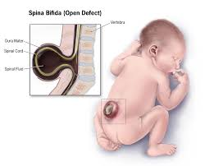
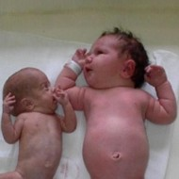
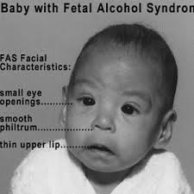
Effects of Environmental Agents on Embryonic Development
Folic Acid Deficiency can lead to Spina Bifida in which the
spinal cord fails to develop properly – incomplete closing
of the embryonic neural tube.
Smoking causes lower birth weight
which in part is attributed to nicotine constricting blood vessels.
Restricts the movement of oxygen and nutrients for growth
Fetal Alcohol Syndrome – can be 100% prevented by not
consuming alcohol at ANY time during pregnancy. This
syndrome can have severe mental implications for the
child’s lifetime

Slide 10
Teratogens – Chemicals and Microbes causing developmental abnormalities

Slide 11
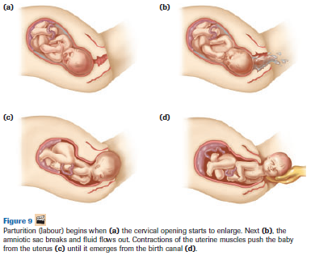

Slide 12
Birth
Labour and Birth
Uterine contractions signal the beginning of Parturition (labour)
Hormones play a vital role in birthing
  Relaxin is produced by the placenta causing the ligaments in the pelvis to loosen
  Oxytocin is produced by the pituitary gland cause strong uterine contractions
  Pitocin is a synthetic version of oxytocin to help stimulate uterine contractions

Slide 13
Lactation
Prolactin, produced by the pituitary gland, is responsible for
stimulating glands within the breast to begin producing
fluids.
Colostrum contains milk sugar and milk proteins but not
milk fat – Fore milk
Hind milk – thicker milk that ‘fills’ a baby up, and slows down
the release of milk.

Slide 14
Assignment – to be turned in for marks
Select one of the following Human Reproductive Technology processes and
  1 – Describe the technology
  2 – the efficacy of the technology – how effective is the technology and are there any adverse implications
  3 – the challenges in society (whether it is accepted or not, costs associated outside of Health Care)
  You must use at least one scholarly article – do not rely on Wikipedia
  Standard essay format; citations required (if used)
  500-800 word length

