Slide 1
Molecules of Living Systems

Slide 2
Objectives

Slide 3
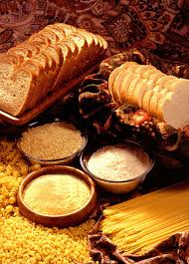
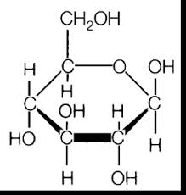
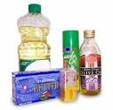
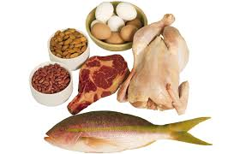
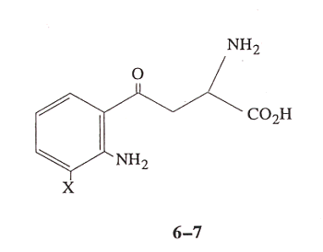
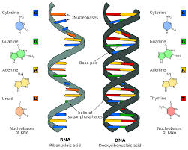
Macromolecules – 4 types
Carbohydrate
Lipids
Proteins
Nucleic Acids

Slide 4
Why do we need Macromolecules?
Royal

Slide 5
Assembling and Diassembling Macromolecules
Dehydration Synthesis
Enzymes
Covalent Bond
Hydrolysis

Slide 6
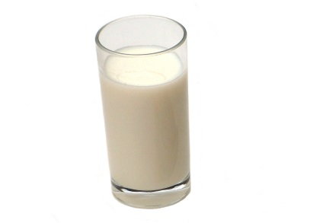
Carbohydrates
Simple sugar
3-7 C
Monosaccharide
Disaccharide
Polysaccharide
Starch
Glycogen
Cellulose

Slide 7
Dehydration and Hydrolysis of Carbohydrates

Slide 8
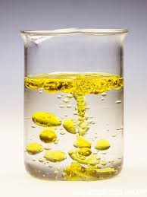
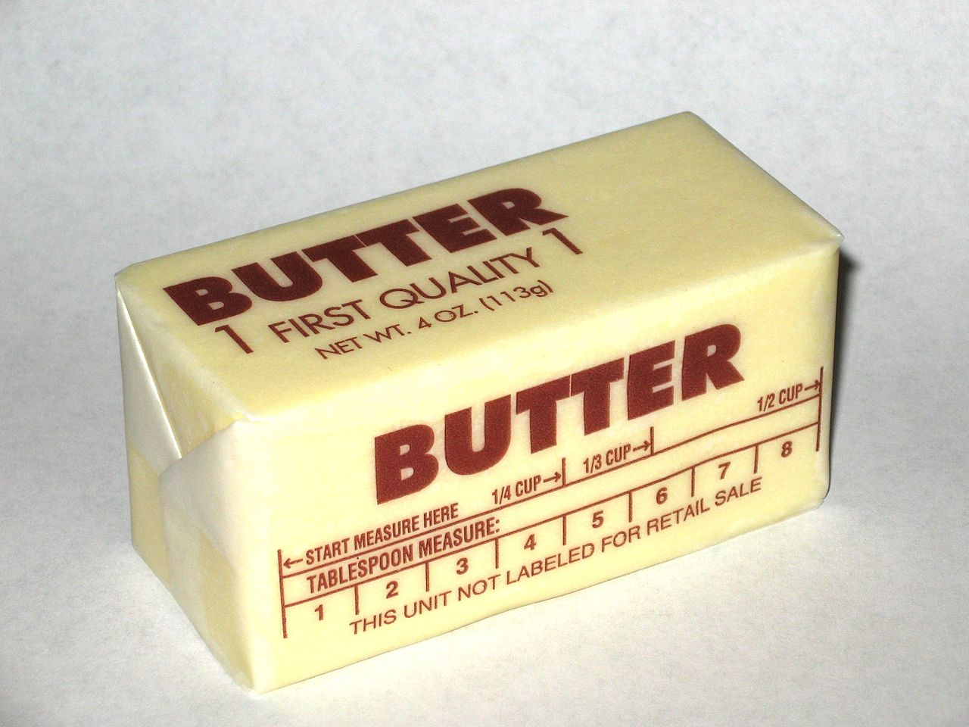
Lipids
Energy source
Phospholipids – Cell structure
Saturated
Unsaturated

Slide 9
Dehydration and Hydrolysis of Lipids

Slide 10
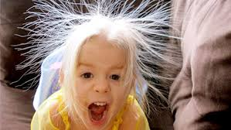
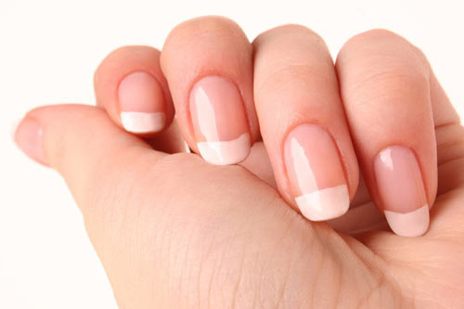
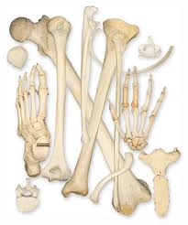
Protein
Subunit is amino acid

Slide 11
Dehydration and Hydrolysis of Proteins
Amino acids are connected by peptide bonds
Bonded amino acids are polypeptides
How they bond determines their 3D shape as well as the type of R group

Slide 12
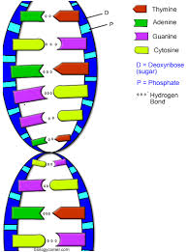
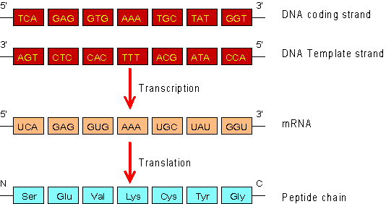
Nucleic Acids
RNA – ribonucleic acid
(mRNA – messenger RNA)
DNA – deoxyribonucleic acid

Slide 13
Distribution of Body Fluids
Larger more complex assemblies of organic molecules found in
Compartments are called Macromolecules.

Slide 14
Gangnam Style

