Slide 1
8.4 Digestion
Small Intestine, Pancreas, Liver, Gallbladder, Large Intestine,

Slide 2
Digestive Song

Slide 3
Leaving the Stomach and into the Absorption process

Slide 4
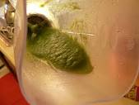
Main function of small intestine
.To complete the digestion of macromolecules and absorb their subunits
At the initial part of food entering the small intestine, there is some initial digestion occurring during a process called segmentation creating a bolus called chyme

Slide 5
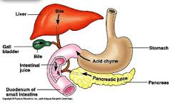
Region and structures of the Small Intestine
Divided into three regions: Duodenum (25cm), Jejunum (2.5m) and Ileum (3m)
1 - Duodenum

Slide 6
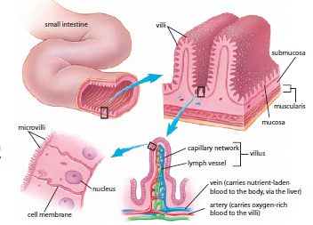
Maximum Absorption

Slide 7
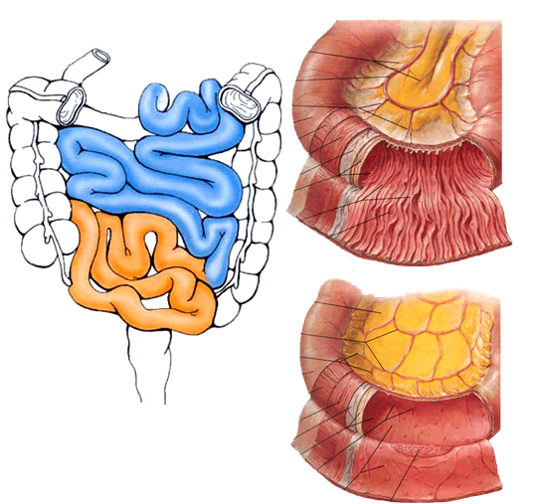
Jejunum contains more folds and secretory glands which is where the primary breakdown of the chyme occur.
The has less folds so its primary function is to absorb remaining nutrients and push the remaining undigested material into large intestine

Slide 8
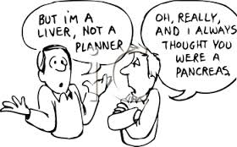
Accessory Organs

Slide 9
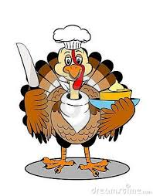
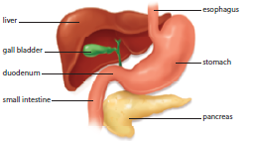
Pancreas
Pancreas delivers pancreatic fluid including several enzymes such as trypsin and chymotrypsin, pancreatic amylase, lipase. They are inactive until enzymes in the duodenum are released.
Pancreas also contains bicarbonate – neutralizing the HCl raising pH to about 8.

Slide 10
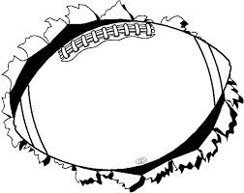
The main digestion-related function of
the liver is bile, specifically BILE SALTS. These
play a crucial role in fat digestion. Fats are insoluble in water, so bile salts act as an emulsifier dispersing the fat droplets into the smaller droplets within the chyme.

Slide 11
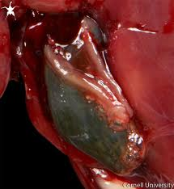
Gall bladder
Bile doesn’t go from liver to small intestine.. It goes into storage
Fat molecules in chyme stimulate release of bile through a duct into duodenum

Slide 12
Digestion and Absorption

Slide 13
Secretions from the small intestine, the liver, the pancrease and the gall bladder add mucus, water, bile and enzymes
Most enzymatic digestion occurs in the duodenum

Slide 14
Carbohydrate digestion and absorption
Digestion of starch begins in the mouth with
Salivary amylase, is interrupted in the stomach
Because of low pH, and resumed in the small
Intestine. Pancreatic amylase then takes over.
Active transport is used to move the
Monosaccharide into the cells of the small intestine
where they enter the bloodstream and are transported directly to the liver. The active transport process requires ATP.
Glucose is circulated from the liver into the bloodstream to all body cells where it is used as a source of energy. Excess glucose is converted and stored by liver into glycogen. When blood sugars dip too low, the liver converts glycogen back into glucose.

Slide 15
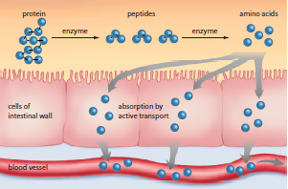
Protein digestion and absorption
Digestion of protein begins in the stomach with
pepson, and further digested in small intestine
with 2 proteases secreted by the pancreas,
breaking the polypeptides into shorter peptide
chains. More enzymes break short peptides
into amino acids
Active transport is used to move the
amino acids into the cells of the small intestine
where they enter the bloodstream and are transported directly to the liver. The active transport process requires ATP.
Amino acids are used in energy-releasing reactions or converted into sugars. When they are released into the bloodstream for other body cells to use, amino acids are used for making enzymes and cellular structures. Excess amino acids combine with CO2 to form urea which is excreted in urine. is converted and stored by liver into glycogen. When blood sugars dip too low, the liver converts glycogen back into glucose.

Slide 16
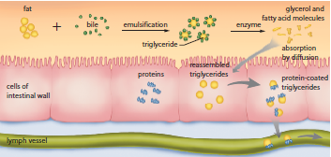
Fat digestion and absorption
Digestion of fat begins in the duodenum with
bile (fat emulsion). Emulsion is a physical process
not a chemical process.
Lipase is used to hydrolyze the fat molecule into
glycerol and fatty acids.
Simple diffusion is how glycerol and fatty acid
are absorbed into the villi. Glycerol and fatty acids are then recombined to form triglycerides, coated with proteins to make them soluble and then are absorbed into th e lymph system.
They travel into the chest region where they are absorbed into the bloodstream where the protein layer is hydrolyzed off and the exposed triglyceride is broken down into fatty acids and glycerol by lipase. Body cells use these subunits as a source of energy..

Slide 17
Nucleic Acid digestion and absorption
Nucleic acids are not abundant enough to be considered a major nutrient.
A healthy diet is sufficient for supply
Digested by enzymes called nucleases in small intestine into nucleotides
Nucleotidases break down nucleotides into base sugar and phosphates which are then absorbed into the bloodstream by active transport

Slide 18
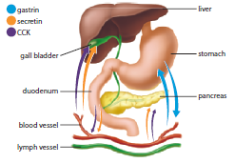
Regulation of Processes in the Small Intestine

Slide 19
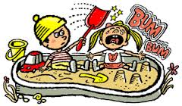
Negative Feedback
Digestion system doesn’t play alone – it is aided by the nervous system and the endocrine system
Nervous system stimulates salivary and gastric secretions
  food in stomach stimulates the hormone gastrin which stimulates HCl and pepsin. When the gastric juice pH is lowered, gastrin is inhibited reducing amount of pepsin and HCl released. Negative Feedback helps to maintain secretion and concentration of gastric fluid

Slide 20
Passage of chyme from stomach into duodenum inhibits the contraction of the stomach – no additional chyme can enter the small intestine until first amount is processed.
Secretin, CCK (cholecystokinin), GIP (gastric inhibitory peptide) aid in this inhibition
Chyme with high fat content is the strongest stimuli for CCK and GIP
Chyme with high acidity is strongest stimuli for secretin
All three hormones inhibit stomach movement which allows a high fat meal to remain in the stomach longer for increased digestion.
CCK stimulates pancreatic secretions of digestive enzymes and gall bladder contractions. More bile means more emulsifying – greater digestion of fats
Secretin stimulates release of bicarbonate to neutralize high acid chyme

Slide 21
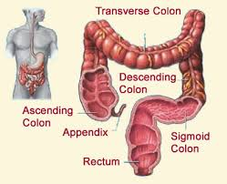
Complete Nutrient Absorption and Elimination: The Large Intestine

Slide 22
Why don’t you poop when you fart?
This is where the leftovers go
Main function is to concentrate and eliminate waste materials
  There is no digestion but absorption of remaining water and salts occurs here. Waste can be reduced from ~500mL to 150mL
In the colon water and salts are absorbed, where intestinal bacteria break it down further. The bacteria also produce vit B12 and K and some amino acids
Remain undigested material, along with bacteria are formed into feces which passes into the rectum and anal canal where it is passed out the anus.
The function of the rectum is to store the feces.
There are three folds in the rectum that enable it to retain the feces while passing gas.

Slide 23
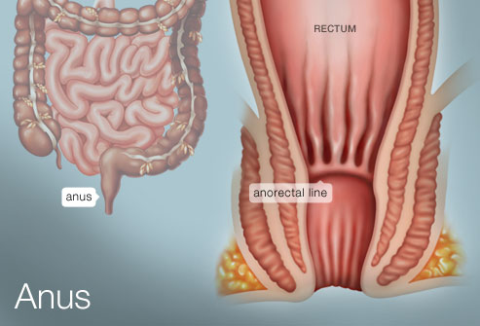
The opening to the anus is controlled by two sets of sphincters
You can control the contraction and relaxation of one while the other is under the control
of the nervous system
When the rectum is full, it triggers receptors that start the movement of feces out of the
body by peristalsis contraction

