Slide 1
Enzymes

Slide 2

Objectives

Slide 3
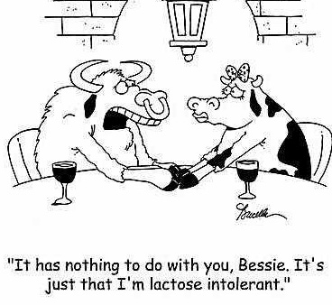
What is an Enzyme?
Protein catalysts that regulate
reactions within living organisms

Slide 4
CATALYSTS, ENZYMES AND SUBSTRATES

Slide 5
Factors affecting enzyme reactions - pH

Slide 6
Factors affecting enzyme reactions – Substrate Concentration

Slide 7
Factors affecting enzyme reactions – Temperature

Slide 8
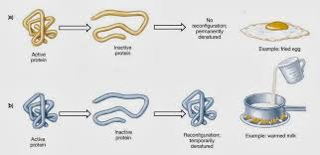
Denaturation & Coagulation
Coagulation
Denaturation

Slide 9
Factors affecting enzyme reactions – competitive inhibition

Slide 10
Regulation of enzyme activity
Feedback Inhibition

Slide 11
Explore Learning Gizmo
Learn Alberta – English – Keyword: Identifying Nutrients
Explore Learning Gizmo - Identifying Nutrients

