Slide 1
Blood and the Immune System
The Body’s Lines of Defence

Slide 2
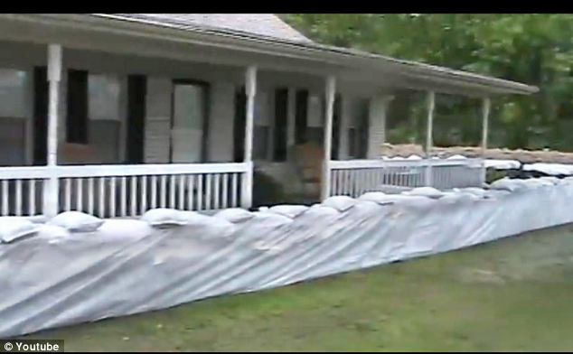
First Line of Defence
Skin – the largest organ, and mucous membranes defend against viral and bacterial invaders.
The skin acts as a physical barrier as wells as a chemical barrier – acidic secretions which inhibits the growth of microbes
Lysozyme – antimicrobial enzyme secreted in tears, saliva, mucous secretions and perspiration destroys cell walls of bacteria
Mucus in the respiratory tract trap foreign debris and invading microbes
Cilia sweep particles up where coughing can expel them
Corrosive acids in stomach and protein-digesting enzymes destroy most of invading microbes in food.

Slide 3
Second Line of Defence
Leukocytes (WBC) engulf invading microbes
Rely on process of phagocytosis. Monocytes migrate from blood to tissue and develop into macrophages. Extend pseudopods to attach to surface of microbe which is then engulfed and destroyed
Neutrophils are attracted to chemical signals – chemotaxis is the process where neutrophils squeeze out of capillaries and migrate towards infected tissue. Engulf microbe and release lysosomal enzymes where both microbe and leukocyte are destroyed.

Slide 4
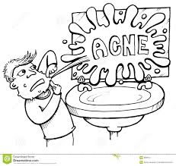
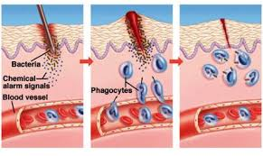
Pus and Inflammation
Remaining fragments of protein, dead WBC and digested invaders after phagocystosis
Non-specific response is seen as inflammation around the area where tissue has been damaged = swelling, redness, heat and pain

Slide 5
The Immune Response – Third Line of Defence
Found localized in the brain, lungs, kidneys, liver and connective tissue
Complement Proteins – antimicrobial plasma protein triggered by foreign bodies
Act in three ways:
Envelop and seal invader
Attaches and punctures the cell membrane causing cell to swell and burst
- Attaches to invader attracting leukocytes

Slide 6
Lymphocytes
WBC that produce antibodies
Foreign bodies contain many antigens on their surface.
T-cell lymphocytes are produced in bone marrow stored in thymus gland
Seeks out intruder and signals attack
B-cell leukocytes are anti-body producing. Each B-cell produces a single type of antibody.
Super-antibody-producing cells are called plasma cells which produce 2000 antibody molecules/sec

Slide 7
Antigen-Antibody Reactions
Y-shaped proteins that are specific to the foreign invaders.
Antibodies produced against influenza will not protect against HIV
Antibodies only attach to its complementary marker creating a larger complex making it an easier target for macrophages to engulf and destroy
Toxins are prevented from prevented from destroying cells when the antibody binds to the toxin and interferes with the attachment of toxins to the cell.

Slide 8
Viruses and Mutations
Use receptor sites as points of entry
Injects hereditary material into cell but leaves an outer protein coat at receptor site.
HIV attaches to receptor sites of T-cells. The virus is engulfed but since the blue-print for the antibody has been engulfed, it is not recognized as being a foreign invader.
Antibody may cause virus to change shape. May only change slightly because of a mutation which allows the virus to still gain access to receptor site without being recognized by an antibody

Slide 9
Recognizing Harmful Antigens
Foreign antigen markers are not destroyed in engulfment
Pushed to cell membrane of macrophage where the antigen is couples with helper T cells
Lymphokine – chemical messenger released by T cells reading antigen’s shape
B cells are encouraged to divide based on lymphokine
Second message is released by helper T cells to B cells triggering production of antibodies
Helper T cells trigger killer T cells = search and destroy missions
They go after viruses by detecting the viral coat and attacking the infected cell.

Slide 10
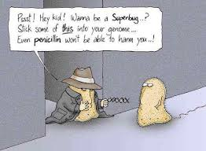
Killer T Cells
Destroy mutated cells – attack pre-cancerous cells
Antigen markers on cell membrane of donor tissue different from recipient – an assault is issued.
Immunosuppressant drugs (cyclosporin) are given to slow down Killer T cells
-will become susceptible to bacterial infections
Suppressor T Cells inhibits immune response
Helper T cells and Suppressor T cells spend a lot of time on the ‘cell’ phone talking to each other

Slide 11
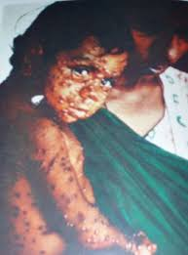
Immune System Memory
18-19th Century Aboriginal populations were greatly impacted after coming into contact with European settlers carrying the small pox virus
No antibodies present
Helper T cells reads a blueprint of invader before B cells produce antibodies
Memory B cell is generated during infection – holds an imprint of antigen
T and B cells die off days after fight, but memory B cells stick around and can identify invader at a later date.

Slide 12
Magic School Bus Ride - Inside Ralphie

