Slide 1
Blood and the Immune System
Components of Blood

Slide 3
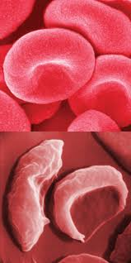
Erythrocytes
Red Blood Cells transport oxygen. Hemoglobin increases the oxygen carrying capacity by a factor of 70.
~280million hemoglobin molecules/red blood cell.
Heme – Iron containing pigment
Globin – protein structure
4 heme groups bind with oxygen ~ oxyhemoglobin giving blood its red color
When deoxygenated, the hemoglobin changes shape reflecting blue light – why veins appear blue.
When mature, the RBC is enucleated and has a biconcave shape.
RBC have a life span of ~120 days. To ensure that the body has an adequate supply, specialized white blood cells located in spleen and liver monitor the age of the RBC. Breakdown of RBC sees a release of the iron which is stored in the liver and bone marrow for production of new RBC. The heme is transformed into bile pigments.
Anemia is a disease which is a deficiency in the hemoglobin or RBC decreasing oxygen delivery to tissues. Hemorrhage is the most common cause of low RBC count. A deficiency in iron can also cause anemia

Slide 4
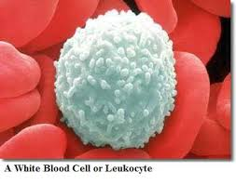
Leukocytes
Have a nucleus, are colorless and are the largest cell in blood. Show granules in the cytoplasm under Wright Stain
Divided into three groups: granulocytes, monocytes and lymphocytes.
Granulocytes – consist of neutrophils, basophils and eosinophils and attack foreign cells (infection)
Monocytes – can leave the bloodstream and become further specialized macrophages
Granulocytes and monocytes destroy invading bacteria through phagocytosis – they squeeze out of the capillaries and move in an amoeba like motion engulfing the microbe. An enzyme is released where the microbe and the leukocyte is destroyed.
Lymphocytes – produce proteins (antibodies) that incapacitate pathogens and allows them to be detected and destroyed

Slide 5
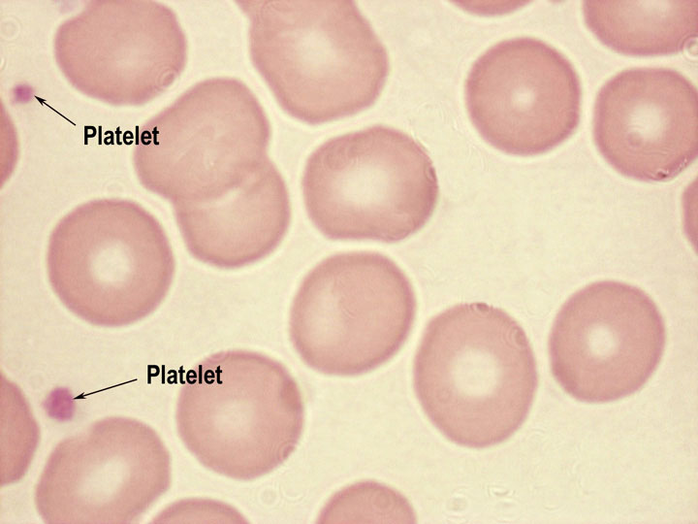
Platelets
Also called thrombocytes
Enucleated
Produced from large nucleated cells in bone marrow.
Fragments of cells that form when larger cells in bone marrow break apart.
Key role in blood clotting.
A sticky substance is released at injured site, platelets stick and begin build up.
They form a plug to stop the bleeding.
Change shape from round to spiny and release substances (thromboplastin) to trap more platelets.

Slide 6
Blood Clotting
Injury to blood vessel starts a chain of cellular events
Substances released by broken blood vessel attract platelets
Collecting platelets rupture to release chemicals that produce an enzyme called Thromboplastin
Calcium ions present – thromboplastin will react with prothrombin to produce thrombin
Thrombin is an enzyme that reacts with fibrinogen to produce fibrin.
A mesh is formed around the injured site , trapping escaping blood cells.
Prothrombin and fibrinogen are produced in the liver.
Thrombus is a blood clot that blocks a blood vessel. Local tissue are not supplied with oxygen and nutrients.
Embolus – a dislodged thrombus. Can travel through the body and lodge in a vital organ – Coronary, cerebral and pulmonary embolisms can be life-threatening.

Slide 7
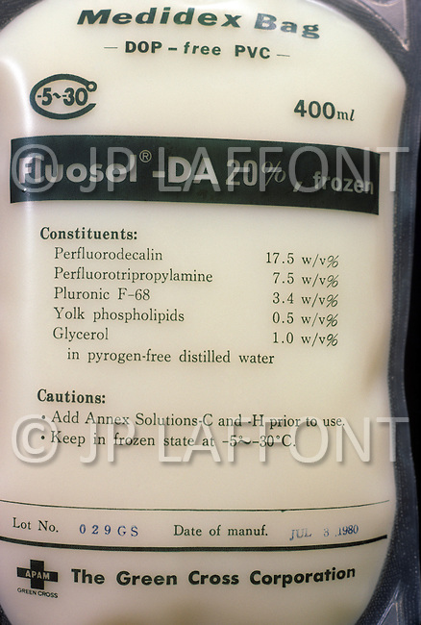
Artificial Blood
Non-toxic liquid that contains fluorine that carries both oxygen and carbon dioxide.
Requires no blood matching and when frozen can be stored for long periods of time.
Does not need to be screened like human blood for infectious viruses.
Administered to patient in 1982 who refused human blood donation on religious beliefs.
Not as good as the human blood because it cannot contribute to the clotting process nor help with immunity.
It provides time until human blood can be administered and serve as supplement for patients with specialized types of anemia.

Slide 8
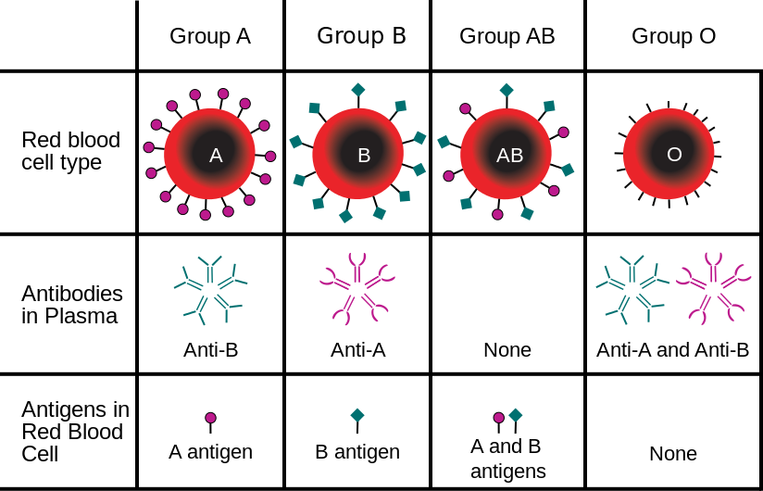
ABO Blood Groups
Blood transfusions rely on the correct type of blood being infused.
Glycoproteins act as markers on the blood cell membrane. Antigens in blood indicate the blood type, and antibodies will react to foreign blood types. O type blood has no antigens, yet has both antibodies to A and B.
Blood type O is the universal donor, however can only receive blood from other O type donors. Blood type AB is the universal recipient but can only donate to other AB blood types.
Agglutination is the clumping of blood. When an A antigen (marker) is present, the antibody B attaches to the marker and causes the blood to clump which prevents it from passing through the capillaries

Slide 9
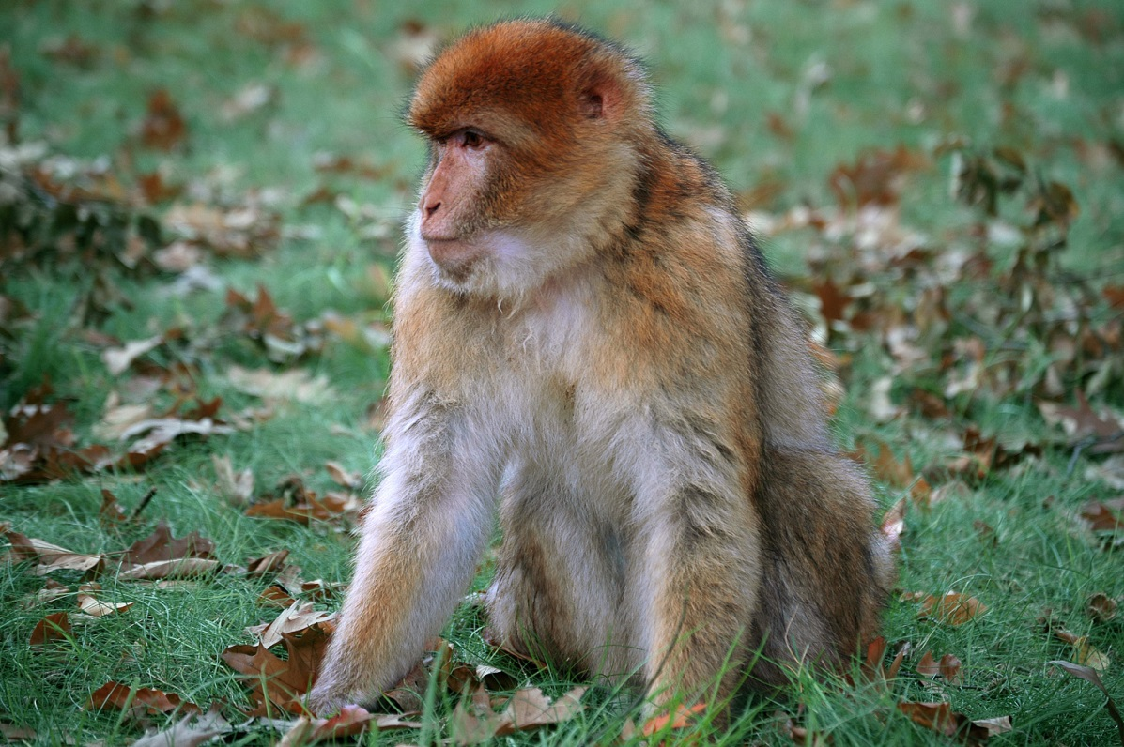
Rhesus Factor
Rhesus factor is inherited
An antigen marker on red blood cell
If the antigen is present then an individual has a positive Rh factor (Rh+)
If the antigen is absent then the individual is Rh-
Rh- can donate to Rh+, but not the reverse because antibodies will reject the transfusion.
Rh+ babies of Rh- mothers. Positive factor is inherited from father and can cause Erythroblastosis fetalis – can cause anemia, jaundice and an enlarged liver.

