Slide 1
Blood and Immunity
Malfunctions of the Immune System

Slide 2
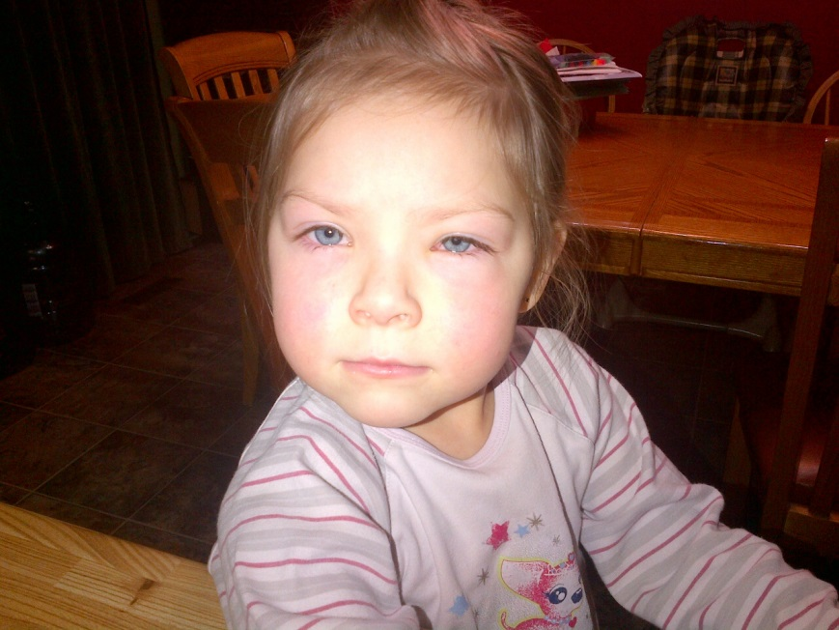
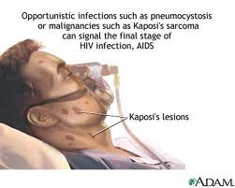
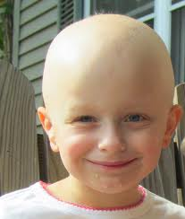
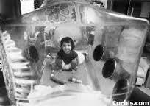
Two Problems
Immunodeficiency Diseases
HIV attacks T cells
SCID – gene mutation that inhibits the production of B cells and T cells.
Attack of Immune System
Allergies - hypersensitivity
Alopecia – autoimmune disease

Slide 3
Allergies
Immune system recognizes a protein as being a foreign invader
Tissue swelling, mucus secretion and restricted passageways may result.
Bradykinin is the chemical messenger that stimulates histamine (produced by basophils in blood and mast cells in connective tissues)
Histamine – capillary permeability – protein/WBC leave – osmotic difference – tissue swell
Anaphylactic shock, weakness, sweating, breathing, nausea, diarrhea, blood pressure drop

Slide 4
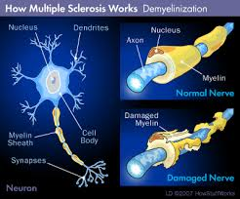
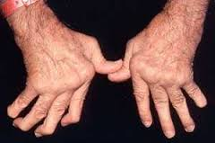
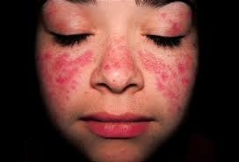
Autoimmune Diseases
Attack own cells - Mutated T and B cells – perhaps?
Supressor T cells secrete a substance that tags renegade cells for macrophages to destroy.
Lupus – antigen/antibody complex that builds up in the walls of blood vessels, joints, kidneys, and skin
Suppressor T cells that may have been weakened by drugs or serious infections leave the body susceptible to autoimmune diseases.
Rheumatoid arthritis affects
the connective tissue

Slide 5
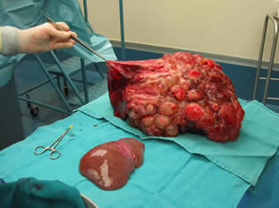
Organ Transplant
Self vs Non-Self recognition
Donor is considered foreign invader by distinctive protein markers on cell membranes - Major Histocompatibility Complex
Recipient makes antibodies designed to destroy foreign body.
Immunosuppressant drugs are used to reduce immune system’s ability to fight invading bodies – can comprise patient’s health
Kidney transplants are the greatest. Close matching is essential
HOPE – human organ procurement and exchange
U of A hospital - AB, SK, NWT, BC
One of only two accredited banks in Canada

Slide 6
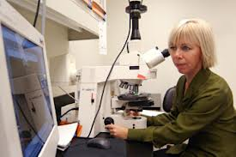
Stem Cell Research
Another option aside from transplantation.
Can be used to replace a variety of different tissue.
Intestinal stem cells reline the gut
Skin stem cells replace cells that continuously slough off
Bone Marrow stem cells help with a wide range of blood cells.
Pluripotent – different types of body cells
Research from Montreal Neurological Institute – Multipotent cells from skin become neurons or muscle cells.

Slide 7
Nobel Prize Immune Response Activity

Slide 8
Group Work Assignment
Work in designated groups to design a presentation to be made to classmates in regards to the Blood Components and Roles
Components of Blood
Blood Makeup
Components
Function
Transport
Clotting
Resisting Pathogens
Blood Types
Group
Rh
Antigens and Antibodies
How does Canadian society support scientific research and technological development:
Evaluate the risks and benefits associated with blood transfusions
Human Defense System
Components
Function (Role)
Evaluate the ethical implications
of organ and tissue transplant, in
terms of needs, interests and
financial support of society on
scientific and technological
research in this field

