Slide 1
Beyond Mendel
DNA is the Hereditary Material

Slide 2
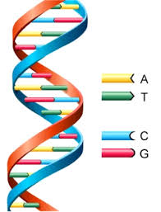
Material of Heredity
DeoxyriboNucleic Acid – DNA
  Is the chemical instructions for coding
  BBC - DNA

Slide 3
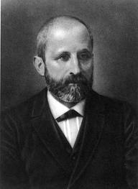
Friedrich Miescher
1869 discovered nuclein by extracting white blood cells on bandages
Two portions – one acidic (nucleic acid) and one alkaline (protein)
Later to be revealed that nucleic acid was two nucleic acids – RNA and DNA

Slide 4
Joachim Hammerling
1943 – demonstrated that the nucleus was region where hereditary material of cell would be found

Slide 5
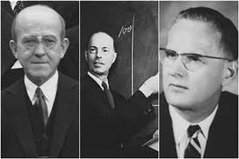
Go Team Canada!
Of Mice and Pneumonia
Oswald Avery and Colin MacLeod along with Maclyn McCarty built upon work of Frederick Griffith to come to the conclusion that DNA was indeed the molecular material of heredity

Slide 6
Hershey and Chase End the Debate
Used radioisotopes to tag a bacteriophage to see what it actually did when it came in contact with cells.
Proteins tagged with ³⁵S and DNA tagged with ³²P

Slide 8
Race to Reveal the Structure
James Watson on Ted Talks
Nobel Prize - DNA Molecular Structure of the Double Helix
Rosalind Franklin – xray diffraction
Maurice Wilkins – xray diffraction
James Watson
Francis Crick

Slide 9
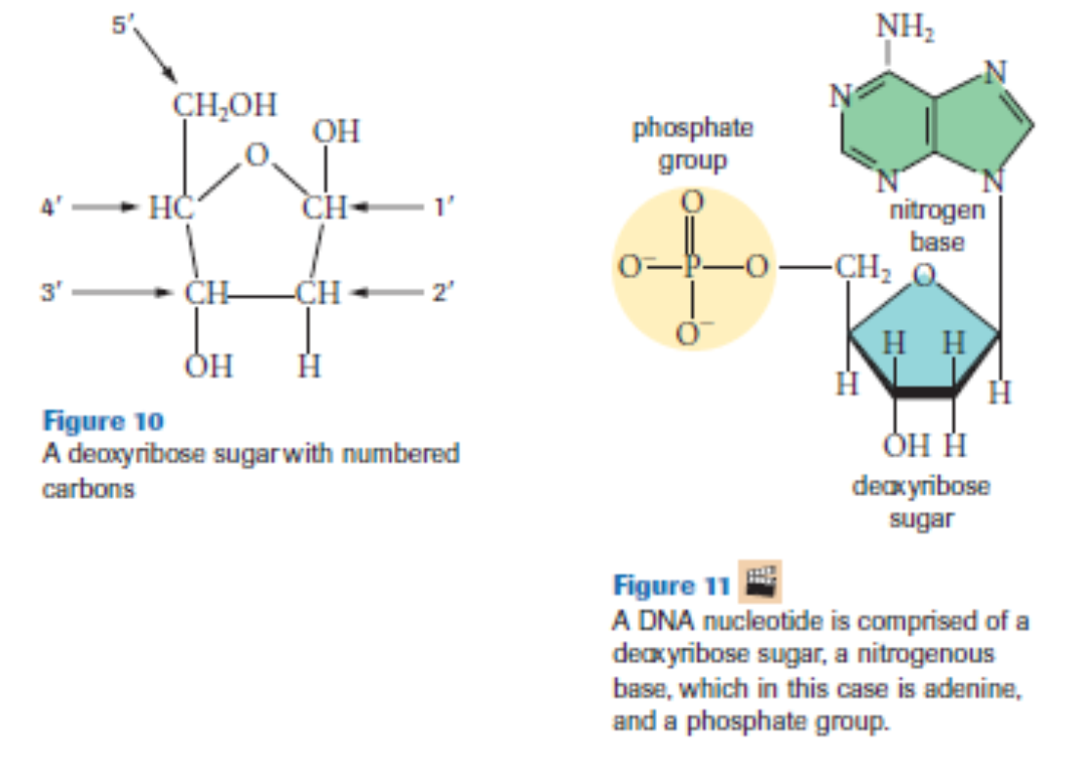
Base Structure of DNA

Slide 11
Kiwi DNA Extraction Demo
Genegeek Kiwi DNA Extraction

