Slide 1
Beyond Mendel
Chromosomes and Genetics

Slide 2
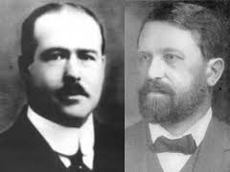
Chromosomal Theory
Sutton and Boveri each observed that chromosomes came in pairs and segregated during meiosis
-supports Mendel’s explanation of inheritance
-called alleles of genes
Sutton hypothesized that each chromosome carries genes – known as linked genes

Slide 3
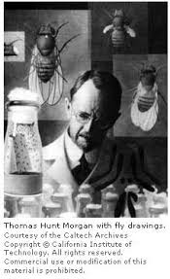
Sex-Linked Traits
Thomas Hunt Morgan – geneticist who examined Drosophilia melanogaster for principles of inheritance
F2 generation showed that all males had white eyes and all females had red eyes
Although X and Y chromosomes act as homologous pairs during meiosis they actually contain different genes

Slide 5
The male offspring always inherits a sex-linked trait from the mother. The father
supplies the Y chromosome which makes the offspring male.

Slide 6
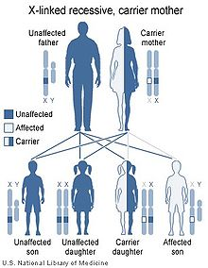
Barr Body
Recognized dark spot in some of the somatic cells from female mammals
not all female cells are identical
inactive and active indicates that some will express a certain trait while others express an alternate form even though all cells are genetically identical
Mosaic expression – patterns of both expressions throughout the body
Dr. Murray Barr - Nobel Laureate

