Slide 1
Basis of Heredity
Other Patterns of Inheritance

Slide 2
Pleiotropic Genes
Marfan Syndrome
Affect more than one characteristic
Sickle-cell anemia occur in individuals with two copies of mutated allele – affects multiple health areas
Marfan Syndrome can affect 4 organ systems at once

Slide 3
Multiple Alleles
Traits determined by more than two alleles – most common seen is Wild Type
Mutant – non-wild-type traits, alleles are mutant
Hierarchy of dominance in multiple alleles

Slide 4
Exercise 1
What will be the phenotypic ratio of the offspring from the mating of the following Drosophilia individuals
E1E4 (wild-type eye colour) x E2E3 (apricot eye colour)

Slide 5
Incomplete Dominance
Two alleles equally dominant – create a new phenotype
Homozygous parents of different phenotype create an F1 generation of all the same genotype. A cross between F1 generations sees a phenotype ratio of 1:2:1

Slide 6
Codominance
Two alleles show codominance they are fully expressed in a heterozygous individual but not in the same cells.

Slide 7
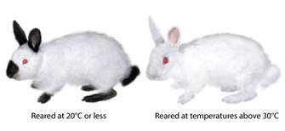
Environment and Phenotype
Himalayan Rabbits
Environment can have a profound effect on phenotypes.

Slide 8
Group Activity
Pg 612 18.4 Question 1

