Slide 1
Section 3
Word Equations and Simple Types of Reactions

Slide 2
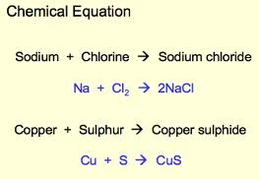
Word Equations
Word equations are always written in the same format:
The left side of the equation lists all reactants
The right side of the equation lists all products
An arrow points from the reactants to the products. It show that something is produced during the reaction

Slide 3
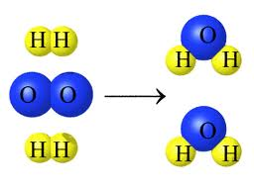
Simple composition reaction
2 or more simple elements combine to form a compound
The product is always a compound
Element A + Element B -> Compound AB
H2(g) + O2(g) -> H2O(l)
Building a new substance!

Slide 4
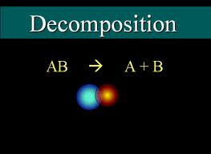
Decomposition Reaction
Breaking down a compound into its smaller parts
Products are always elements
Compound AB -> Element A + Element B
Water(plus electric energy) -> H2(g) + 02(g)
Most absorb energy (Endothermic)

Slide 5
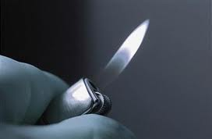
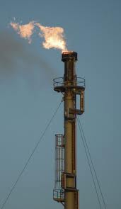
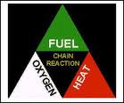
Combustion reactions
Combustion always occurs in the presence of 0xygen (02)
Candle, gasoline, butane, Oil & Natural gas

Slide 6
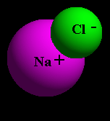
Elements are:
pure substance made up of only one kind of atom.
matter that cannot be broken down into different kinds of matter.
elements can combine to form compounds.
Compounds are:
substance formed by the chemical combination of two or more elements.

Slide 7
Naming Compounds
Every compound has both a chemical name AND a chemical formula.
To prevent confusion, scientists use a universal language of symbols to create the formulas.
We use the symbol for each element from the periodic table.
Each formula shows
WHICH elements make it up
HOW many of each there are, and
the STATE.

Slide 8
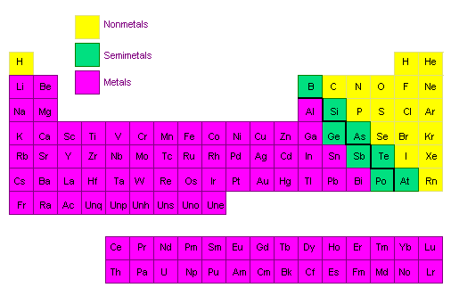
Ionic compounds have one metal and one non-metal.

Slide 9
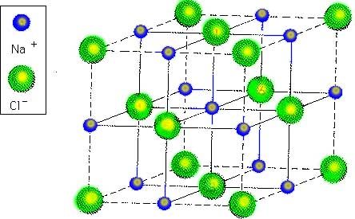
Naming Ionic Compounds
The metal is always written first the non-metal goes second.
The metal keeps its normal name.
The non-metals name is changed to have an “ide” ending
(Ex. Chlorine →chloride)
This molecule is
sodium chloride

Slide 10
Writing Formulas
Just switch the word for the element with its symbol for the periodic table!
Ex. Lithium bromide
LiBr

Slide 11
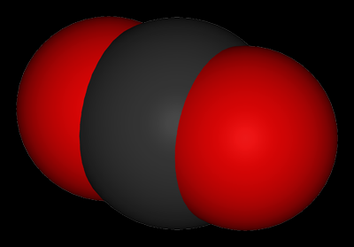
How many atoms of each?
To show how many of each element there is in a formula, we use subscripts:
Ex. calcium chloride
Sub. in the symbols:
calcium = Ca, chloride = Cl
CaCl
there needs to be 2 Cl atoms so we use a subscript 2.
CaCl₂
A smaller letter/ number BELOW the symbol

Slide 12
Practice: ☺
Compound name | # of Elements in compound | # of atoms | Drawing of compound
C₆H₁₂O_{6 (s)}

Slide 13
The state
The compounds state (at room temperature) is also written in subscripts.
Complete the chart below
Solid
Liquid
Gas
Aqueous*
S
Aqueous means: “will dissolve in water”
l
g
aq

Slide 14
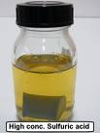
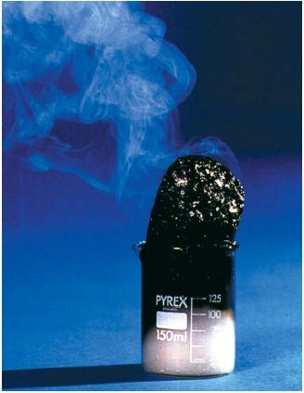
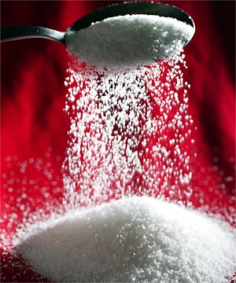
Conservation of Mass in Chemical Reactions
When a chemical reaction occurs, products are formed from the reactants.
These products often look very different than the reactants.

Slide 15
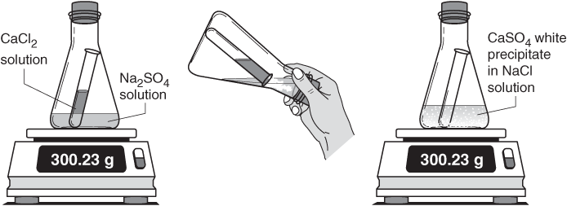
HOWEVER, the total mass of these products always equals (is the same as) the mass of the reactants.
This is called the conservation of mass.
No matter is created or destroyed in chemical reactions.
-was there matter created or destroyed? Why did the substance no longer fit in the container?
MASS OF REACTANTS = MASS OF PRODUCTS

