Slide 1
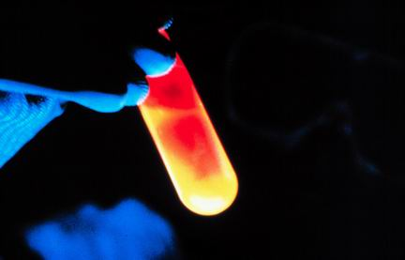
USEFUL CHEMISTRY
SECTION 2 – INVESTIGATE AND CLASSIFY CHEMICAL REACTIONS

Slide 2
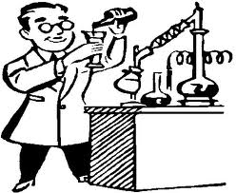
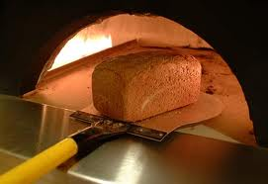
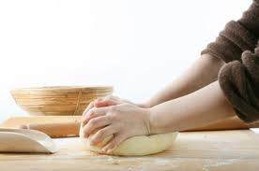
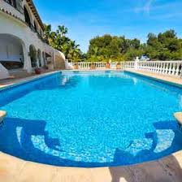
Useful Reactions - examples
Baking Bread
A baker combines flour, yeast, liquid, salt, and other flavorings in a bowl.
Shaped into dough
Back in a hot oven
Swimming Pool Scent
Chlorine is added to water to kill produce an acid – that kills micro-organisms.

Slide 3
Simple Compounds – around you!
O2 – Oxygen
CO2 – Carbon Dioxide
Co – Carbon Monoxide (the silent killer)
CH4 – Methane (natural gas)
C2H5OH - Alcohol (Ethanol)
NaCl Table Salt (Sodium Chloride)
C6H1206 Sugar (Glucose)
H20 Water (dihydrogen oxide)
Note!!! You must know these compounds!!!!

Slide 4
Chemical Reactions
Some reactions require energy – e.g. cooking
Some reactions release energy – e.g. demolition of a building.
Reactant + Reactant → Product
The substances you start with(reactants) are different then the substances you end up with (Products)

Slide 5
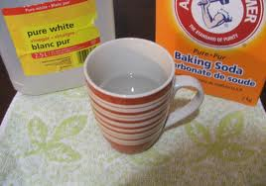
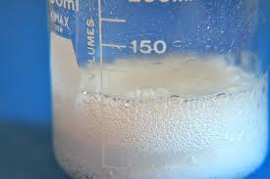
Example
Reactant + Reactant → Products
Acid + Base → Water + Salt
Baking soda + Vinegar → Water + Salt
→ →

Slide 6
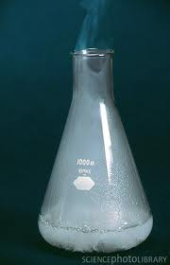
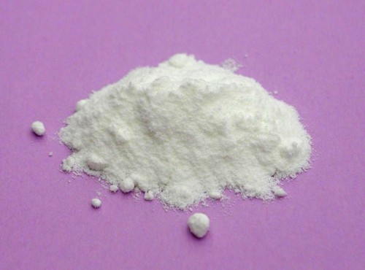
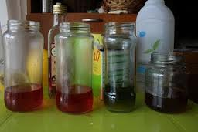
Reactions Continued
In some chemical reactions
Gases may be given off
Solids may be formed (Precipitate)
Color changes may occur

Slide 7
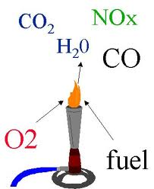
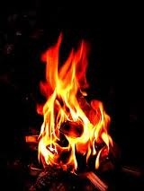
Other Chemical Reactions
Combustion Reactions
Fuel burns in oxygen to produce carbon dioxide (CO2) and Water (H2O)

Slide 8
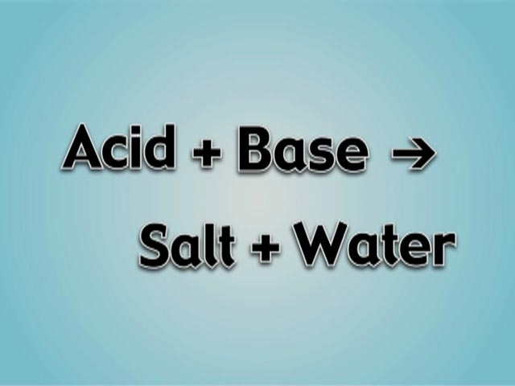
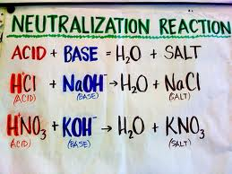
Other Chemical Reactions
Neutralization Reactions
Acid mixed with a Base to produce a Salt and Water
pH of 7 - neutral

Slide 9
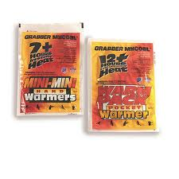
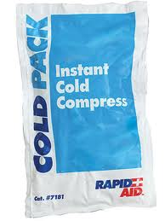
Evidence that a change has occurred
Energy changes
Exothermic – releases energy
Heat pack, fire
Endothermic – absorbs energy
Cold pack

Slide 10
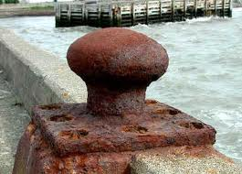
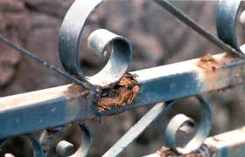
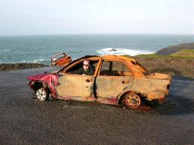
Corrosion

