Slide 1
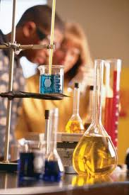
CHEMISTRY
SECTION 1
The composition, structure, properties, and reactions of a substance.

Slide 2
Useful Chemistry
Over the past 100 years there has been incredible advances in Chemistry (overall knowledge of chemical structures and reactions, ability to produce synthetics)
Many of the things we take for granted today were unimaginable when your great-grandparents were your age.
Our growing knowledge of chemistry has made many of these processes and products possible.

Slide 3
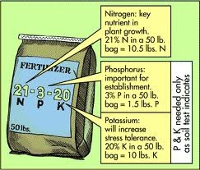
For example…
Farmers and gardeners used manure for their livestock to fertilize the crops and gardens.
Now most use fertilizers produced in chemical laboratories.
Synthetic PESTICIDES:
Herbicides – kill unwanted plants
Insectides – kill unwanted insects

Slide 4
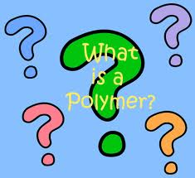
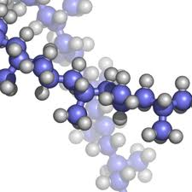
Polymers
A Type of compound(2 or more elements) that occurs in nature
E.g. Silk in spider webs and sap from rubber trees

Slide 5
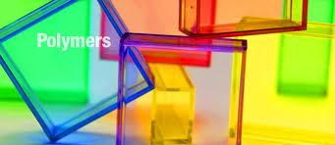
Synthetic Polymers
A Polymer is a giant molecule made up of many small identical sub-molecules.
Neo prene – shoe soles, hoses, wet suits
Polyethylene – milk jugs
Polystrene – styrofoam ups, insulation
Polyurethane – upholstery, clothing

Slide 6
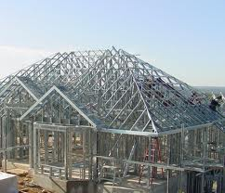
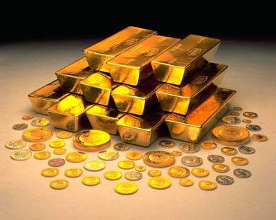
Alloys – mixture of metals
Many of the products you use today – from cars to jewellery – are made from alloys.
Steel is an allow of iron and chromium.
Pure gold is very soft and gets damaged very easily – so most jewellery is made with alloys.

Slide 7
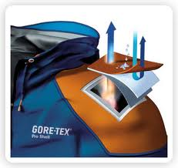
Other examples of common materials that have changed over the past 100 years

Slide 8
1.3 Chemical Safety
At Home and at Work

Slide 9
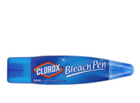
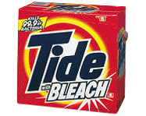
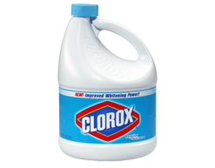
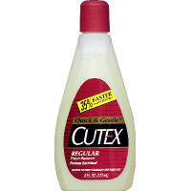
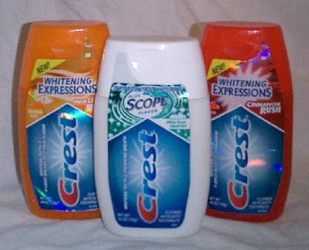
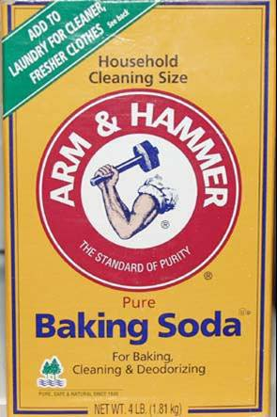
We use chemicals every day.
List 5 chemicals you use daily/ weekly:
Examples:
Bleach/ cleaning products
Toothpaste/ Nail polish remover, make-up/ soap
Cologne/ perfume
Oil/gas in cars
Pop
Printer ink
Chlorine in pool or hot tub

Slide 10
WHMIS: Which stands for Workplace Hazardous Materials Information System.
MSDS: Material Safety Data Sheet
HHPS: Hazardous Household Product Symbols

Slide 11
WHMIS
WHMIS labels are on the container that contain the material.
The label summarizes how to handle it.
People who work at jobs where chemicals and toxic cleaners are used t be educated in WHMIS training.
E.g. Compressed gas

Slide 12
WHMIS
Flammable
Oxidizing Material

Slide 13
WHMIS
Poisonous and Infectious Material (TOXIX)
Poisonous Material

Slide 14
WHMIS
Biological Hazard
Corrosive Material
Reactive

Slide 15
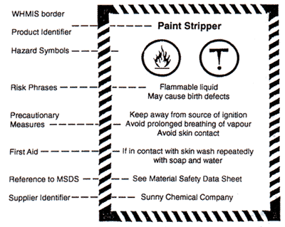
MSDS sheets are slightly more detailed.
They are not stuck to a container.
They give information on the physical and chemical properties of the material.
Safe handling, first aid advice and disposal procedures

Slide 16
Hazardous Household Product Symbols
HHPS: These types of labels are found on products that are:
reactive (likely to explode, or create a violent reaction if mixed)
dangerous and toxic.
They are bright and visible, so that your attention is immediately drawn to the notice, and you know to be careful with it.

Slide 17
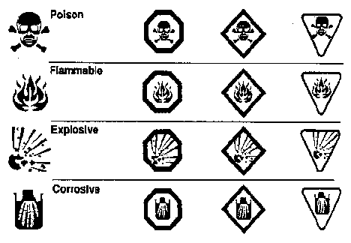
HHSP
Stop signs indicate danger. It is the most harmful of the HHSP
They are red
Diamonds means warning…medium warning
They are orange
Upside down triangles mean caution… the least dangerous, but still be careful
They are yellow

