Slide 1
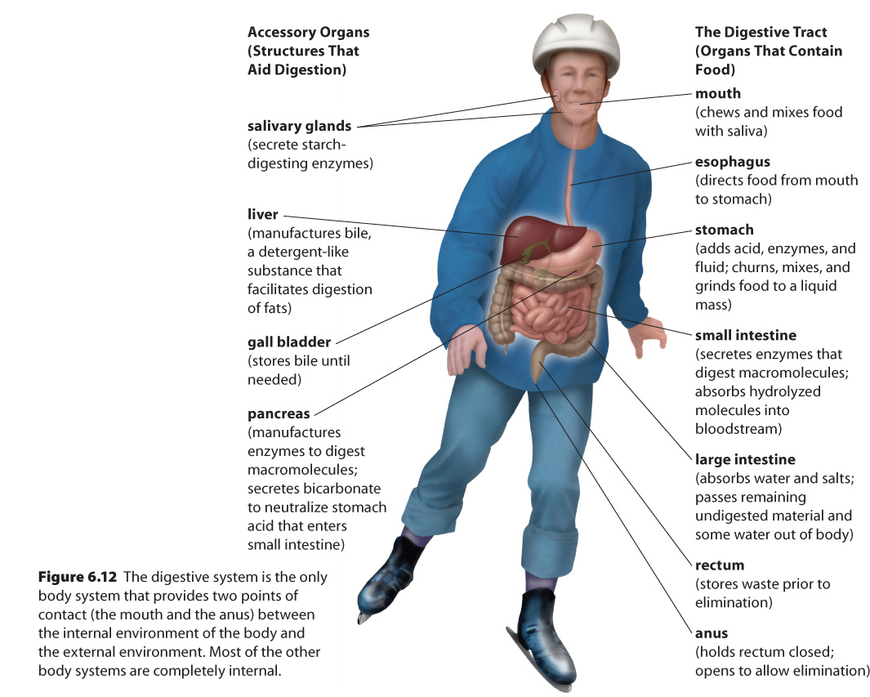
6.2 – Digestive System

Slide 2
Digestive System
Ingests, breaks down food, and absorbs nutrients
Works with circulatory system to deliver nutrients to cells
Both chemical breakdown (hydrolysis), and physical breakdown of material
A tube ~8m long
Waste eliminated through anus

Slide 3
Digestive Tract
Organs that contain food
Mouth
Esophagus
Stomach
Small intestine
Large intestine
Rectum
Anus
Accessory Organs
Salivary glands
Liver
Gall bladder
Pancreas

Slide 4
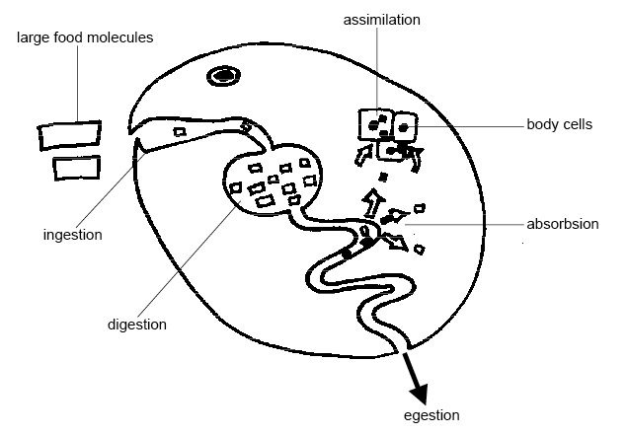
The Digestive Process begins with → Ingestion
The taking in of nutrients

Slide 5
Digestion
The breakdown of complex organic molecules into smaller components by enzymes

Slide 6
Absorption
The transport of digested nutrients to the cells of the body

Slide 7
Egestion
The removal of food waste from the body

Slide 8
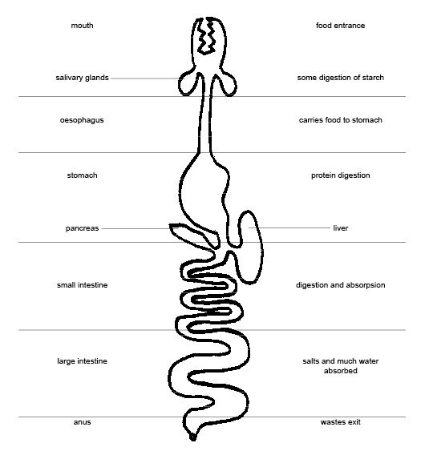

Slide 9
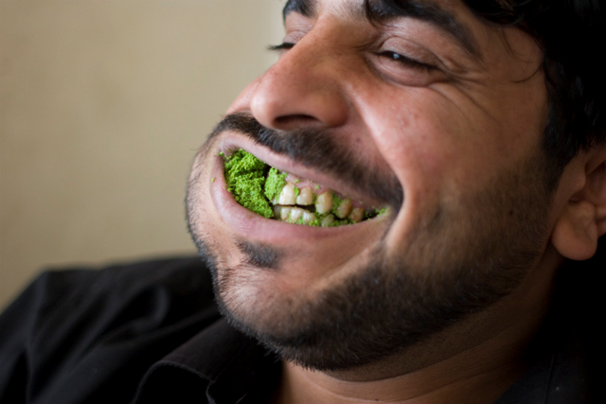
Mouth & Physical digestion
Teeth break down food into smaller pieces → increases surface area for chemical digestion

Slide 10
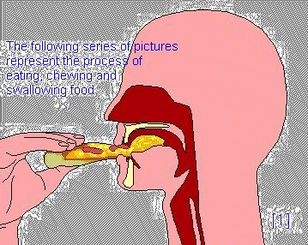
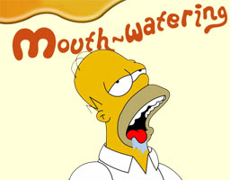
Mouth & Chemical digestion
Idea, smell, or thought of food triggers the salivary glands
Secrete saliva
Begins digestion of starches (using amylase)
Lubricates mouth & food to aid swallowing

Slide 11
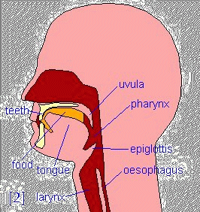
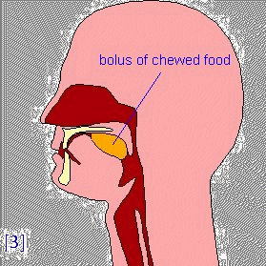
Moving Food to the Esophagus
Tongue forms food into a bolus
Bolus passes through pharynx, epiglottis closes, and bolus continues to esophagus

Slide 12
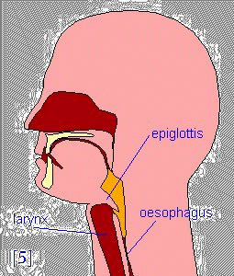
Epiglottis
The flap of tissue that prevents food from going into the trachea

Slide 13
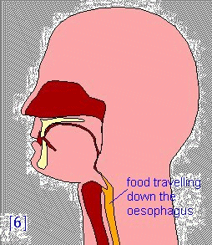
Esophagus
Tube from the mouth to the stomach
Food travels partly by gravity, but mostly by peristalsis

Slide 14
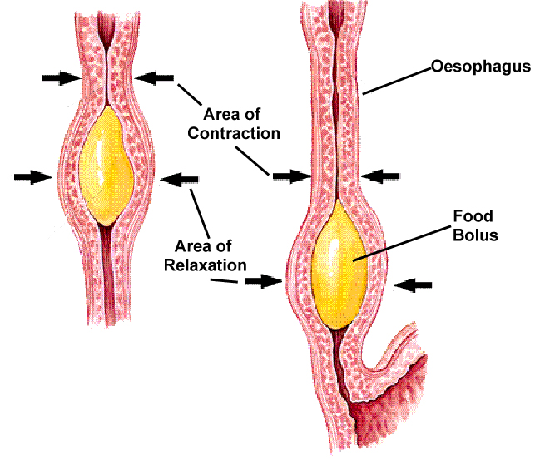
Peristalsis
Wave-like muscular contractions, involving circular and longitudinal muscles

Slide 15
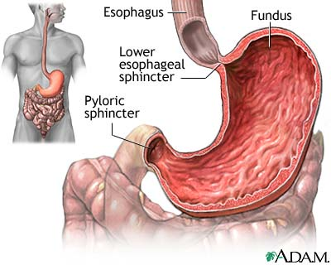
esophageal sphincter
Entry of bolus into stomach is controlled by the esophageal sphincter, which prevents stomach acid from backing up into esophagus

Slide 16
Stomach Function
J-shaped, muscular
Pyloric sphincter controls movement of stomach contents to small intestine
Functions:
Storage
Some digestion
Push food into small intestine

Slide 17
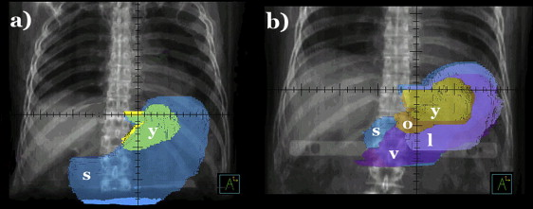
Stomach Size
Empty – 50 mL capacity; can expand to store 2-4 L of food

Slide 18
Stomach Structure
Notes:
Folds inside the stomach are called ‘rugae’

Slide 19
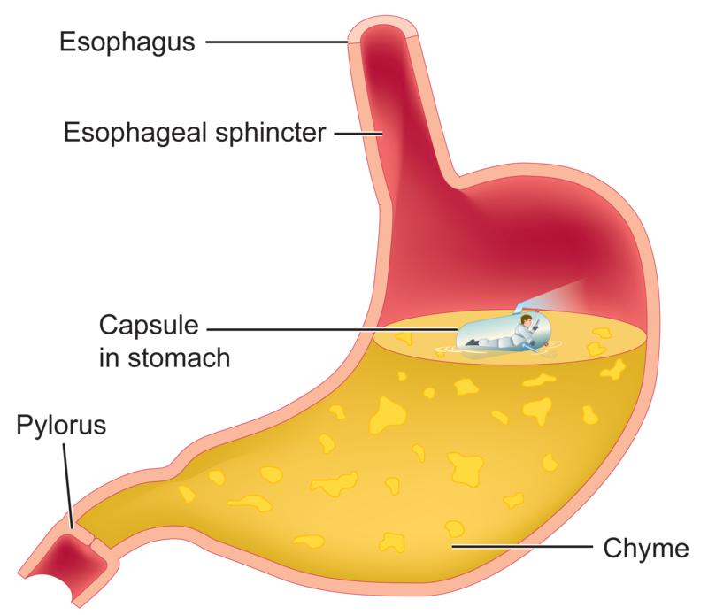
Digestion in the Stomach
Physical & chemical digestion
Churning mixes food with gastric juice, creating a thick liquid → chyme
Gastric juice
Water, mucus, salts, hydrochloric acid, enzymes
pH 1-3 → helps kill bacteria

Slide 20
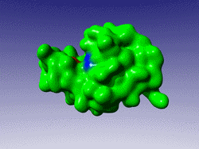
Protein Digestion
Proteins and polypeptides are very large molecules
An enzyme known as pepsin is produced by peptic cells in the stomach
This enzyme works along with the hydrochloric acid in the stomach to break down the polypeptides into smaller units

Slide 21
Why Doesn’t Stomach Digest Itself?
3 methods of protection:
Does not secrete much gastric juice until food is present
Mucus is secreted to protect stomach lining
Stomach secretes pepsin (a protein-digesting enzyme) that is not activated until it is in the presence of hydrochloric acid

Slide 22
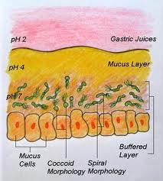
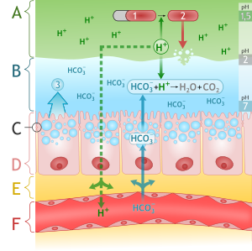
Stomach Layers
A → Acid Chyme
B → Mucus (with buffering)
D →Stomach lining producing mucus

Slide 23
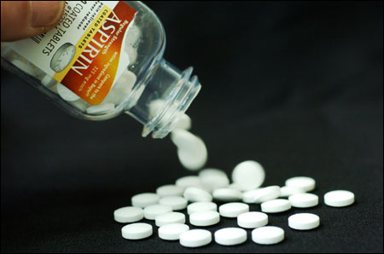
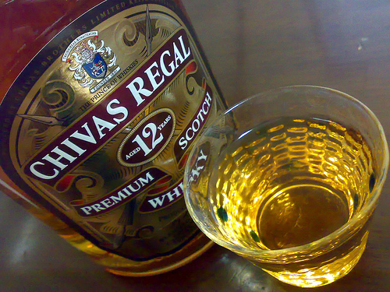
Absorption in the Stomach
Few substances are absorbed in stomach (they are not broken down enough yet)
Does absorb water, some salts, alcohol, and some medications

