Slide 1
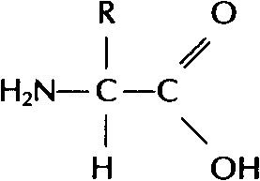
3. Proteins
Most diverse type of macromolecule
Assembled from amino acids
R group → the section that makes each amino acid different
20 amino acids → body can make 11, others must come from diet “essential amino acids”

Slide 2
Making a Polypeptide
A chain of several amino acids bonded together
Peptide bond
the bond between an amino group of one amino acid, and the carboxyl group of another
Notes:
Peptide bond – see pg 211, figure 6.7

Slide 3
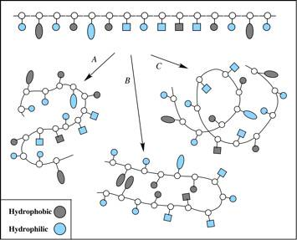
Protein Shape
Depends on attraction/repulsion of R-groups
3-D structure determines the protein’s function
R-Groups can be
Hydrophobic
Hydrophylic
Have other bonding properties

Slide 4
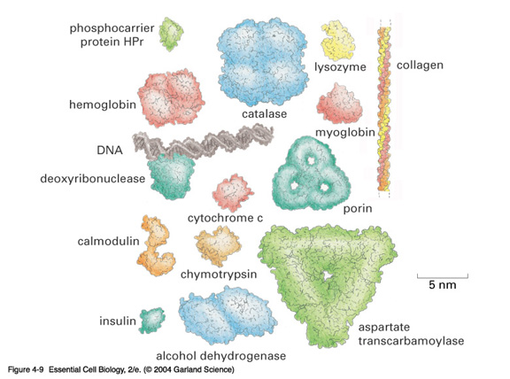
Example Proteins

Slide 5
Functions
1. Structure: tendons, bones, skin, cartilage, hair, wool, etc.
2. Movement: muscles, contractions
3. Catalysis
4. Transport: protein hemoglobin moves O2
5. Energy transportation and storage: Rhodopsin
6. Storage: iron in the liver.
7. Protection: Anibodies.
8. Control: Hormones such as insulin and glucagon.
9. Buffering: can help to neutralize acids and bases.

Slide 6
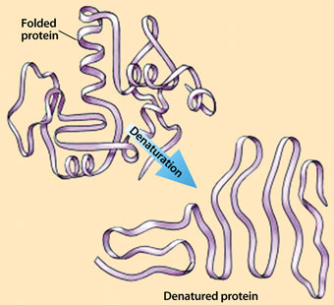
Denaturation
Exposing a protein to excess heat, radiation or a change in pH will alter its shape
Denaturation
Occurs when the bonds of a protein are disrupted, causing an often permanent change in shape
ex. X-ray radiation or nuclear radioactivity can disrupt protein structure and can lead to cancer or genetic damage.
Notes:
‘what happens when you fry an egg’. The proteins in the egg have coagulated – no matter how much you cool it, it will not change back to its original condition.

Slide 7
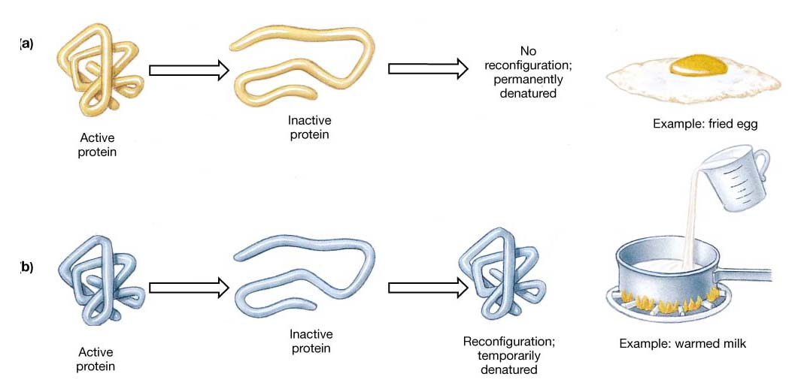
Denaturation can be temporary Only once the denaturing agent is removed Heat, pH or other extreme surroundings

Slide 8
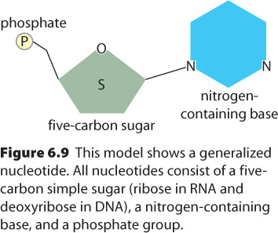
4. Nucleic Acids
Directs the growth and development of organisms using the genetic code
RNA → ribonucleic acid
DNA → deoxyribonucleic acid
Subunits: Nucleotides → there are 4 different nucleotides
Adenine
Guanine
Cytosine
Thymine (DNA)
or Urasil (RNA)
Notes:
DNA contains the genes/information needed to build the cell
RNA → gene is copied into RNA, which is then used to make proteins.

Slide 9
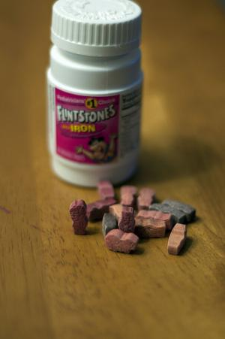
Vitamins and Minerals
Key components of reactions that give energy, and make, or break down compounds
Only needed in small amounts
Vitamins – organic – serve as coenzymes
Involved in tissue development & growth, resistance to disease
Minerals – inorganic
Build bones & cartilage, essential
components of hemoglobin, hormones,
and enzymes

Slide 10
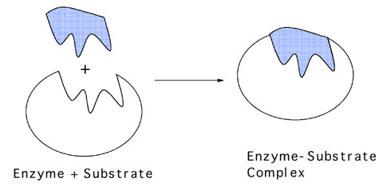
Enzymes
Proteins acting as a biological-catalyst
Increase the rate of chemical reactions without being used in the reaction
Lower the amount of energy required to initiate the reaction
Each one has a precise shape to fit certain molecules (substrates)

Slide 11
Enzyme Names
Enzymes are often named after the substrate (molecule) they bond with, using the suffix “ase”
e.g. substrate enzyme
sucrose → sucrase
Cellulose → cellulase
lipid → lipase

Slide 12
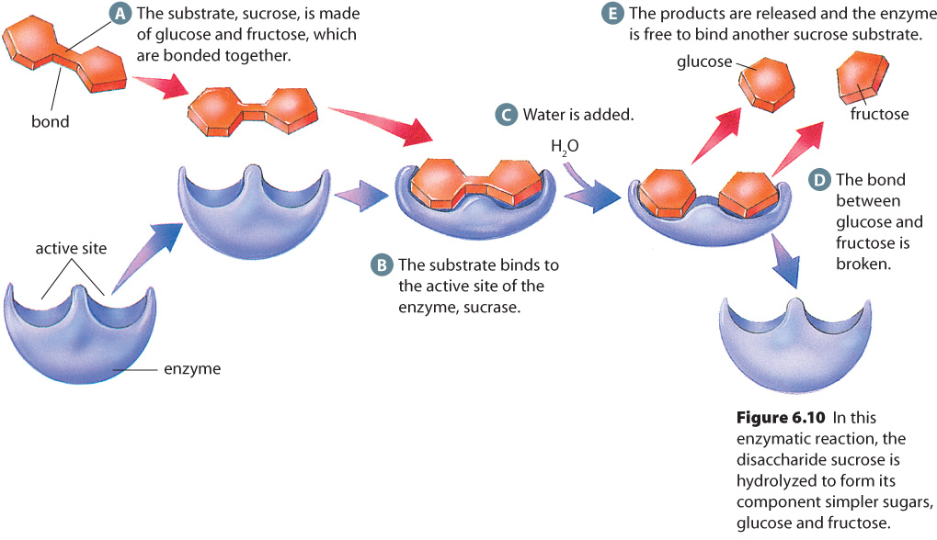
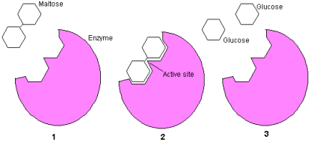
How an Enzymes works:
Notes:
When the substrate binds to the active site, the bonds of the substrate become much less stable → more likely to be altered.
Can be used repeatedly.

Slide 13
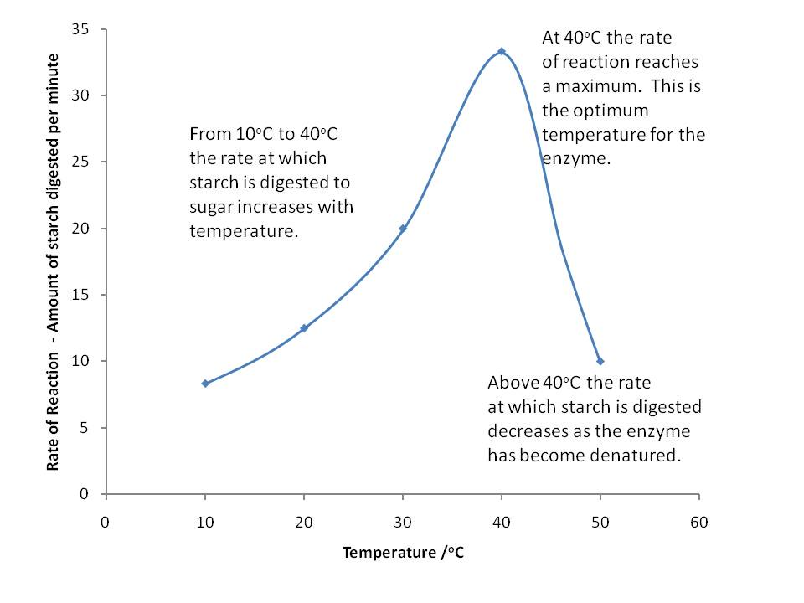
Factors Affecting Enzyme Action
Temperature and pH → function best within a narrow range

Slide 14
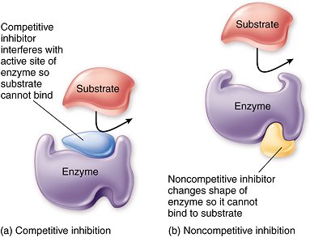
Inhibitors
Molecules that attach to the enzyme and reduce its ability to bind the substrate
Competitive – attach at the active site
Non-competitive – attach elsewhere on the enzyme, thereby changing the enzyme shape
Notes:
Assignment: pg 216 Q#1,2,3,4,8,9

