Slide 1
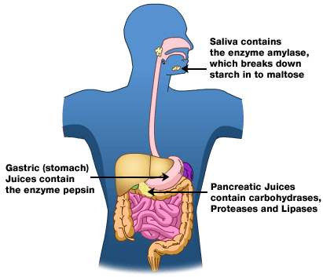
Unit 4: Human Systems Chapter 1: Digestion
The Molecules of Living Systems → 6.1

Slide 2
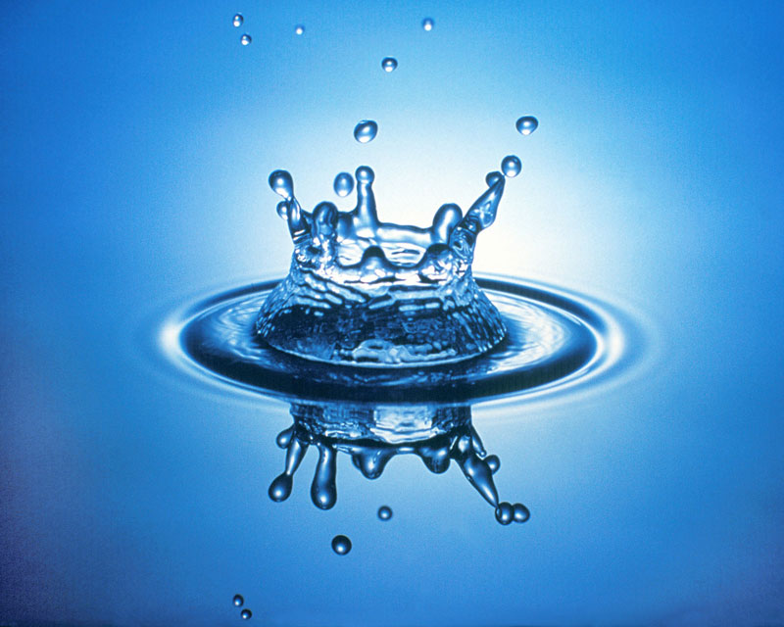
Fluid Compartments of the Body
Most of the fluid is water, but there are also other molecules and ions.
Inside Cells
Cytoplasm in cells (27L-30L)
Outside Cells
Fluid between cells (11L-13L)
Fluid in blood (plasma) (3L-3.5L)

Slide 3
Macromolecules
Large organic molecules (contain C-H bonds)
4 types:
1. Carbohydrates
2. Lipids
3. Proteins
4. Nucleic Acids
Notes:
See Table 6.1, pg 206 (Macromolecules)

Slide 4
Assembling Macromolecules
All types of macromolecules are assembled in the same way
Dehydration Synthesis
An –OH (hydroxyl) group is removed from one subunit
An –H is removed from another subunit
Results in a covalent bond being formed, and water being released
Involves enzymes
Notes:
Enzymes control the timing of these reactions and the positioning of the reactants.

Slide 5
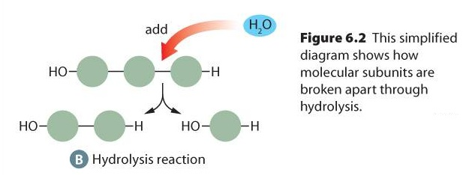
Disassembling Macromolecules
Reverses the dehydration reaction
Hydrolysis
Water molecule is added
An –H joins one subunit
An –OH group joins the other subunit
Results in covalent bond between subunits breaking
Involves enzymes

Slide 6
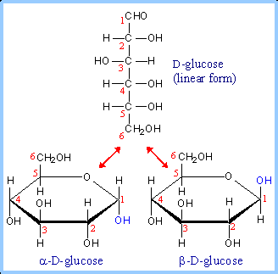
1. Carbohydrates
Always contain C, H, and O
Almost always in same proportion →1-C, 2-H, 1-O
Provide either short term or long term energy storage for organisms
2 types:
Simple Sugars
Polysaccharides

Slide 7
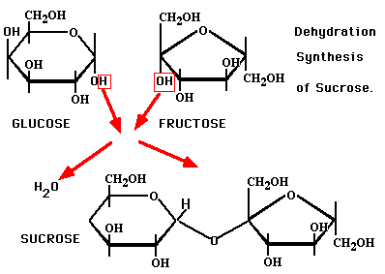
Simple Sugars
Monosaccharides – has 3-7 carbons and the corresponding number of hydrogen & oxygen atoms (eg. glucose)
Disaccharides – made up of 2 monosaccharides (eg. Maltose)

Slide 8
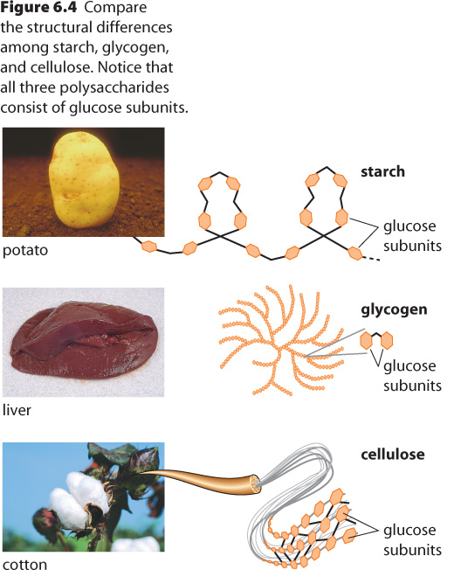
Polysaccharides
Many linked simple sugars
Starch -
energy storage in plants
Glycogen -
energy storage in animals
Notes:
Glycogen has more branching, and therefore contains many more glucose units per cell than starch does.

Slide 9
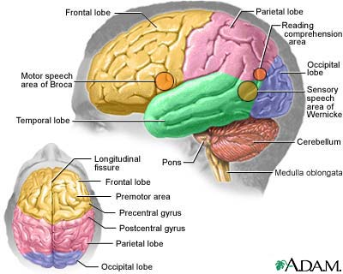
Low Carbohydrate Diets… (FYI)
One of the downfalls of a low carbohydrate diet is the lack of sugar in the body.
The human brain uses sugar to repair & develop new network systems, and to function properly.

Slide 10
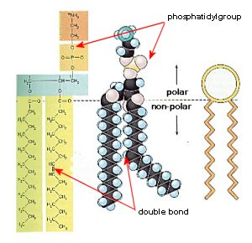
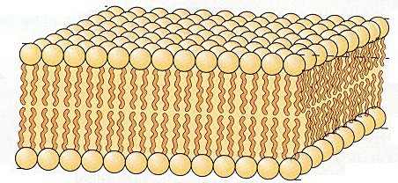
2. Lipids
Important property:
Insoluble in water
Functions:
Fats & Oils → Energy storage (stores on average 2.25 X more energy than other biological molecules)
Phospholipids → cell membranes (ex. covering for head of sperm)
Steroids → help to
make sex hormones

Slide 11
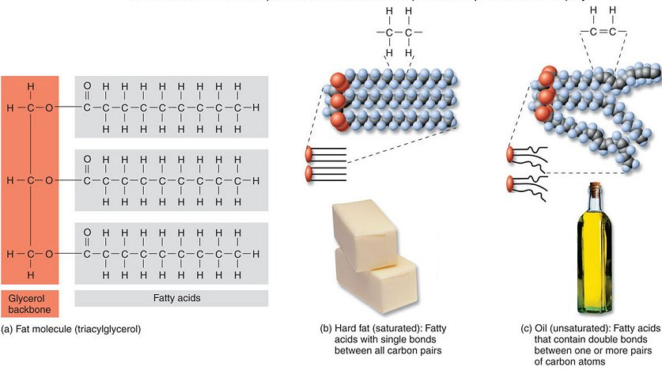
Common lipids
Fats - Formed from animals, solid at room temp.
Oils - Formed from plants, liquid at room temp

Slide 12
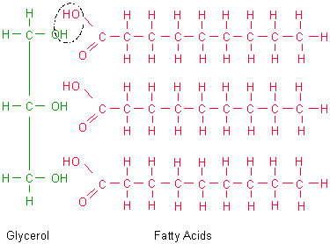
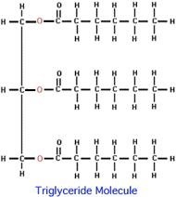
Triglycerides
Made from 1 glycerol + 3 fatty acids →triglyceride
Fatty acid chains can differ
Saturated fatty acids – full of hydrogens, usually solid
Unsaturated fatty acids – have one or more C=C bonds (sometimes a triple c-c bond), usually liquids

