Slide 1
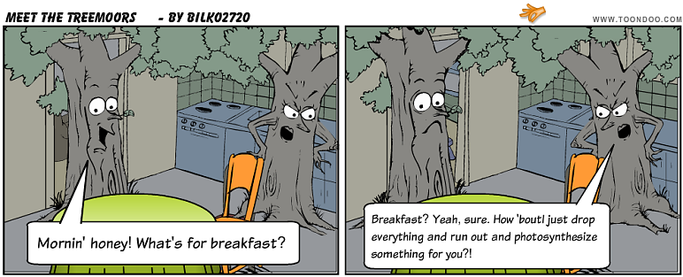
Matter and Energy Pathways in Living Systems
Notes:
Ask students to recall the formulas for cellular respiration and photosynthesis

Slide 2
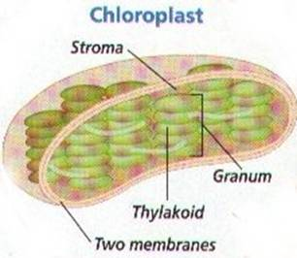
Photosynthesis
Chloroplasts in autotrophs convert solar energy into chemical energy
Byproducts: oxygen, ATP, heat
Some used immediately
Some stored as sugars & carbohydrates

Slide 3
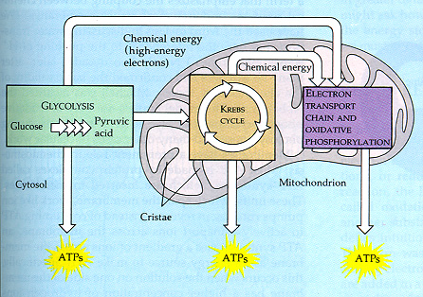
Cellular Respiration
Chemical energy is stored in chemical bonds → must be broken down to release energy
Mitochondria break
down carbohydrates
into ATP
***ATP is the source
of energy for nearly
all cellular activities***

Slide 4
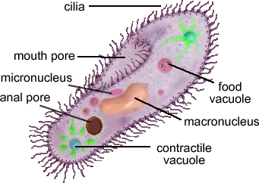
ATP and Cellular Activity
ATP is always being used – cells constantly synthesize it
Active transport
Moving chromosomes during cell division
Movement of cilia & flagella
Muscle contraction
Synthesizing other compounds

Slide 5
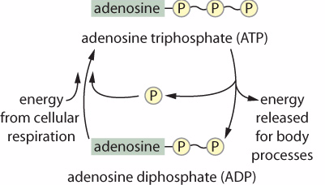
The third phosphate group breaks off the ATP molecule, leaving ADP and a free phosphate group
ATP is synthesized when a free phosphate bonds to ADP (requires energy)

Slide 6
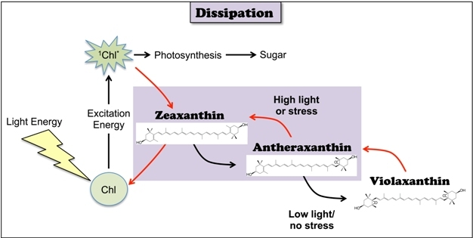
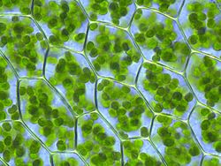
Chloroplasts
Contain chlorophyll → pigment that traps solar energy

Slide 7
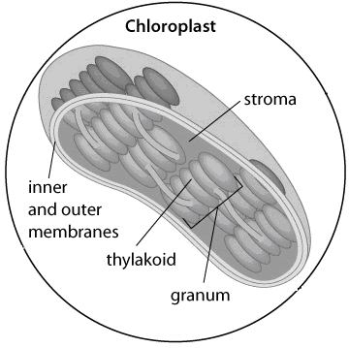
Chloroplast Structure
2 membranes (outer & inner)
Stroma – fluid that contains materials for making carbohydrates
Thylakoids – interconnected, flattened sacs → contain chlorophyll
Granum – a stack
of many thylakoids

Slide 8
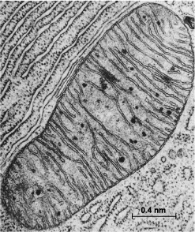
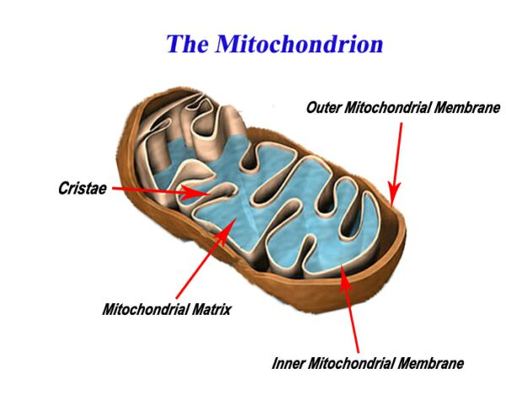
Mitochondria
Site of Cellular Respiration
In Eukaryotic organisms

Slide 9
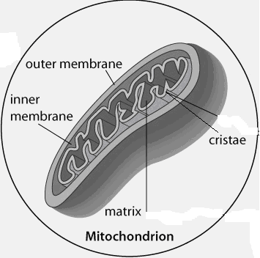
Mitochondrial Structure
2 membranes
Matrix – fluid-filled space of the inner membrane → contains proteins & other materials needed to break down carbohydrates
Cristae – folds in the
inner membrane →
increases surface area
for the synthesis of ATP

Slide 10
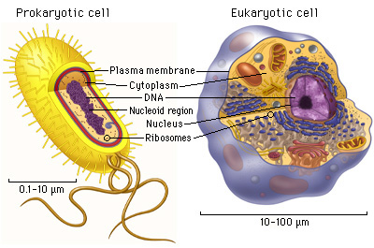
Prokaryotic vs. Eukaryotic
http://www.youtube.com/watch?v=gfzVWG2DnQ4

Slide 11
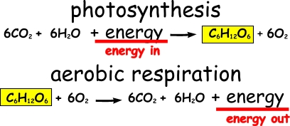
Metabolic Pathways and Energy for Cellular Reactions
Reactions for photosynthesis and respiration seem to be exact opposites, but these are just overall reactions
Notes:
Combustion of wood – cellulose is made up of thousands of glucose units. Requires high temp to start and maintain the fire. Cells would not survive the high temp or energy output. Instead, reactions in living cells → large number, controlled.

Slide 12
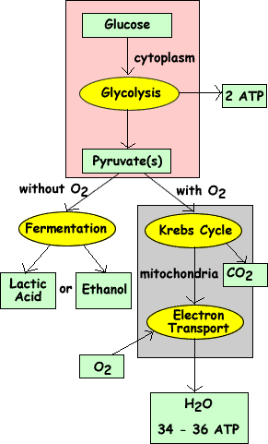
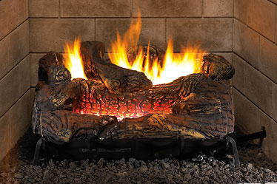
Cellular Respiration → like slow combustion of wood
Large number of controlled reactions in step-by-step sequences → metabolic pathway
Product of one reaction
becomes the reactant of
another reaction
=

Slide 13
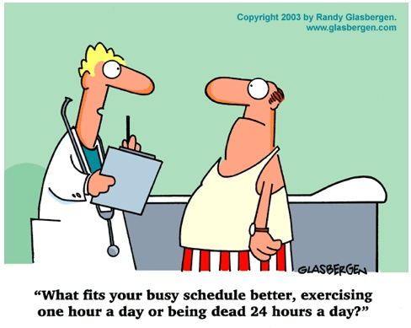
Metabolism
All of the chemical reactions that occur within a cell to support and sustain life functions.

Slide 14
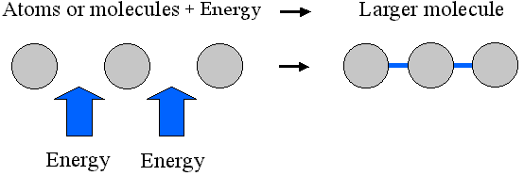
Anabolic pathways
Makes larger molecules from smaller molecules (requires energy)

Slide 15
Catabolic pathways
Breaks down large molecules (releases energy)
Needs some factor to activate the reactions → enzymes

Slide 16
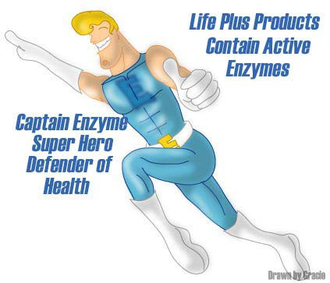
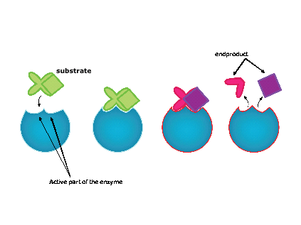
Enzymes
Specialized proteins that lower the energy required to activate a reaction
Enzymes are specific to each type of reaction

Slide 17
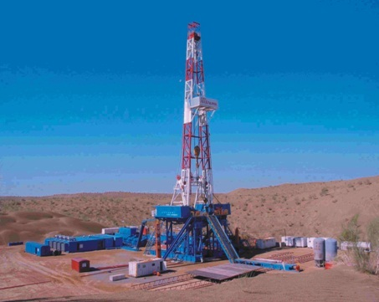
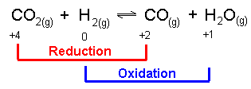
Oxidation and Reduction
Oxidation – losing an electron
Reduction – gaining an electron
“OiL RiG”
All compounds/atoms contain more energy in their reduced form than in their oxidized form → said to have “reducing power”
Referred to as REDOX reactions.
Notes:
See figure 5.7, pg 167
Assignment Pg 168 Q#1,2,3,4,7,8,9

Slide 18
Chapter 5 work check
Assignment Pg 168 Q#1,2,3,4,7,8,9 (Oct. 29)
Climate Brochure due for Tuesday (Oct. 30)
Read Chapter 5 by next Friday (~ 10 pages per day will do it) (Nov. 2)
Ch. 5 Bio Dictionary due Tuesday (Nov. 6)
One other Project (Due date to be negotiated)

