Slide 1
Chapter 4
Mechanisms of Population Change

Slide 2
4.1 Adaptations
Organisms that live long enough to reproduce will pass on their traits to the next generation
Those organisms that are best adapted to their environments will be most likely to survive
Adaptations can be either structural, behavioural, or physiological

Slide 3
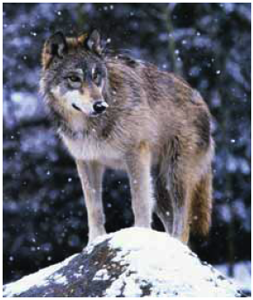
Adaptations and Biomes
Biomes are often identified with characteristic biotic factors,
such as a cactus in the desert or a caribou on the tundra.
Many of these characteristic factors have special adaptations for that biome.
An adaptation is a characteristic that
allows an organism to better survive and
reproduce.
There are three types of adaptations
An organism can have.
Let’s use the wolf to look at all three

Slide 4
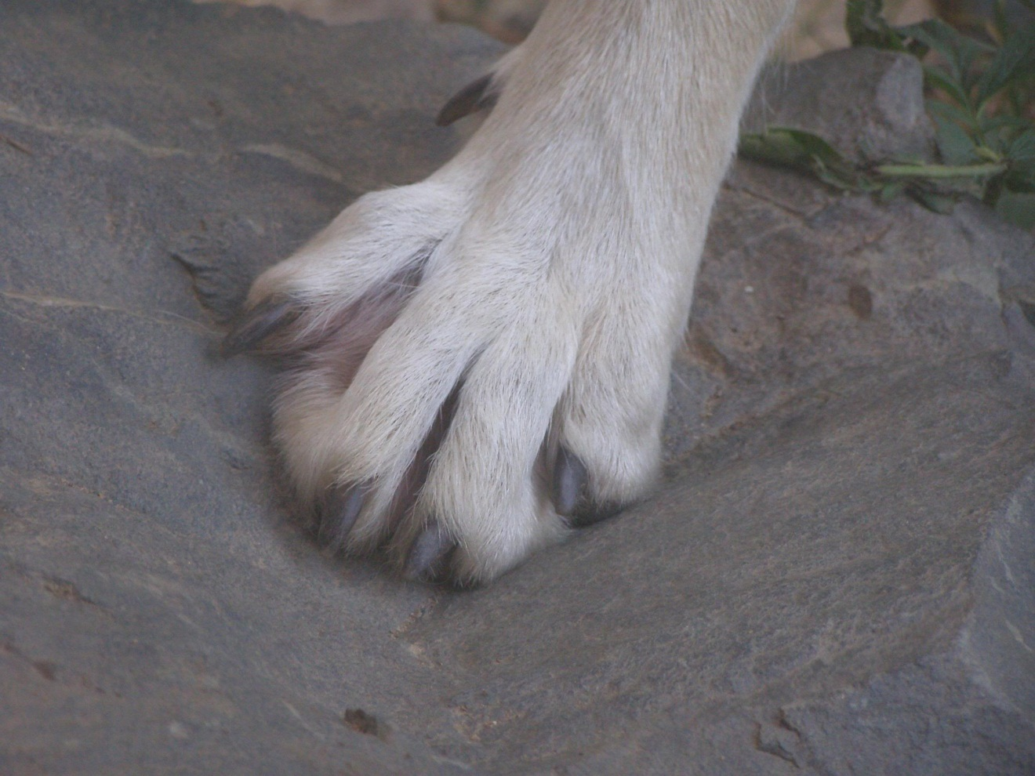
Structural adaptation
A physical feature
that helps an organism
survive
A wolf has large
paws to help it run
in snow.

Slide 5
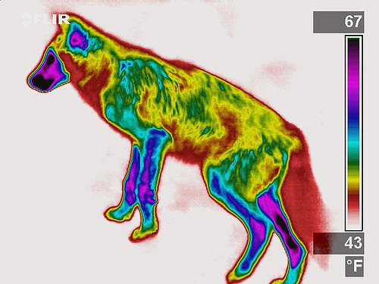
Physiological adaptation
A physical or chemical event inside the body of an organism that allows it to survive
A wolf maintains
a constant body
temperature.

Slide 6
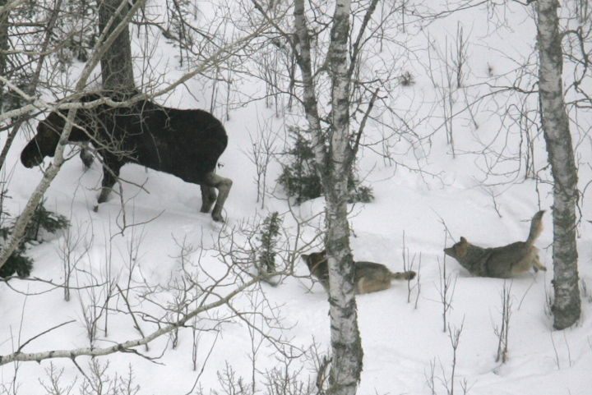
Behavioural adaptation
A behaviour that helps an organism to survive
Wolves hunt in
packs to
capture large
Prey like the
moose.

Slide 7
Behavioural adaptation

Slide 8
Behavioural adaptation

Slide 9
Behavioural adaptation

Slide 10
The Source of Adaptations
Adaptations are due to the gradual change in the characteristics of a population over time
Although variations can result in adaptations, not all variations are beneficial

Slide 11
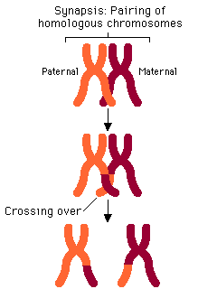
Variation Within Species
Variation is the result of genetic changes and recombinations
The recombination of
genes can occur during
sexual reproduction

Slide 12
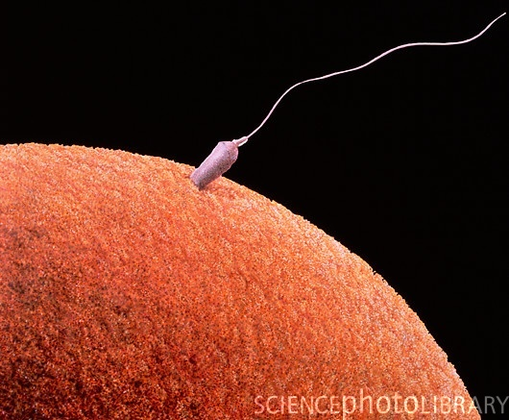
Sex
Mate selection is varied
Chromosomes are shuffled Randomly
Genes are swapped before being separated in meiosis

Slide 13
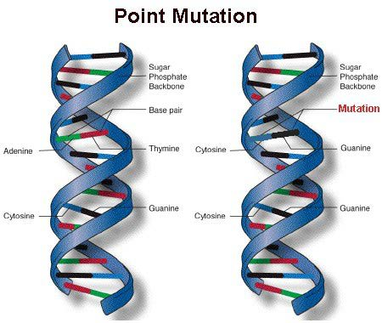
Mutations and Variation
However, ultimately, all variation is due to mutations
Changes in the
genetic code result
in slightly different
genes than the
genes present in
Other organisms

Slide 14
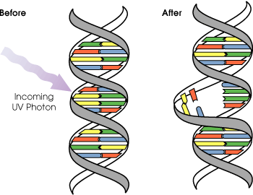
Mutagenic agents
DNA mutations can occur from errors in copying the DNA, and damage from radiation or mutagens
Any substance, energy, or condition that case a change in DNA
Ex.: cosmic rays, X rays,
UV radiation, and
chemical mutagens.

Slide 15
The Effect of Mutations
Genes code for proteins
A change in the genetic code will alter the sequence of amino acids that forms a protein
This change in the amino acid sequence will change the shape of the protein, which changes its action
Watch DNA to protein →
http://youtu.be/983lhh20rGY

Slide 16
Some mutations occur in somatic cells (the cells that make up body tissues)
These mutations will disappear when the organism dies
However, if mutations occur in germ line cells (those that produce sperm or eggs), the mutations will be passed on to the next generation

Slide 18
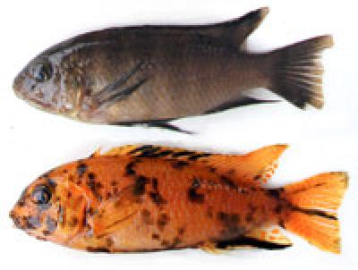
Mutations and Selective Advantage
Some mutations produce a change in an individual that is beneficial
These mutations increase the individual’s chance of survival and
will most likely be
passed on to the next
generation

Slide 19
Case Study: Venom-Resistant Squirrels
In California, some ground squirrels have developed a mutation that makes them more resistant to rattlesnake venom
Therefore, the ground squirrels with the mutation have a greater chance of survival and therefore will pass on their traits to the next generation
Ultimately, the majority of the squirrel population will have this beneficial adaptation because they are more likely to survive to reproduce

Slide 20
Case Study: Pesticide Resistance
In 1955, the World Health Organization initiated a widespread program to kill malaria-carrying mosquitoes using DDT
This program was initially very successful in decreasing mosquito populations, but they quickly reappeared
Because of the reduced effectiveness of DDT and its negative environmental effects, the spraying program was discontinued

Slide 21
Case Study: Pesticide Resistance
Why did DDT lose its effectiveness?

Slide 22
Case Study: “Superbugs”
In 1928, Sir Alexander Fleming discovered that penicillin could be used to kill bacteria
Penicillin was first used as a medicine in 1941
By 1945, there were already reports of penicillin-resistant strains of bacteria
There are now bacterial strains that are resistant to all known antibiotics

Slide 23
Case Study: “Superbugs”
Read Thought Lab 4.1…
What factors contributed to the development of antibiotic-resistant bacteria?

Slide 24
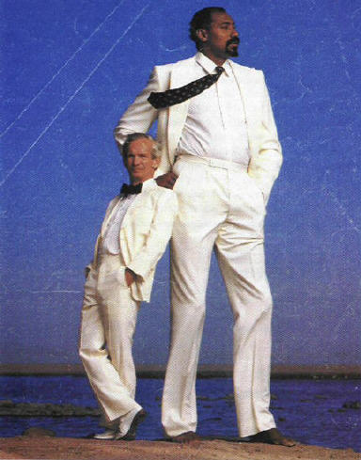
Natural Selection
Individuals that have beneficial adaptations that are passed on to their offspring will change the population as those traits are passed on to the next generation
For natural selection to occur, there must be variation within the species

Slide 25
In a population, individuals are selected for by their environment
It is important to consider that individuals do not change during their lifetime – rather, the population changes over time
The environment will exert a selective pressure on a population

Slide 26
Example: Selective Pressure
In a population of grasses, some of the grasses are better adapted to survive drought conditions
If a drought occurs, it exerts a selective pressure that favours those plants that are drought-resistant
This causes a change in the makeup of the population

Slide 27
Variations that are not beneficial in a certain environment may not be harmful, they may simply be useless
If a variation is detrimental, it is unlikely that it will be passed on until the environment changes to select for that variation

Slide 28
Natural Selection & the Environment
Natural selection does not anticipate changes in the environment
Instead, random changes occur and produce traits that may be beneficial in the future
When the environment changes, then those variations that have been produced increase the ability of some organisms to survive

