Slide 1
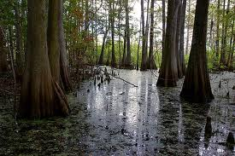
3.3 Studying Organisms in Ecosystems

Slide 2
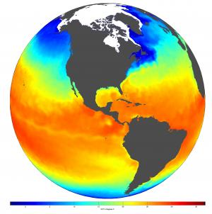
Abiotic factors affect the distribution of organisms
Temperature
Humidity
Salinity
Moisture

Slide 3
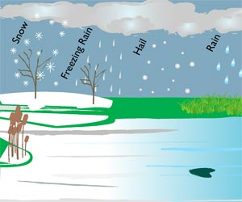
Climate
Climate
The average weather conditions in a particular region over a period of time.
What Affects Climate?
Precipitation → soil → vegetation → animals, fungi, etc
Notes:
Does anyone remember from Science 10 what the definition of Climate is?
The average weather conditions in a particular region over a period of time (>30 years)
What affects climate?
Unequal heating of Earth, local geography, albedo (snow cover), and proximity of large bodies of water
The unequal heating causes currents and trade winds
Precipitation influences the type of soil that forms. These factors, combined with topography, altitude, latitude, and temperature influence the type of vegetation and other photosynthetic organisms, which in turn influence the type of animals, fungi, etc that can live in an area.

Slide 4
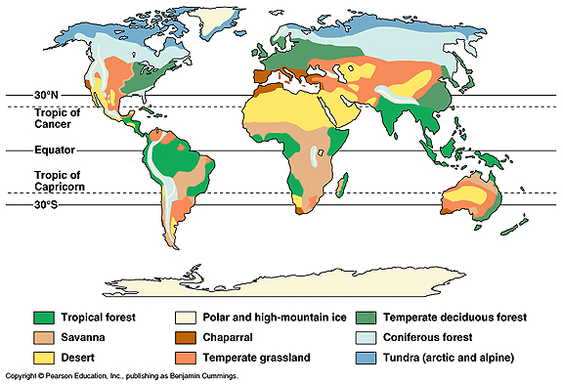
Biomes
Large ecosystems or groups of ecosystems with a particular mix of biotic and abiotic factors
Can have different vegetation zones (variation within biome)

Slide 5
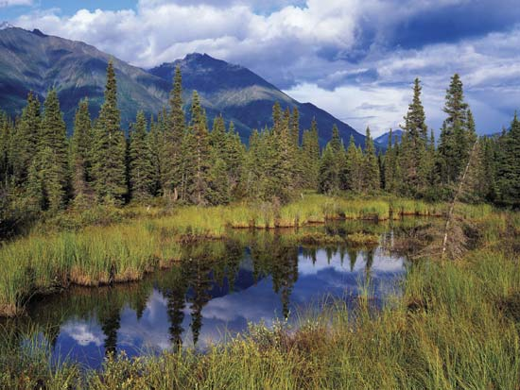
Alberta’s Biomes - Taiga
Boreal Forest Biome
Conifers
Ecosystems vary widely
Eg.) Muskeg Ecosystem
Cooler climate
Permafrost layer
Slow decomposition
Boggy or swampy in summer
Notes:
Conifers are well adapted to warm, moist summers and cold dry winters.
Waxy needles – prevent water loss, protects against frost (less surface area)
Pyramid shape – snow slides off so that branches don’t break
Ecosystems vary due to abiotic factors both vertically and horizontally. Canopy receives more light, whereas the forest floor may be completely in shade. Different birds inhabit different areas of a tree – seeds may only grow in certain areas of a tree (near the top, middle, or bottom).
Animals that may be found in these ecosystems are: red or flying squirrels, moose, voles, white-tailed deer, spruce grouse, black bears, grizzly bears, weasels, owls, and wolverines.
Muskeg ecosystems – due to the cooler temperatures and layer of permafrost, water is unable to escape. Decomposition of organic material is slower, due to the temperature, and it gets trapped in the water, creating a bog. Due to the lack of good soil, different plants have adapted to this ecosystem. Typically shorter plants with expansive, fibrous root systems grow here, and hold the loose bog material together.
Organisms of the bog: lichens, mosses, tall grasses, small shrubs, stunted conifers, blackflies, mosquitoes, caribou.

Slide 6
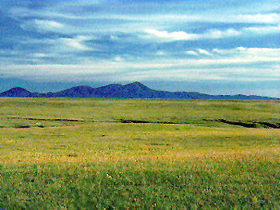
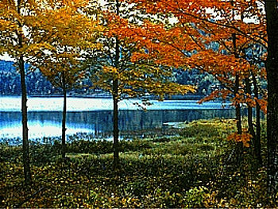
Alberta Biomes - Grassland
Rich soil (most fertile in world)
Less biodiversity than Taiga
Deciduous Forest Ecosystem
Edges of Grassland, just before Taiga
Also found near rivers
Trees grow faster, need less water than conifers
Great biodiversity
Notes:
Organisms of grassland biome – rough fescue, wheat grass, spear grass, deer, squirrels, rabbits, birds, snakes
Deciduous forest ecosystem – very rich soil, many layers creating greater biodiversity (leaf litter, understorey, canopy, etc). More light reaches floor in spring, allowing the undergrowth to become well-established.
Organisms of Deciduous forest ecosystem – aspen, balsam poplar, birch, bushes/shrubs, a variety of insects, various birds, shrews, deer moose, etc.

Slide 7
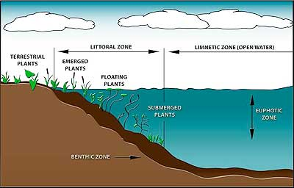
Lake Ecosystems
Zones:
Littoral → area from shore to where no more plants grow in the lake bottom
Limnetic → area where there is open water and sufficient light for photosynthesis to occur
Profundal → area in which no photosynthesis can occur (below limnetic zone)
Notes:
Where might you find algae? Snails? Cattails? Fish? Why might these organisms not survive in other areas of the same lake? What about the temperature of the lake – would it be the same throughout?
In a lake, different zones arise due to the amount of light available, the water temperature and the oxygen levels.
The littoral zone is the most productive part of a lake.
In the limnetic zone, the most abundant organism is plankton (autotrophic and heterotrophic).
The profundal zone is not normally found in ponds, as they are too shallow and light can penetrate to the bottom all the way across. The detritus (dead material) from plants and animals in the limnetic zone provides nutrients for the profundal zone. Less oxygen at this level, as bacteria and other decomposers use oxygen to decompose detritus.
Assign Thought Lab 3.2 – Forest Habitat and Bird Biodiversity

Slide 8
Zones = Habitats
These zones provide different habitats and niches for different species

Slide 9
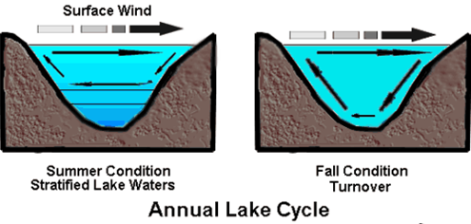
Seasonal Variation in Lakes
Spring and Fall Turnovers cycle the water
Notes:
Water is most dense at 4 degrees Celsius
Epilimnion – the topmost layer of water. Water continually cycles in the epilimnion during summer due to the wind. In the winter, this is the water that is approximately 0 degrees Celsius.
Thermocline – the layer just below the epilimnion in which there is little mixing. There is a sudden drop in water temperature.
Hypolimnion – little or no mixing, depleted oxygen, the most dense part of the lake (approx. 4 degrees Celsius in winter)
The spring and fall turnover help to replenish the oxygen levels throughout the lake. Often the sulfur oxides that have built up in the hypolimnion are released, resulting in a rotten egg, or swamp gas smell.
This is a good point to stop – resume the rest of the section next class

Slide 10
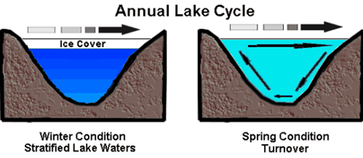
Seasonal Variation in Lakes
In winter and summer, the lake is stratified based on water temperature

Slide 11
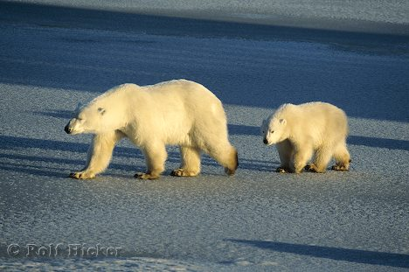
Habitats
Within biomes and vegetation zones are different habitats
Areas with specific biotic and abiotic factors in which organisms are adapted to survive and reproduce
Notes:
The adaptations of the organisms are behavioral, physical, and physiological.

Slide 12
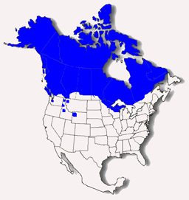
Range
The geographical area in which a species or population is found
Limited by habitat
requirements

Slide 13
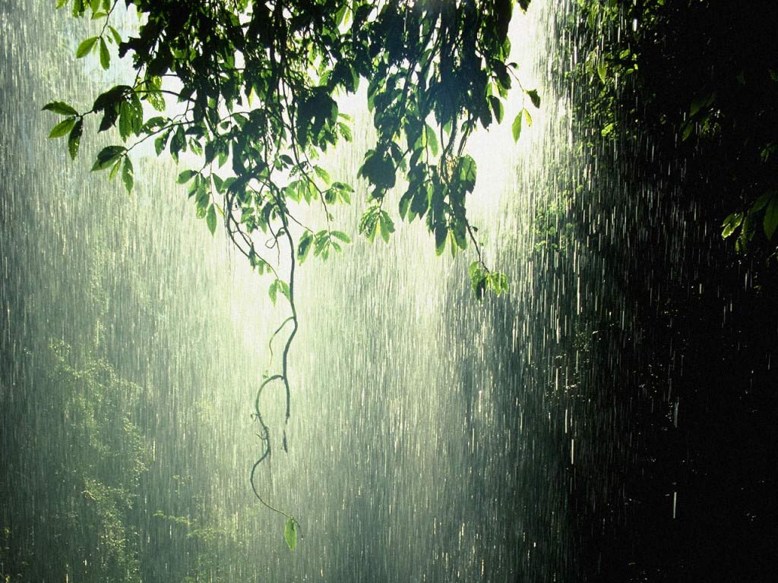
Limiting Factors
Can be living or non-living

Slide 14
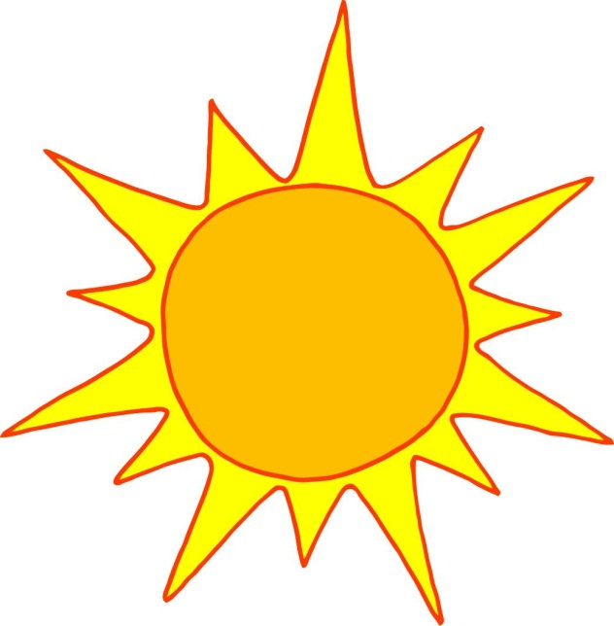
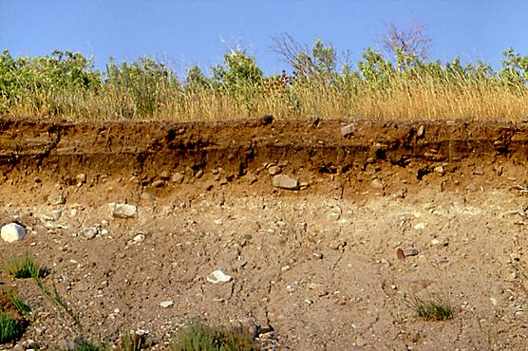
Abiotic Limiting Factors
Soil conditions
Temperature
Moisture
Humidity
Nutrients
Precipitation Levels
Sunlight

Slide 15
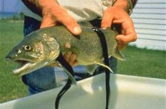
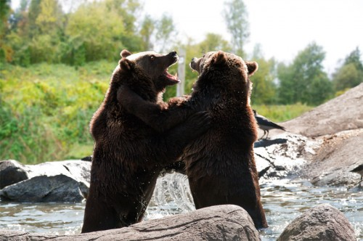
Biotic Limiting Factors
Competition
Predation
Parasitism

Slide 16
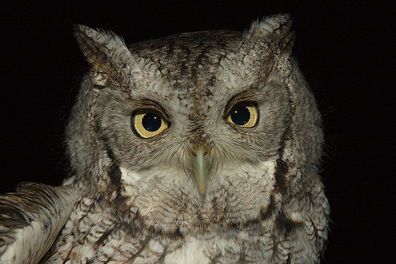
Ecological Niche
The role that a species plays in a community, and the total range of biotic and abiotic factors required for its survival
Many species can share the same habitat as long as they have different niches
Notes:
An organism’s niche includes its habitat, place in the food web, breeding area, and the time of day that it is most active.
Reduces competition among species.

Slide 17
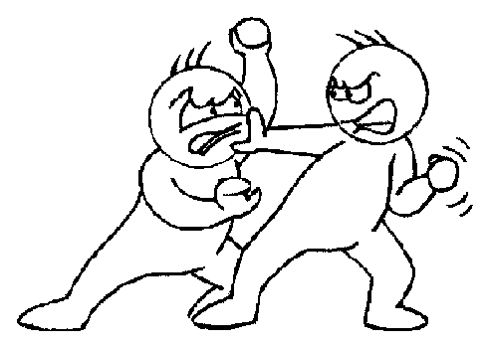
Competition for Niches
Introduction of new species
Natural
Seed Dispersal
Migration of animals
Artificial
Humans introduce new species
Can make it difficult for native species to survive
Notes:
Assign Case Study on page 88 of Nelson Biology (this might be done on one of the days I’m away)

Slide 18
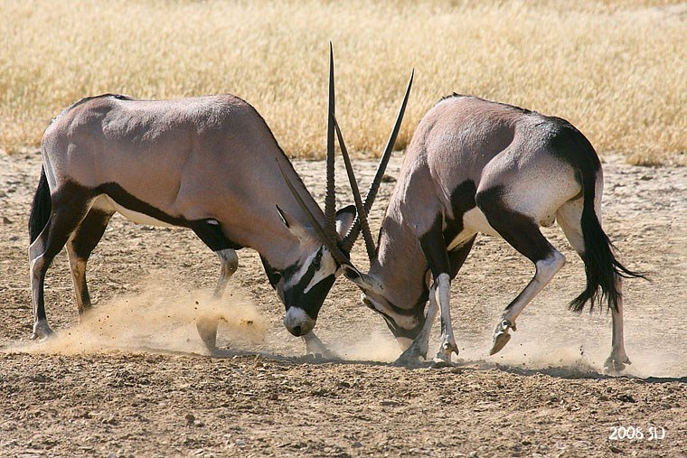
Intraspecific Competition
Members of the same population compete for a limited resource
Notes:
What are some resources that a population (plant or animal) may compete for?
Food
Water
Sunlight
Shelter
Mates
Territory/breeding sites
Assignment → have students complete the Thought Lab 3.3 on page 102. They may use the computers to research knapweed. (Work in pairs if necessary, give students ~30 min) http://www.ag.ndsu.edu/pubs/plantsci/weeds/w842w.htm ; http://www.invasivespeciesinfo.gov/plants/spotknapweed.shtml

Slide 19
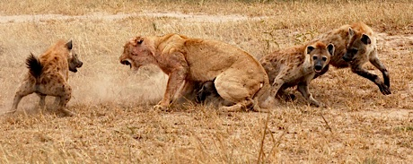
Interspecific Competition
Two or more different populations compete for a limited resource
Same niche → one population or species will eventually disappear from the area

Slide 20
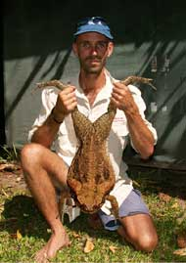
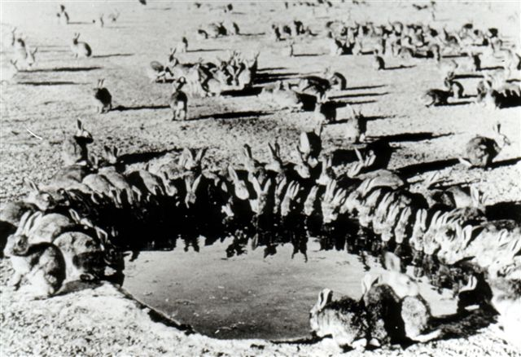
Invasive (Exotic) Species
Invasive Species
Lack natural population controls
Can out-compete native species
Change natural ecosystems
Expensive and difficult to control
Notes:
Homework – P. 108 #1-5

