Slide 1
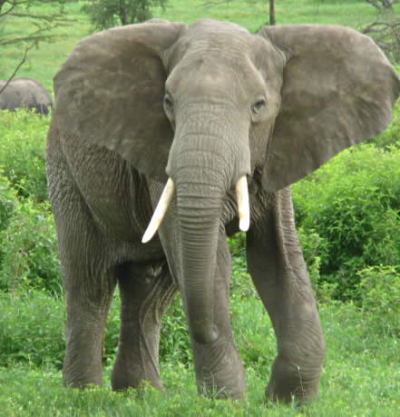
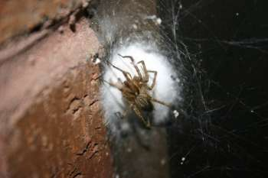
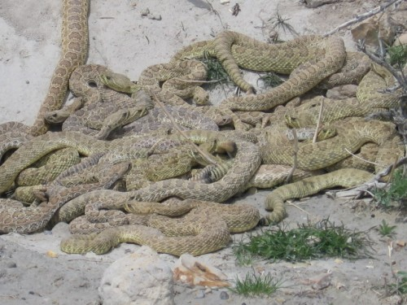
Population Growth and Interaction

Slide 2
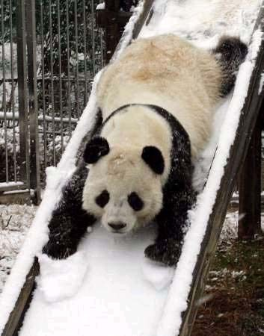
Biotic Potential
Highest possible per capita growth rate for a population.
Factors which contribute to biotic potential are:
Number of young per reproductive cycle
Number of young surviving to reproduce
Age of reproductive maturity
Life span of animals

Slide 3
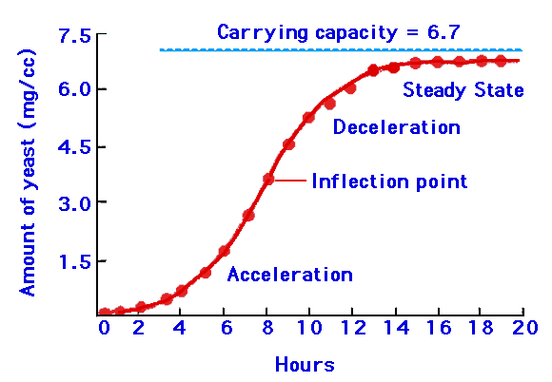
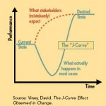
Types of Curves Describing Population Growth
S- shaped – logistic growth pattern
Lag phase
Exponential phase
Stationary phase
J- Shaped
Lag phase
Exponential phase

Slide 4
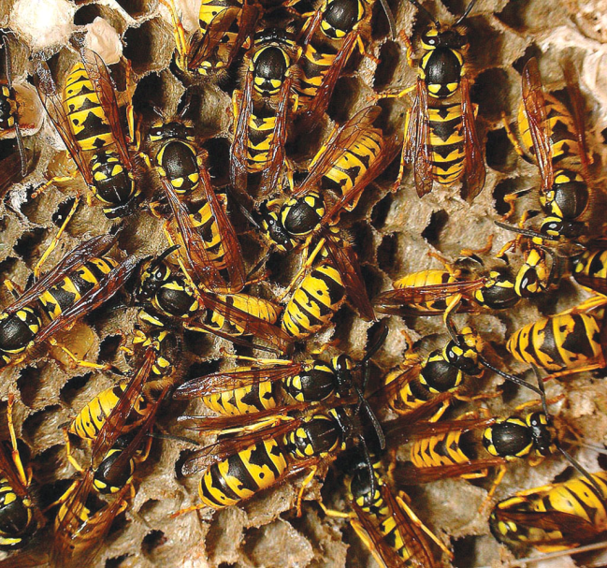
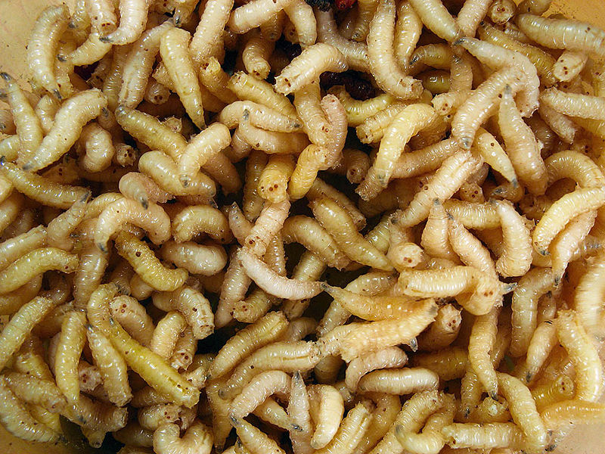
Life Strategies
r – selected – reproduce close to biotic potential
Short life span
Early reproductive age
Large groups of offspring with little to no parent care.

Slide 5
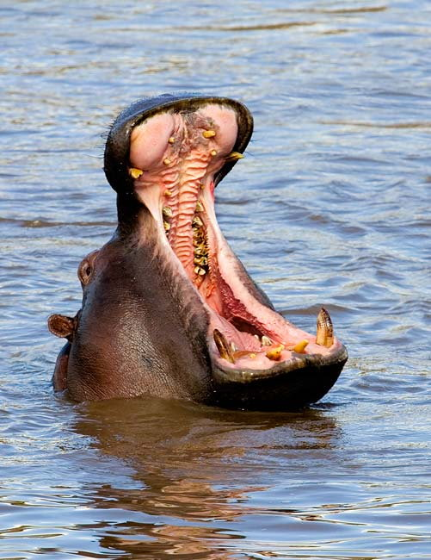
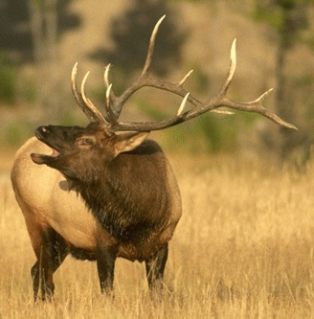
K – selected – reproduce close to their carrying capacity
Few offspring per reproductive cycle
Live for relatively a long period of time
Take a long time to get reproductive age
Lots of parental involvement

Slide 6
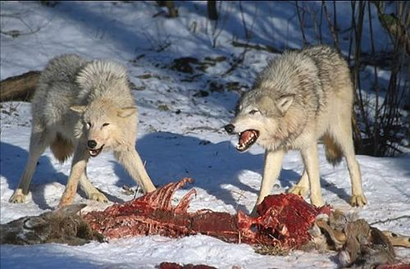
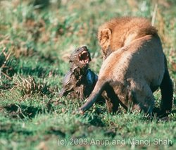
Population Interactions
Intraspecific Competition
Competition for limited resources among the same species
Interspecific Competition
Competition for limited resources between different populations

Slide 7
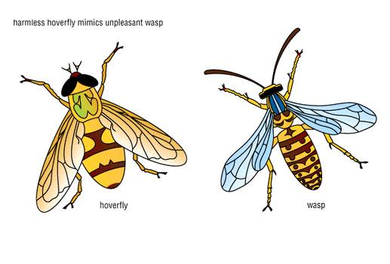
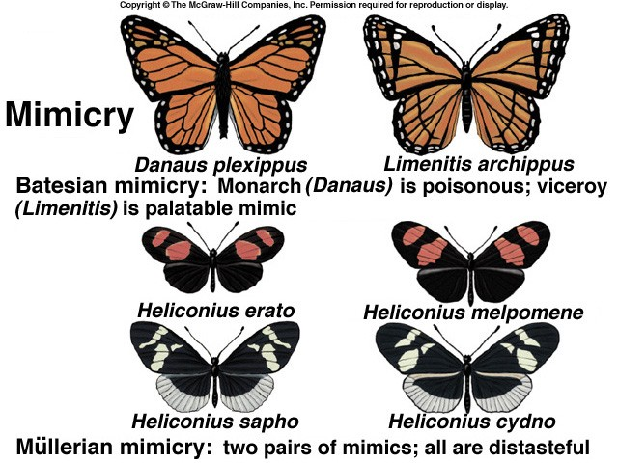
Mimicry
The look alikes
Bastesain – look like a well defended model
Mullerian – two different species with are both poisonous helps to look alike.

Slide 8
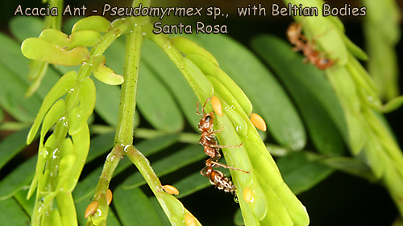
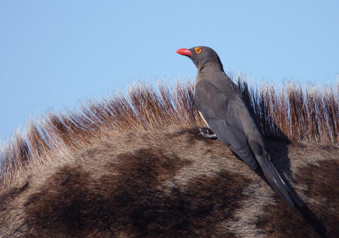
Symbiosis
Mutualism – both partners in a symbiotic relationship benefit or depend on it in order to survive.

Slide 9
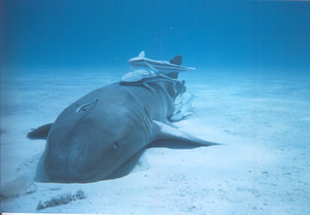
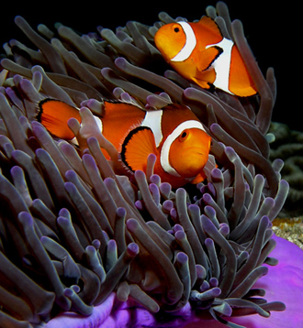
Symbiosis
Commensalism – symbiotic relationship on partner benefit and the other neither benefits nor is harmed.

Slide 10
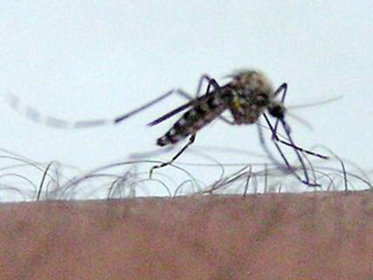
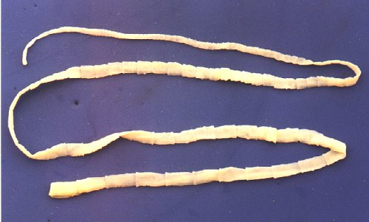
Symbiosis
Parasitism – one partner benefits and the other, the host, is harmed

