Slide 1
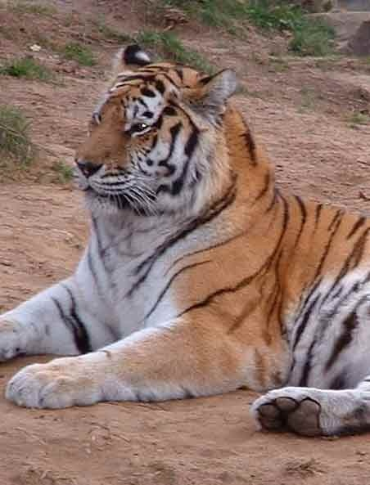
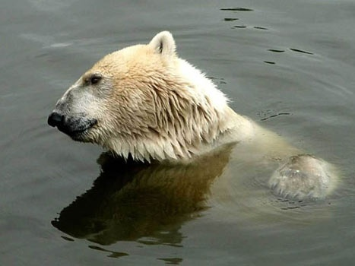
Population Changes in Density and Size
Notes:
1

Slide 2
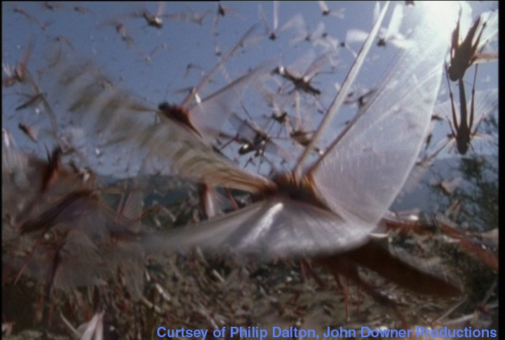
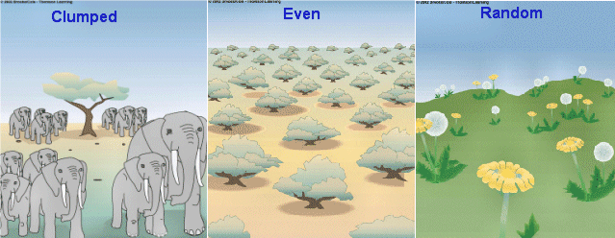
Population Density & Dispersion
Notes:
2

Slide 3
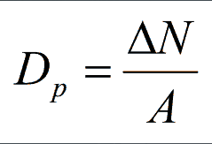
Density
Density describes the number of organisms in a defined area.
Can be found with the following formula:
D_{p} = N / A (or D = N / S in Nelson)
D_{p} is density
N is number of organisms
A is area
Notes:
3

Slide 4
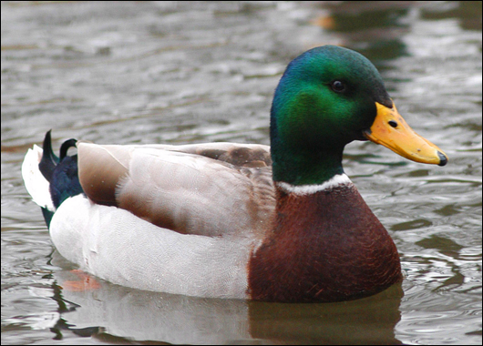
Density Example
In northern Alberta, a study of ducks in a specific 40 ha area showed some significant changes in population. Use the data from the study showing the population changes over a five year period to answer the question
Duck Gender | 1989 | 1990 | 1991 | 1992 | 1993
Males | 40 | 45 | 50 | 60 | 25
Females | 40 | 45 | 48 | 40 | 20
Notes:
4

Slide 5
Example Continued
D₁₉₈₉ = N/A
= 80 ducks/40 ha
= 2.0 ducks/ha
D₁₉₉₃ = N/A
= 45 ducks/40 ha
= 1.1 ducks/ha
Is this population changing?
How can we describe that change?
Notes:
5

Slide 6
Change in Density
Changes within a population over time is referred to as R or rate of change.
R could be many things. Lets use it for density. Therefore
R_{D} = ∆D/ ∆ t
R_{D} is rate of density change
∆D is change in density, calculated with: ∆ D = D_{f} – D_{i}
∆t is change in time, calculated with: ∆ t = t_{f} – t_{i}
Notes:
6

Slide 7
Rate of change, density example
Rate of change for density of ducks from 1989 to 1993
D₁₉₈₉ = 2.0 ducks/ha, D₁₉₉₃ = 1.1 ducks/ha
R₁₉₈₉₋₉₃ = ∆D/ ∆t
= (1.1 – 2.0)ducks/ha
1993 – 1989
= -0.9 ducks/ha
4a
= -0.225 ducks/ha/a
Notes:
7

Slide 8
Size
Notes:
8

Slide 9
Change in Size or Growth
Four factors determine change in population:
Increasing Factors:
Natality (birth) and Immigration
Decreasing Factors:
Mortality (death) and Emigration
An equation for Change in Population Size:
∆N = (natality + immigration) – (mortality + emigration)
Notes:
9

Slide 10
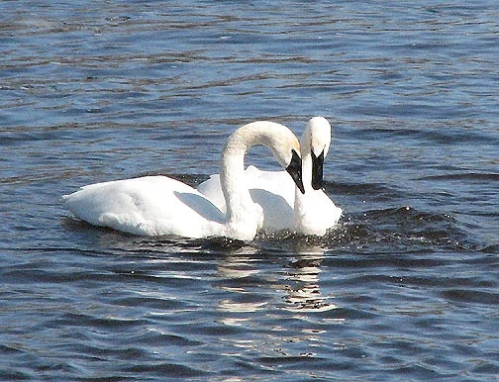
Size Example
A breeding flock of trumpeter swans near Grande Prairie is made up of 50 pairs. This year they had 165 live hatchings, no new birds joined the flock, 5 animals were shot, and 8 did not return this spring.
How has the population of trumpeter swans changed.
∆N = (natality + immigration) – (mortality + emigration)
∆N = (165 + 0) – (5+8) = 152
Therefore this flock gained 152 new members!
Notes:
10

Slide 11
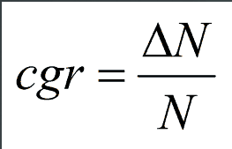
∆Size per capita
Per capita growth rate relates change in population size to the original population
From our swan example. the cgr would be:
cgr = ∆N / N
cgr = 152 / 100 = 1.52
Therefore this pop is growing by 1.52 swans per swan.
Notes:
11

Slide 12
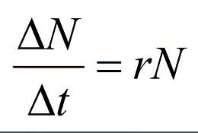
∆Size per capita per time
Growth usually considers a time frame as well. Adding this to our formula gives:
cgrN = ∆N / ∆t
This type of growth is referred to as just Growth rate. Growth rate considers all of these factors:
initial size
per capita growth rate
factors affecting size
time
Notes:
12

Slide 13
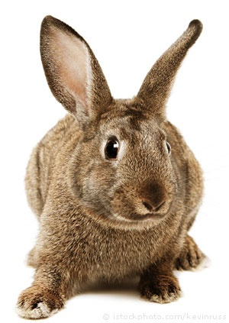
Growth Rate Example
A population of 100 rabbits has a growth rate of 0.1 per year.
What is the change in population for the first year?
rN = ∆N / ∆t rewrite for ∆N, ∆N = rN ∆t
∆N = 0.1 x 100 x 1 = 10 rabbits
What is the population at the end of the first year?
100 + 10 = 110 rabbits
What is the change in population for the second year?
∆N, ∆N = rN ∆t
∆N = 0.1 x 110 x 1 = 11 rabbits
What is the population at the end of the second year?
110 + 11 = 121 rabbits
Every year the size of the increase grows, but the rate remains the same.
Notes:
13

Slide 14
Homework
P. 745 # 1, 2
P. 747 # 3
P. 750 #1, 2

