Slide 1
Recycling Matter Nitrogen Cycle
The flow of nutrients between organisms and their environment is referred to as a biogeochemical cycle.

Slide 2
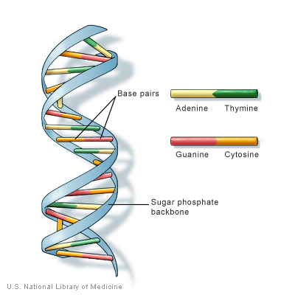
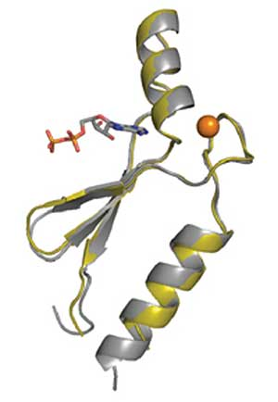
Nitrogen is Important
Needed for Proteins (amino acids)
Needed for Nucleic acids (DNA)

Slide 3
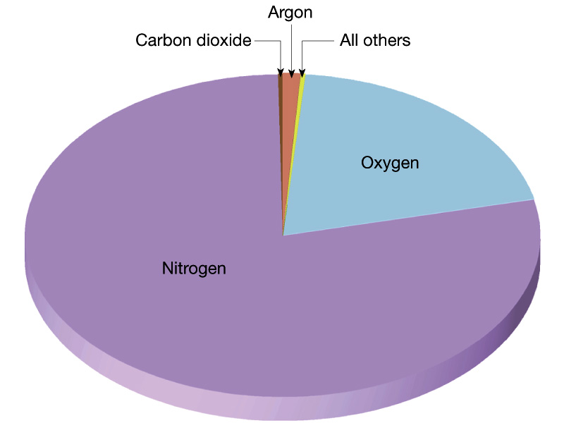
Inert in the Atmosphere FYI
Although it makes up a whopping majority of the atmosphere, N2 is too stable to be used in metabolic processes.

Slide 4
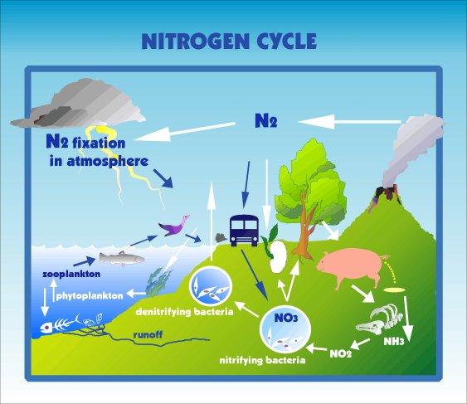
Creation of Nitrates
Small amount by Lightening
Majority by Nitrogen fixing bacteria
Nitrogen fixing bacteria
N₂ to Ammonia or NH₃⁺
Nitrifying bacteria
Ammonia to Nitrite or NO₂⁻
Nitrite to Nitrate or NO₃⁻
Used by plants

Slide 5
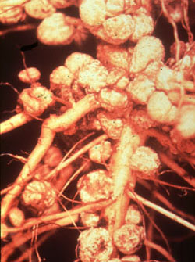
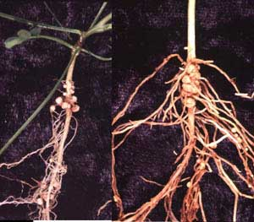
Bacteria live symbiotically
grow in nodules on the roots of many species of plants in a symbiotic relationship
bacteria get sugar from the plant, the plant gets nitrates

Slide 6
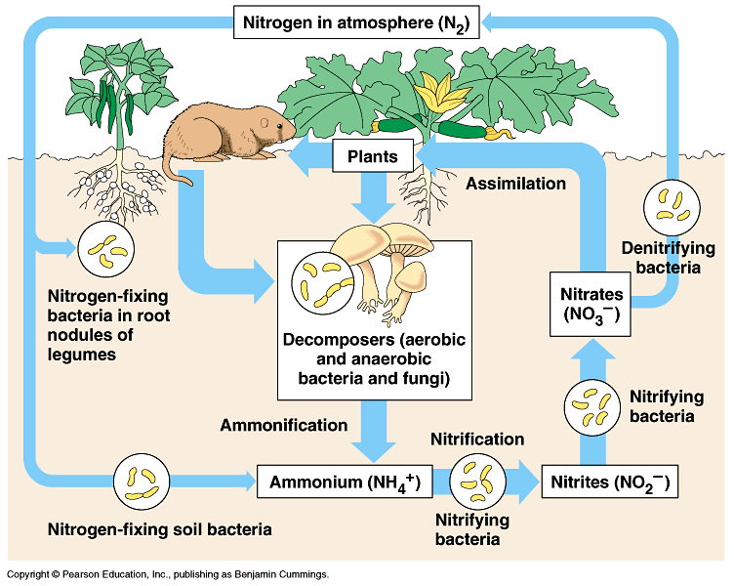
Animals must consume
Animals must consume their nitrogen, by either eating plants, or by eating other animals.

Slide 7
Nitrogen Recycled
Organic waste converted into Ammonia
Bacteria then continue the conversion till Nitrate (NO₃⁻) is reached
Denitrifying bacteria can covert either nitrites or nitrates back into N₂
Released into the atmosphere.

Slide 8
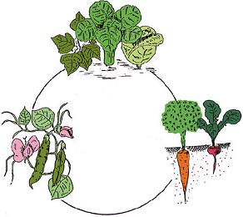
Managing Nitrogen
Crop rotation
Nitrogen fixing bacteria produce more nitrogen then their host plant uses. The excess nitrates are released into the soil.
Aerating lawn
Denitrifying bacteria are anaerobic (they don’t like oxygen).
Adding oxygen to the soil kills them and prevents the loss of nitrates.

Slide 9
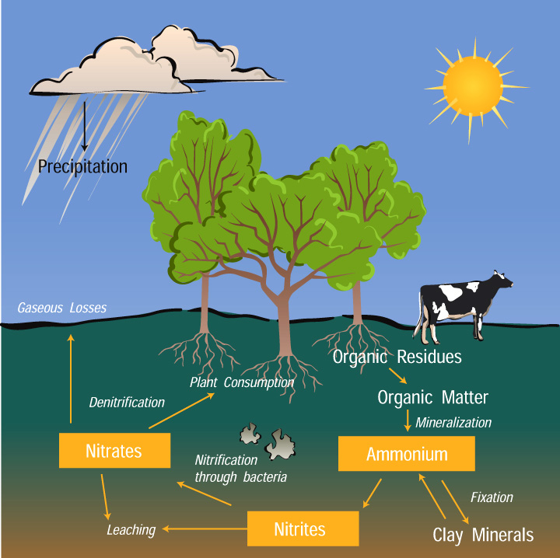

Slide 10
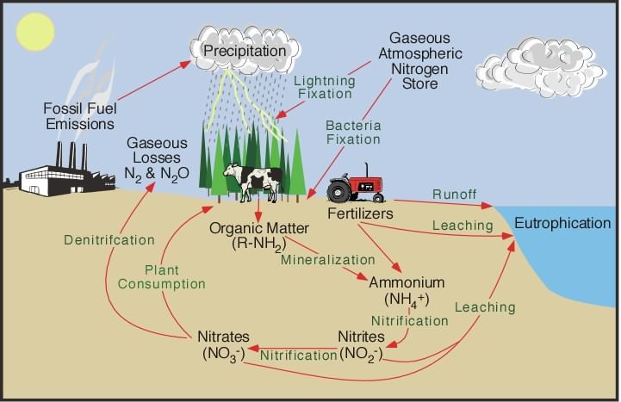

Slide 11
Recycling Matter Phosphorus Cycle
The flow of nutrients between organisms and their environment is referred to as a biogeochemical cycle.

Slide 12
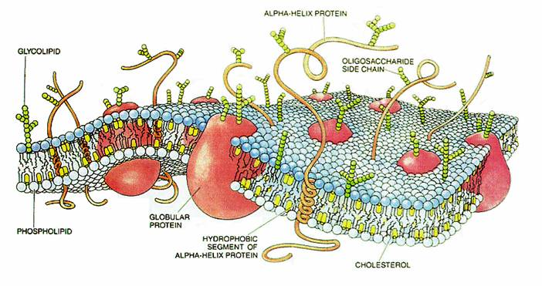
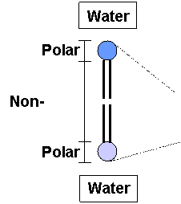
Phosphorus is Important
Needed for cell membranes
Phospholipid by-layer
ATP (adenosine triphospate) or cellular energy
Bone construction

Slide 13
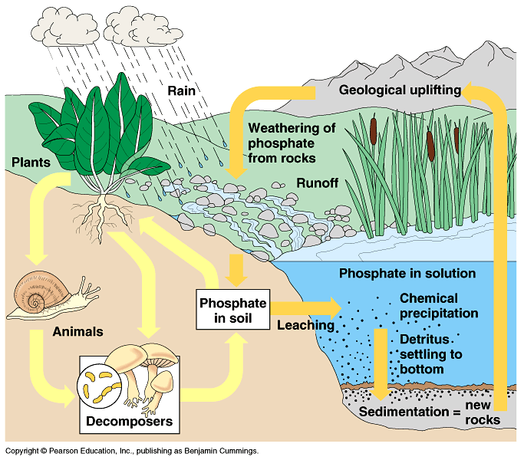
Two Large Cycles
Long Cycle
Phosphate ions combine with other elements and are deposited in rocks.
Short Cycle
Phosphates dissolved in water and taken up by living organisms.
Neither involved phosphorus in the atmosphere.

Slide 15
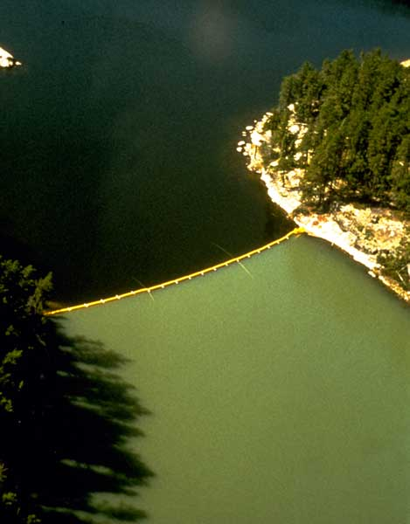
Effects of Excess Phosphate
Low phosphate levels keep plant growth in check.
Excess phosphate in water bodies can lead to algal blooms which can then lead to eutrification of the body of water.

