Slide 1
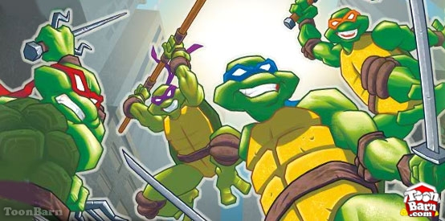
Mutations & Genetic Recombination

Slide 2
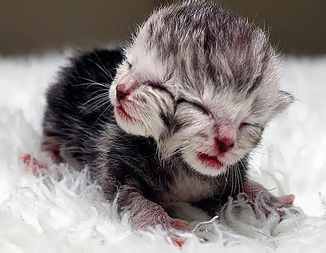
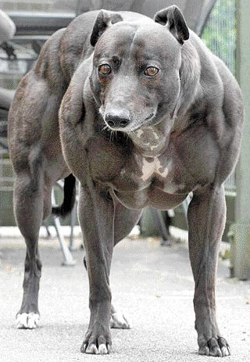
What is a mutation?
Somatic cell – body cell (key cause of cancer)
Germ cell – reproductive cell (passed onto future generations)
Permanent change in the genetic material of an organism

Slide 3
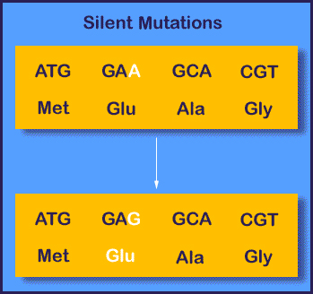
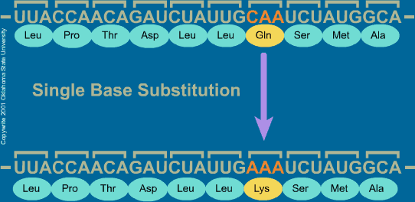
Types of mutations
Point mutation – small changes into nucleotide order.
Silent mutation – no affect on the cell's metabolism

Slide 4
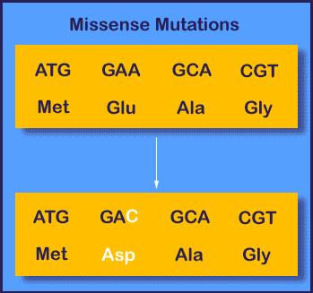
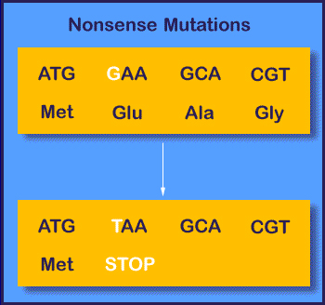
Mis-sense mutation – altered but still functional protein
Nonsense mutation – makes the code impossible to use for a new protien

Slide 5
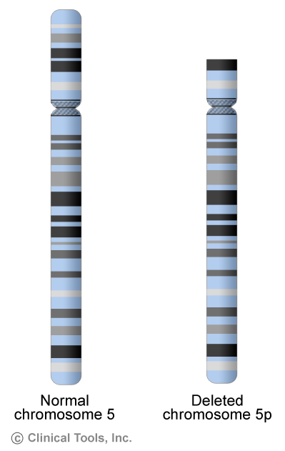
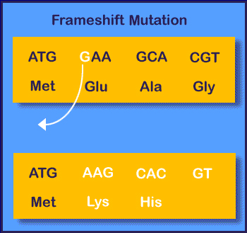
Frameshift mutation – insert or delete one or two nucleotides causes a “shift” in how a code is read.
Chromosomal mutations – deleting or adding whole parts to a chromosome

Slide 6
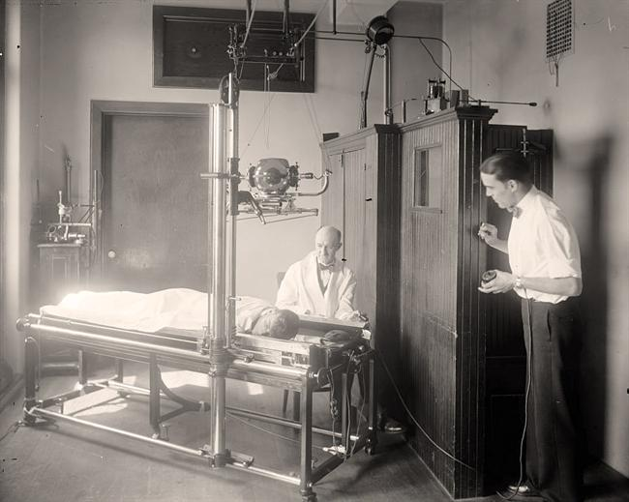
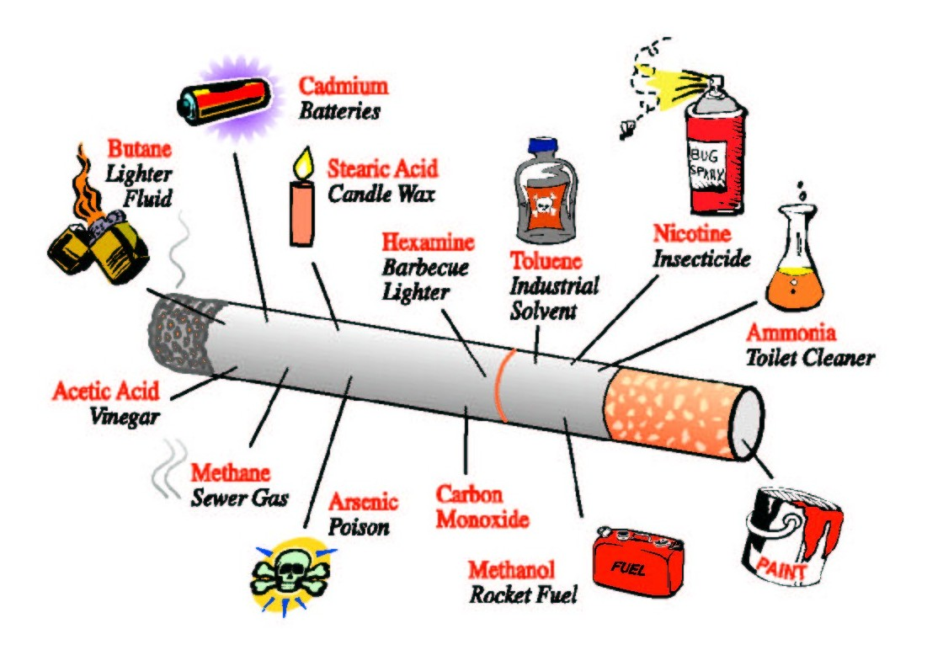
Causes of Mutations
Physical mutagens
  X-rays
  UV rays
  Gamma rays
Chemical mutagens
  Carcinogens
  Nitrates
  gasoline

Slide 7
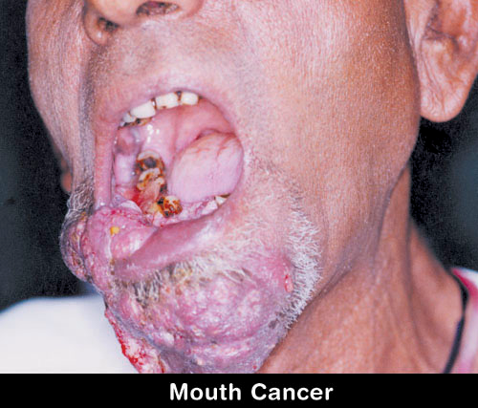
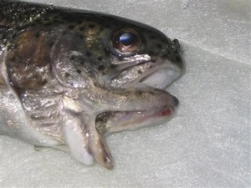
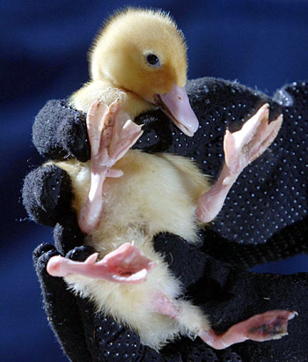
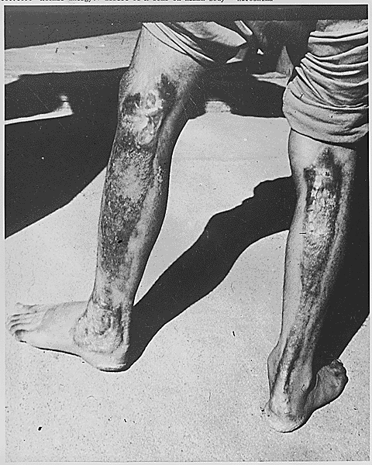
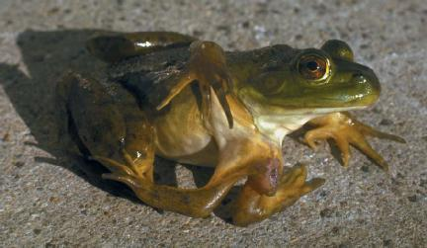
Results of Mutations

Slide 8
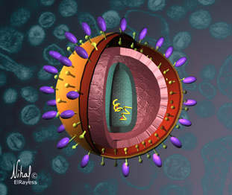
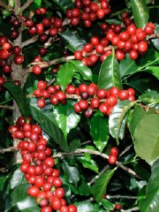
Protein Synthesis
Mutations lead to genetic diversity!
Viruses like HIV mutate very quickly. The mutations cause physical differences in the virus. This is why it is very hard to create antiviral medication…because the virus is always changing faster than the medication can be developed!
Several coffee plants have been developed in nature because of polyploidy – a mutation where the embryo has double the number of chromosomes it should! Rather than die, the embryo develops into a new species of plant!

Slide 9


Protein Synthesis
Random mutations lead to genetic diversity!
Random mutation Here!
Who else will have
the mutation?

Slide 10
Protein Synthesis
Mutations Provide Genetic Diversity!
Imagine one mutation shows up, all the offspring will have that mutation as well.
Imagine over thousands of generations, how many mutations have occurred!
We can use the pattern of mutation inheritance to trace family ancestry!
The closer the relation between two people, the greater the similarity in DNA sequences!
The genetic difference between one person and another is less than 0.1 %

Slide 11
Protein Synthesis
Mutations Provide Genetic Diversity!
The DNA that we test for family relations (such as paternity testing) comes from more than just the nucleus of the cell (although we do test DNA from the nucleus).
CHLOROPLASTS and MITOCHONDRIA also contain DNA!!!
In humans, we can sequence mitochondrial DNA to analyze the maternal family line of an individual.

Slide 12
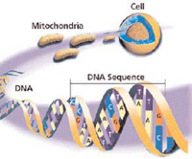
Protein Synthesis
Mutations Provide Genetic Diversity!
Mother’s mitochondria are located in each egg.
So mother’s pass on mitochondrial DNA to each of her offspring.
When a mother gains a mutation in her mtDNA, she passes it on to her offspring.

Slide 13
Protein Synthesis
DNA fingerprinting
DNA fingerprinting is used to compare DNA samples from different locations.
It can be used to match parents to children and it can be used to match blood stains at a crime scene to a suspect.
The more similar the pattern, the closer the two samples are related!
NOTE: DNA FINGERPRINTING WORKS BECAUSE EACH PERSON HAS A DIFFERENT NUMBER OF RESTRICTION FRAGMENT LENGTH POLYMORPHISMS (RFLP) THAT SHOW UP IN THE FINGERPRINT.

Slide 14
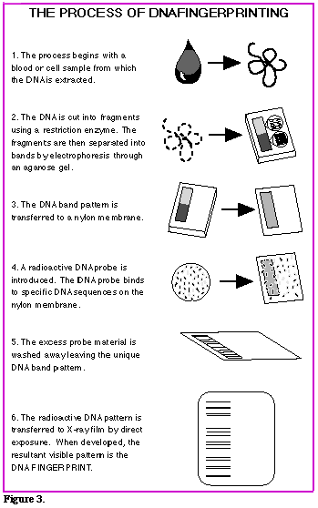
Protein Synthesis
DNA fingerprinting procedure
Collection of sample
Cut DNA with restriction enzymes
Separate DNA segments use gel electrophoresis
Blot DNA segments onto paper
Put radioactive probe on the paper with DNA segments
Take a look using x-ray film!
Check out electrophoresis

