Slide 1
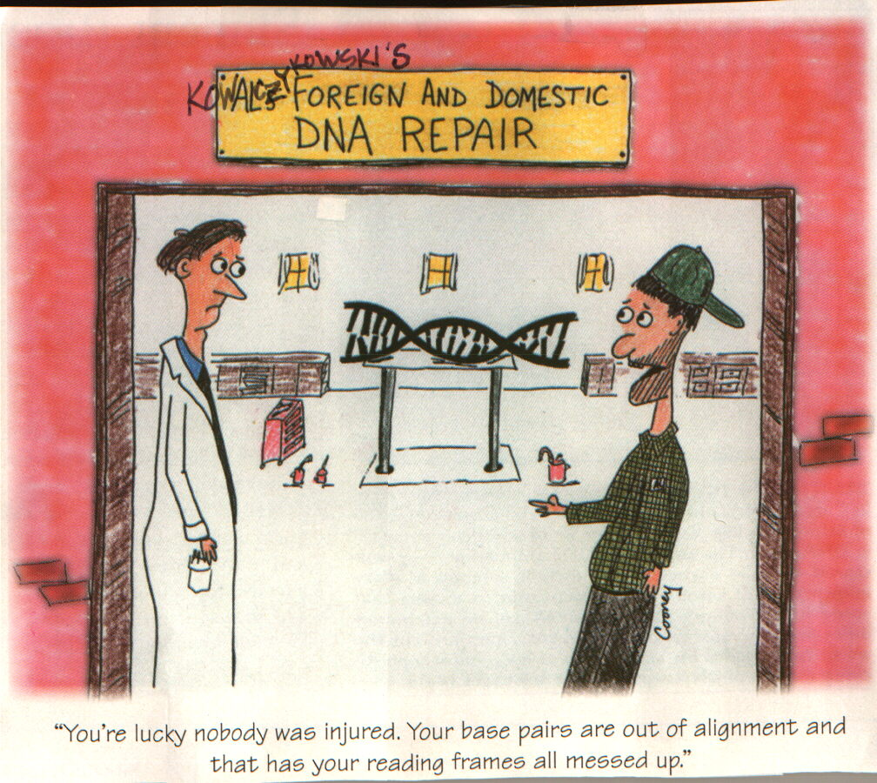
Protein Synthesis

Slide 2
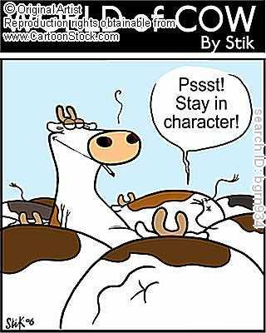
DNA – repeat performer
mRNA – messenger RNA
tRNA – transfer RNA
Amino acids (a.a.)– building blocks of proteins
Codon – set of three bases in mRNA
Anticodon – set of three bases in tRNA
Introducing all Characters

Slide 3
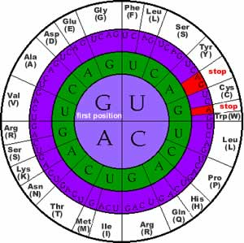
The Genetic Code
The sequence of nucleotides in DNA or RNA (usually read from mRNA) that
determines the specific amino acid sequence in the synthesis of proteins.
Three important characteristics
Redundant – on codon can represent more than on a.a.
Continuous – no spaces, no overlap, no punctuation
Universal – almost all living organisms use the same genetic code.

Slide 4
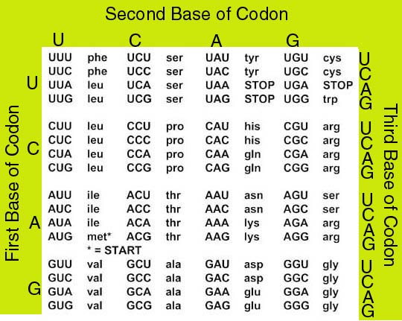
mRNA Codons & Amino Acids

Slide 5
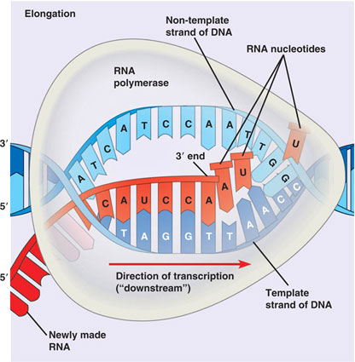
Transcription
Happens in the nucleus
Segment of DNA is copied by mRNA “promoter” DNA – a specific sequence of bases is where RNA start copying RNA using RNA polymerases to copy DNA
To until mRNA hits a “stop” sequences of DNA

Slide 6
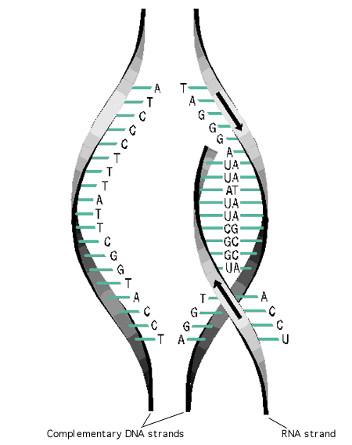
Things to Note about Transcription
mRNA can only be made in 5’to 3’ order
Split DNA has a sense strand (one being copied) and an anti-sense strand (not being copied) RNA is only one strand, therefore no Okazaki fragments.

Slide 7
PRACTICE
Consider the following DNA strand:
Note here we are just looking at one side of the DNA molecule which remember is double stranded!
Provide the sequence of a.a.
DNA: TAC CGT TCT GCT AAA TAT ACC ACT

Slide 8
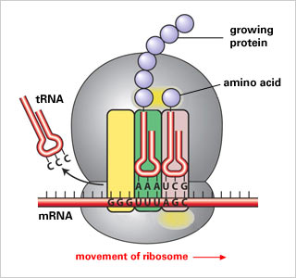
Translation
mRNA goes out of the nucleus and into the cytoplasm
3. Ribosome moves along the mRNA so the tRNA can break off and a new loaded tRNA can join.
Translation happens in the ribosome (which acts like the reader)
Three steps:
1. A tRNA (loaded with a.a.) attaches to the mRNA’s codon
2. A second anticodon (tRNA arrives and attaches), the now empty tRNA breaks off to find new a.a.

Slide 9
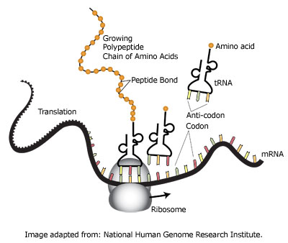
Translation

Slide 10
How to make PROTIEN – Summary!
Starting point = DNA
DNA changes transcribed to mRNA (nucleus)
mRNA translated by ribosomes (cytoplasm)
tRNA organizes amino acids from mRNA template
Amino acids strung together make specific protein.

