Slide 1
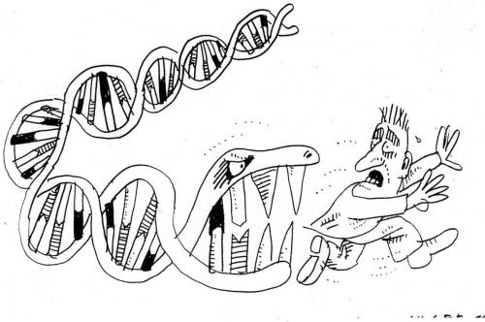
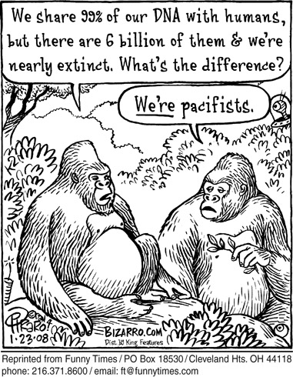
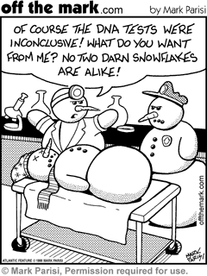
DNA Replication

Slide 2
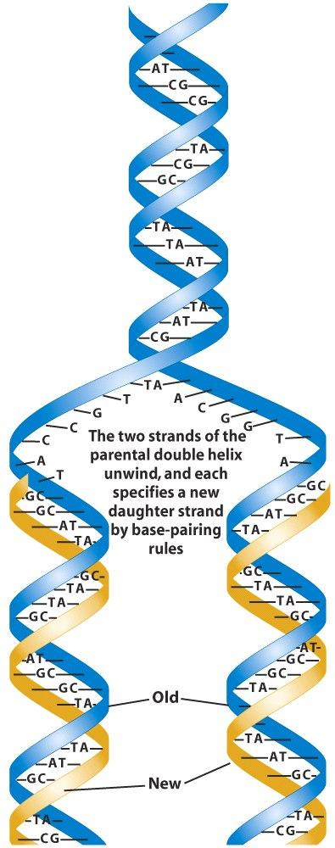
Semi – Conservative Replication
Each new DNA molecule contains one strand of new DNA and one strand of old DNA Each new DNA molecule conserves half of the original molecule.

Slide 3
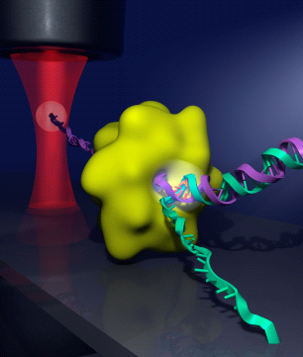
How to start!
“replication origin” is a specific nucleotide sequence
Helicase “reads” this sequence and binds to this site.
Helicase unwinds and pulls apart the DNA helix

Slide 4
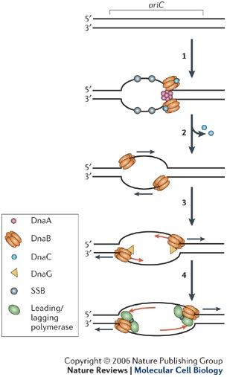
Tacking down DNA
Single stranded binding proteins (SSBP) – act as “tacks” and hold the DNA straight and stable to make replication easier

Slide 5
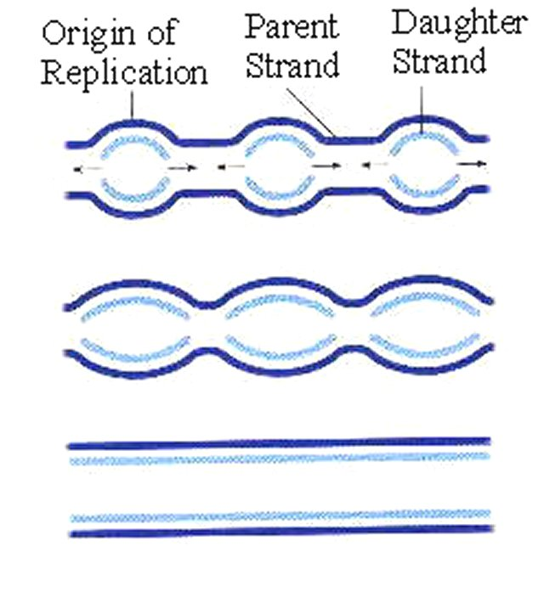
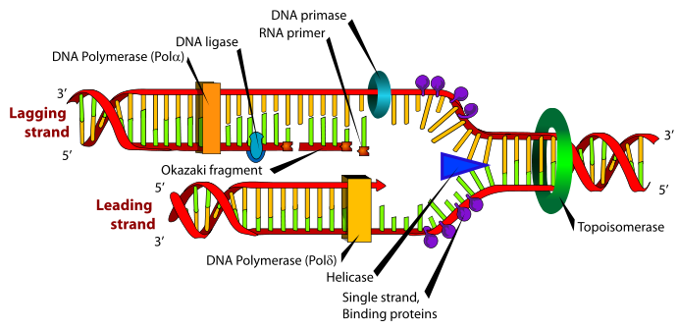
The BUBBLE vs. The FORK
Replication Bubble – oval shape unwound area
Replication fork – the y-shaped area in each bubble.
These are happening in many places, at the same time, along a DNA helix

Slide 6
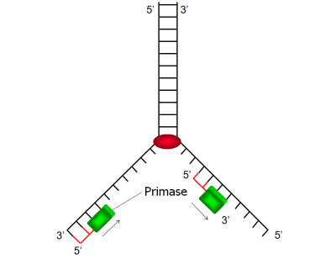
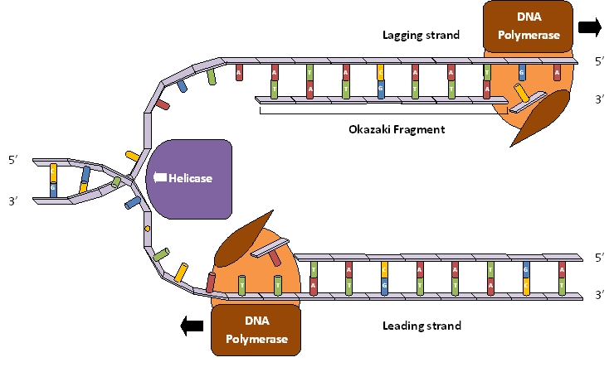
Priming the Replication Machine
Replication only happens in a 5’ to 3’ pattern – meaning the 5 carbon on the sugar molecule vs. the 3 carbon on the sugar molecule
RNA Primer (made by primase) – enters the bubble first, and “primes” the DNA wall

Slide 7
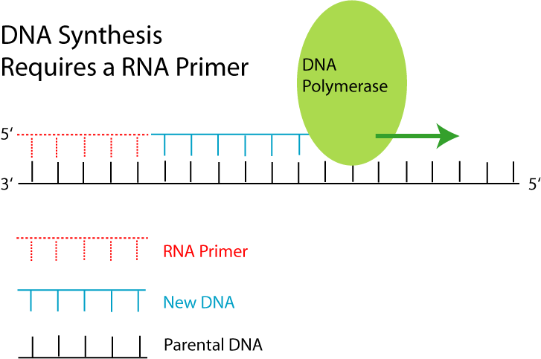
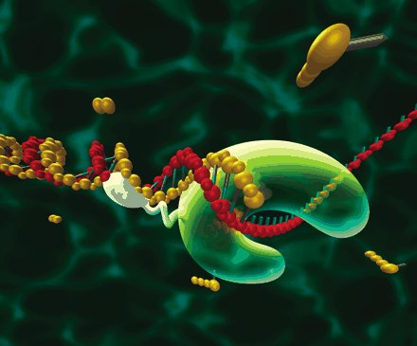
The Building Begins
DNA Polymerase
Enters the replication bubble and begins to add nucleotides to the existing strand.
There are free floating nucleotide in the nucleus
This building process is called elongation.

Slide 8
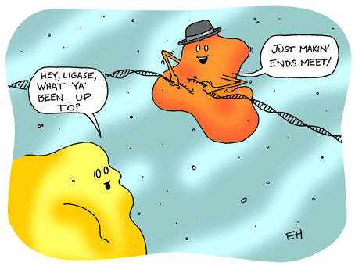
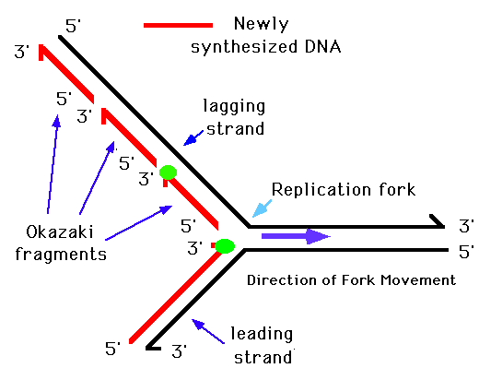
Leading and Lagging Strands
Leading strand – replicated continuously from 5’ to 3’
Lagging strand – replicated in chunks (Okazaki fragments) which then need to “glued together using DNA ligase.

Slide 9
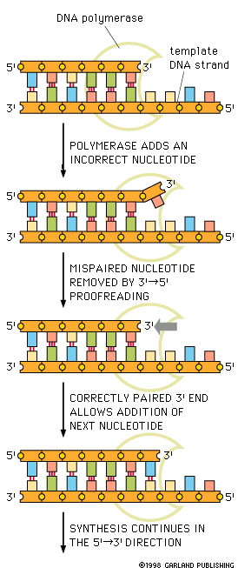
What about Typing Errors?
DNA polymerase
works as a proofreader
Checks to see if hydrogen bond forms between to newly paired nucleotides
If error the polymerase will remove incorrect and put in correct piece.

Slide 10
Interesting Comparison
Imagine:
Typing one letter for each base pair of the human genome
Non-stop and typing one letter per second
It would take you 100 years to complete.
To match the accuracy of the cell
You can only make one typo every 30 years.

Slide 11
In Summary:
Initiation (DNA sequence)
Helicase – unwind and lay flat
SSBP – tack down
Primer (made by primase)
Polymerase – trucks in and attaches nucleotides
Leading – continuous, lagging – Okazaki fragments (glue ligase)
Termination - completion

