Slide 1
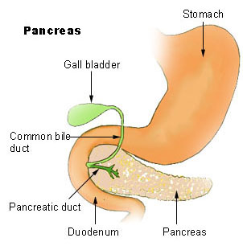
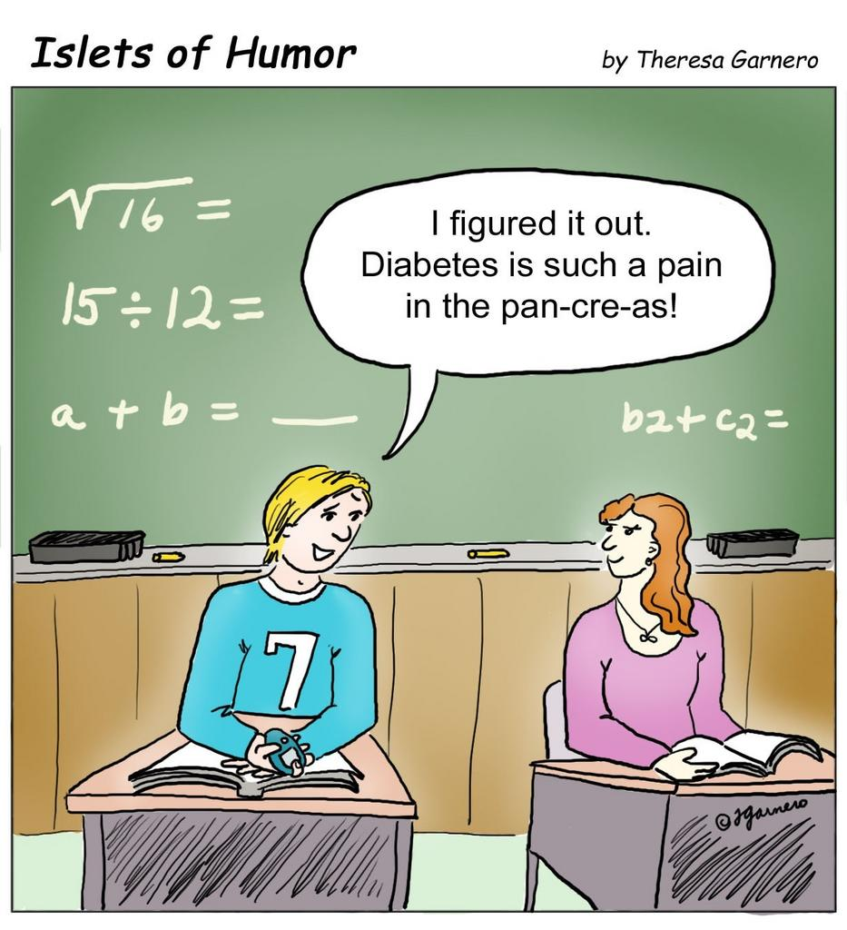
Pancreas
Blood Sugar Regulation

Slide 2
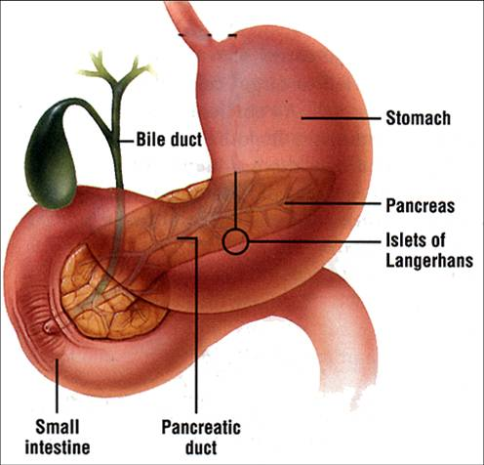
Pancreas
Has both exocrine and endocrine functions
Endocrine: secretes insulin and glucagon into the blood to control sugar levels
Exocrine: secretes digestive enzymes into the small intestine through ducts.

Slide 3
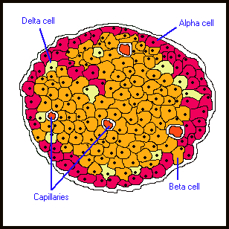
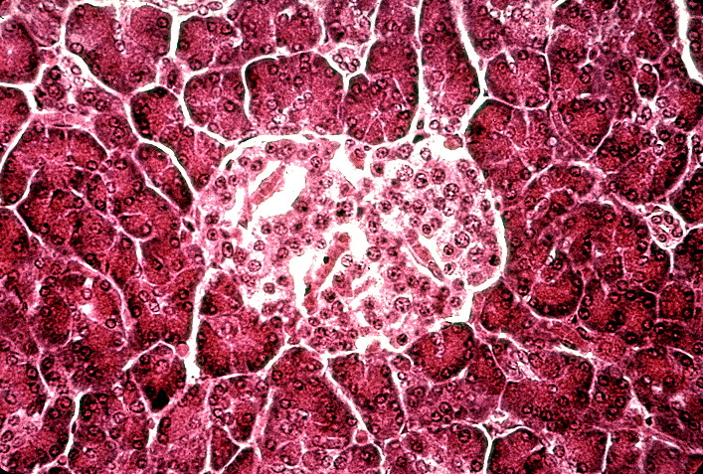
Pancreas
Islets of Langerhans (region in pancreas)
Contains 2 different types of cells
β – Beta cells
α – Alpha cells

Slide 4
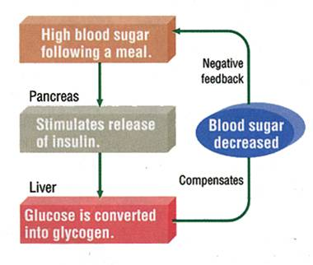
β – Beta cells
- produce insulin.
-Insulin is released as a result of an increase in glucose levels
-promotes the conversion of glucose into glycogen (liver) and cellular glucose absorption

Slide 5
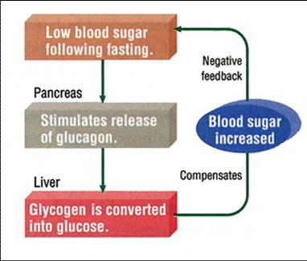
α – Alpha cells
- produce glucagon.
- Glucagon is released as a result of a decrease in glucose levels
- promotes the conversion of glycogen into glucose (liver)

Slide 6
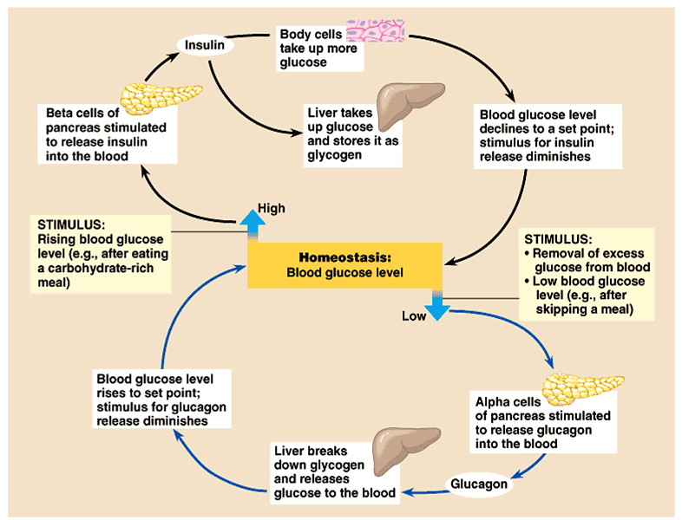
Feedback Loop

Slide 7
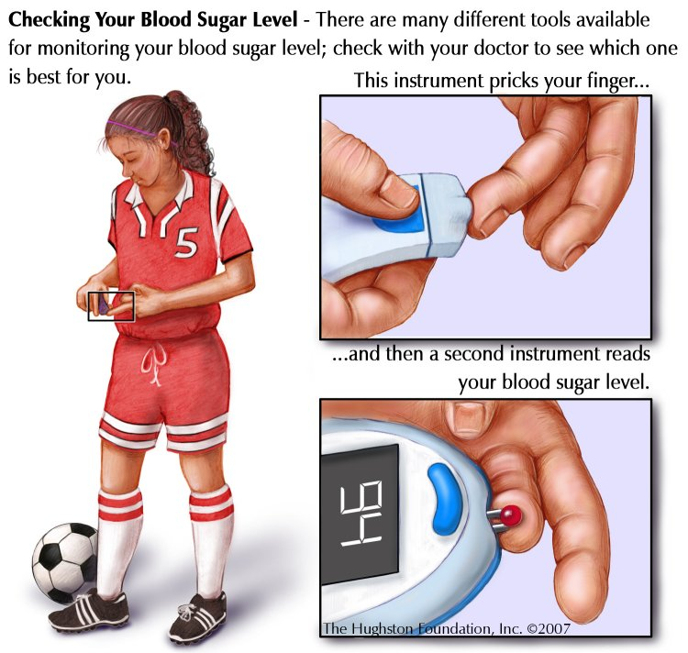
Diabetes Mellitus
Diabetes mellitus (sugar diabetes): inadequate insulin levels
- Low insulin causes too much sugar in the blood (Hyperglycaemia)
Short term effects :
High urine volume
Increased thirst
Fatigue

Slide 8
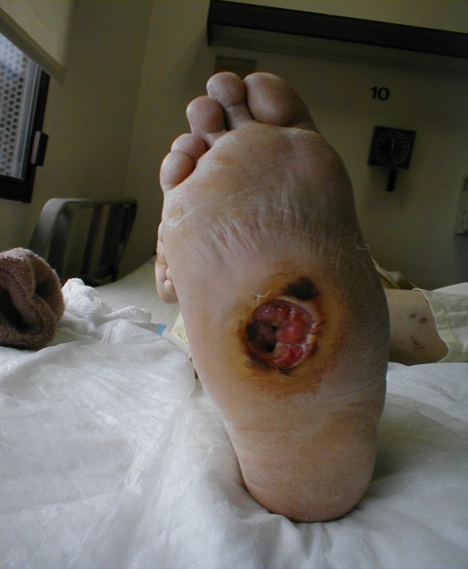
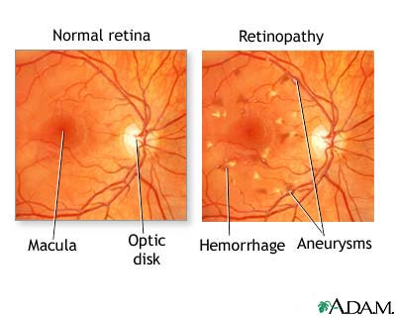
Long Term Effects
eye, kidney, heart problems
trouble with ulcers and feeling in your extremities
glucose in urine
acetone breath

Slide 9
Diabetes Mellitus Types
Type 1 (juvenile) diabetes
treated by insulin replacement
Type 2 (adult) diabetes
controlled by diet or oral drugs (reduce or spread out sugar)
Gestational diabetes
can develop during the late stages of pregnancy.

Slide 10
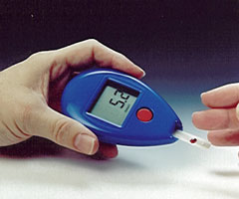
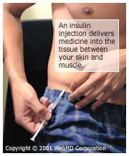
Treatments
- Diet
- Insulin injections
- Insulin pumps
- Islet cell transplants

Slide 11
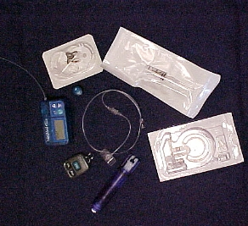
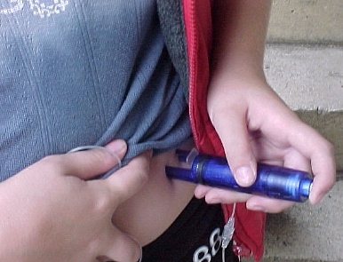
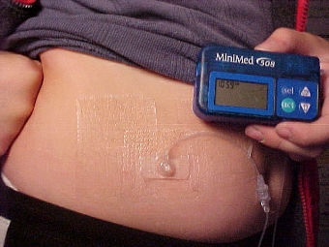
6. Pancreas con’t
The Pump

Slide 12
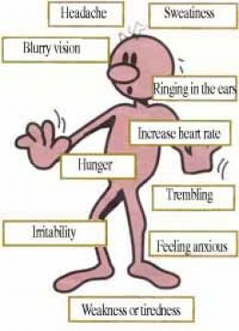
Hypoglycemia
low blood sugar
Can be caused by:
Too much insulin, exercise, alcohol, or heat.
Too little food.
Short Term Effects:
Fatigue
Long Term Effects:
unconsciousness
coma

Slide 13
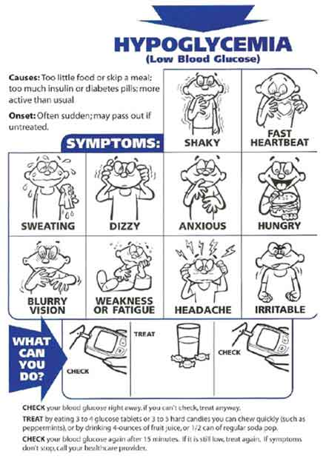
Treatments
Immediate:
Drink sugary drinks or foods
Long Term:
Frequent meals or snacks.

