Slide 1
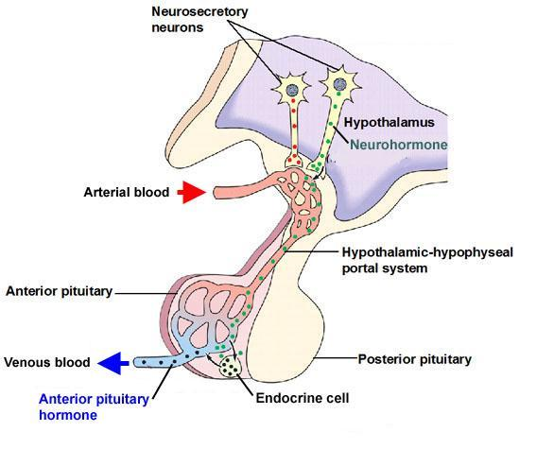
Anterior

Slide 2
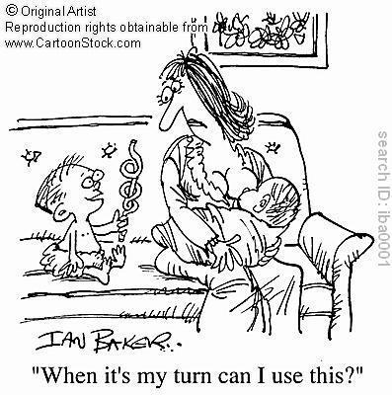
PRL - Prolactin
Malfunctions:
Hyperprolactemia
Women – amenorrhea (no period) and galactorrhea (excessive or spontaneous secretion of milk)
Men – decreased sex drive, decrease sperm count, impotence.
Target
Mammary glands
Primary Function
Stimulates and maintains milk production in females

Slide 3
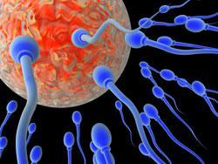
FSH – Follicle Stimulating Hormone
Target
Ovaries or testes
Primary Function
Women – stimulate follicle development in ovaries
Men – promotes development of sperm cells in testes
Malfunction
Decreased in fertility of both men and women

Slide 4
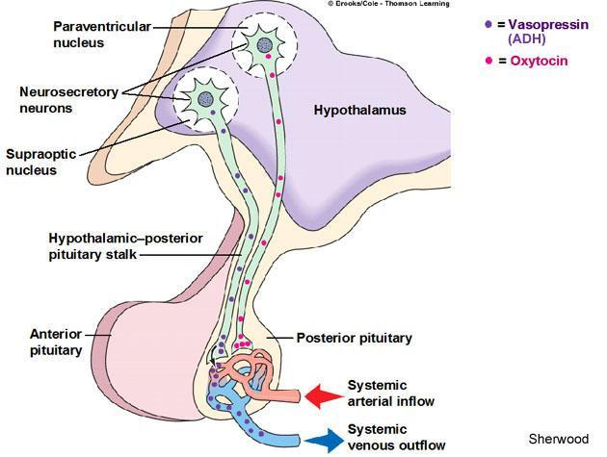
Posterior

Slide 5
OCT - Oxytocin
Target
Uterus
Mammary glands
Primary Function
Initiates strong contractions
Triggers milk production
Malfunction
Stress can decrease production of oxytocin

Slide 6
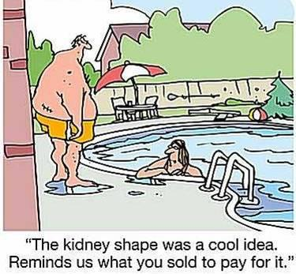
ADH – Antidiuretic Hormone
Target
Kidney
Primary Function
Increase water reabsorption
Malfunction
Hyposecretion – diabetes insipidus – kidneys unable to retain water, leads to frequent urination and thirst.

Slide 7
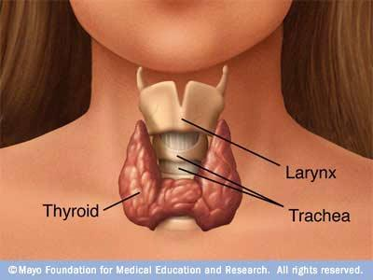
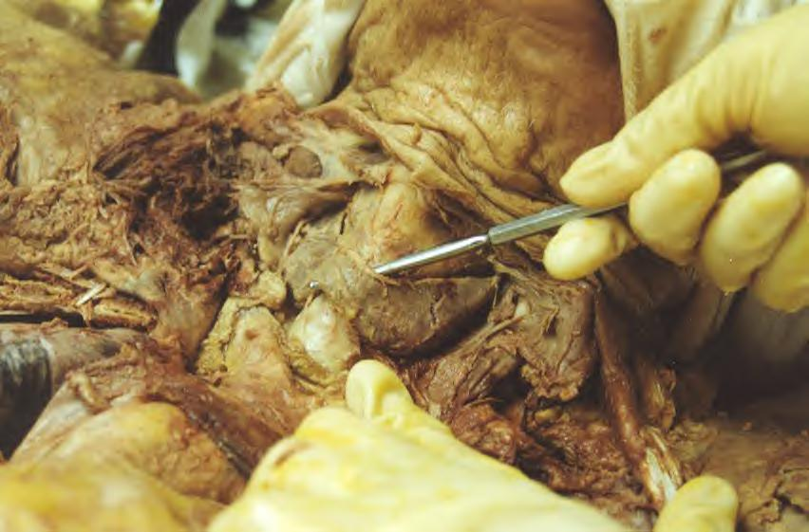

Slide 8
Thyroid Gland
Location and shape
In the front of the throat, below skin and muscle layers
Shaped like a butterfly
Two wings represent each lobe
MAIN FUNCTION TO REGULATES THE BODY’S METABOLISM

Slide 9
Thyroxin – T₄
Target
Body cells
Primary Function
Regulate metabolism
Malfunction
Hypothyroidism – leads to cretinism (children) and dwarfism
Goiters
Hyperthyroidism causes
Irritability
Weight loss
High blood pressure
High pulse rate

Slide 10
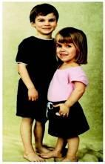
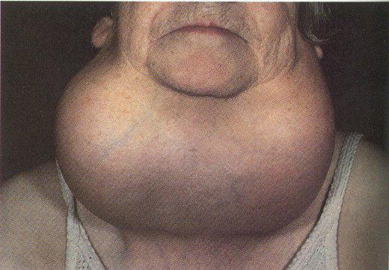
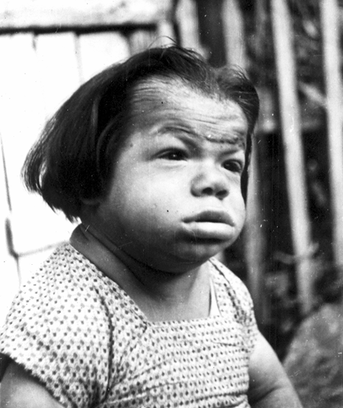
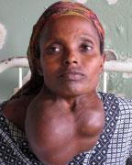
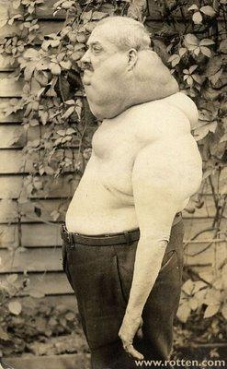
Cretinism
Goiter

Slide 11
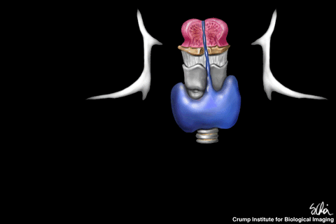
Calcitonin
Target
Blood
Primary Function
Decrease blood calcium levels
Takes calcium from blood and puts into bones

Slide 12
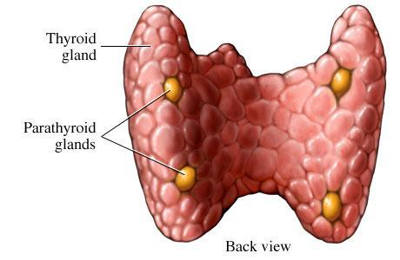

Slide 13
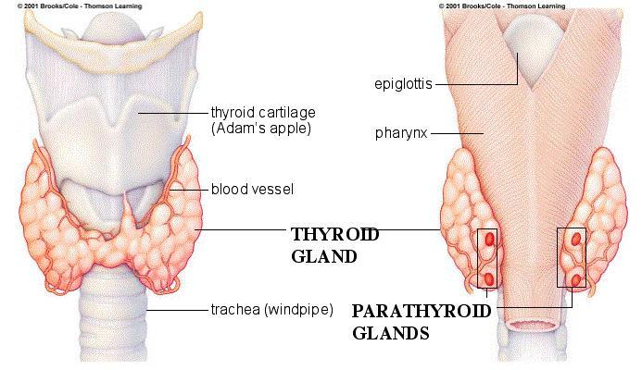
Parathyroid
There are four nodules on the thyroid gland, these are the parathyroid glands
Parathyroid means “beside the thyroid”.

Slide 14
PTH – Parathyroid Hormone
Target
Blood
Primary Function
Increase blood calcium concentrations
Moves calcium from bones to blood
Increase SI absorption of calcium
Malfunctions
Hyposecretion – causes spasms of muscles and disrupts nervous conduction
Hypersecetrion – cause brittle bones or kidney disease, blood clotting time increase.

Slide 15
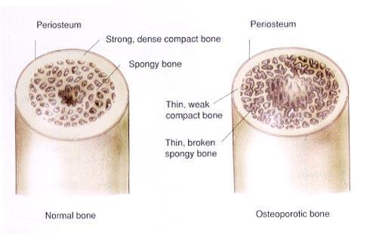
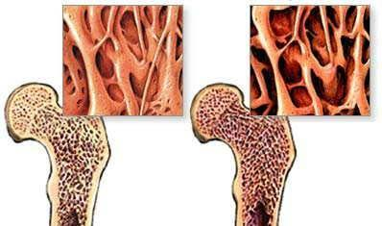
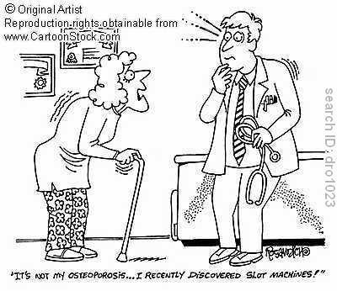

Slide 16
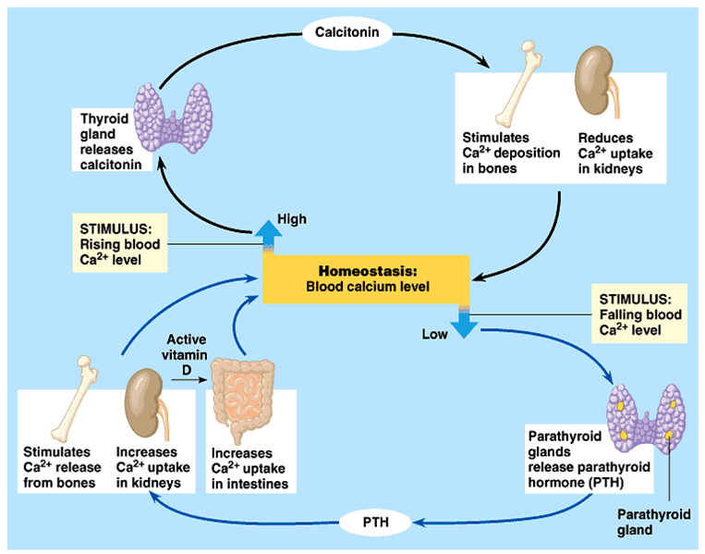
PTH and Calcitonin Feedback Loop

