Slide 1
Endocrine System
Hormone Homeostasis - Unit 1

Slide 2
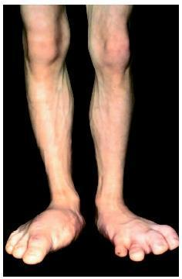
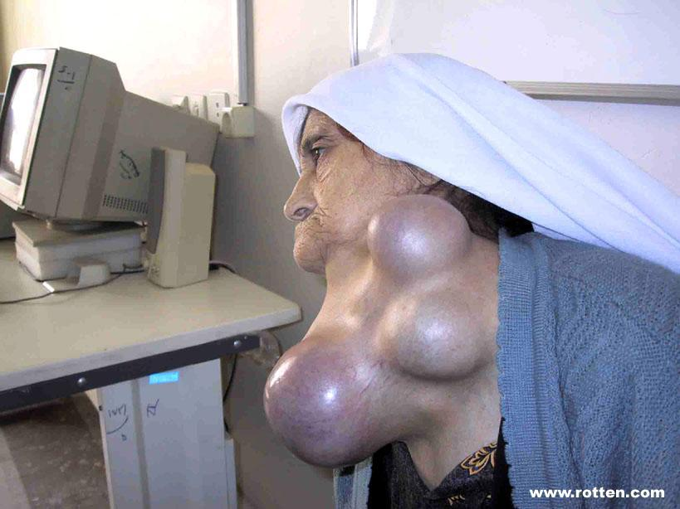
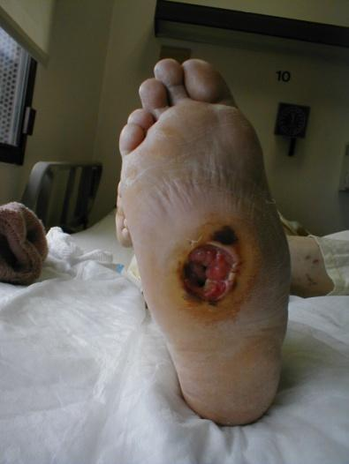
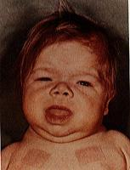
What do these people have in common?

Slide 3
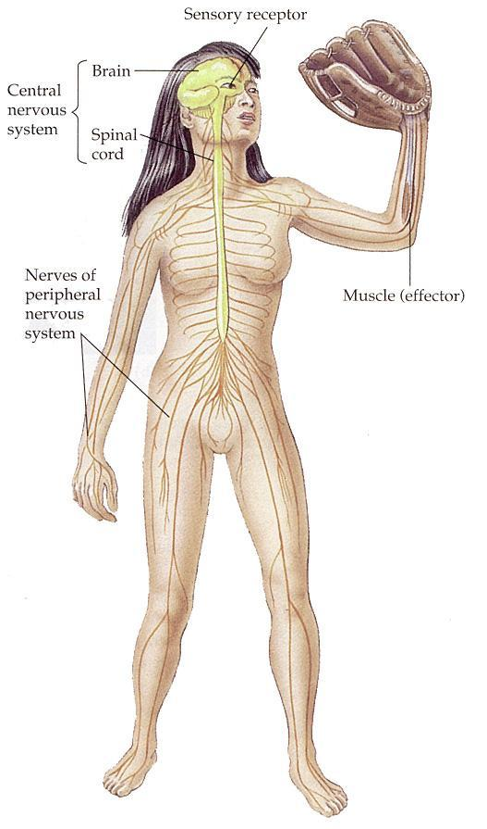
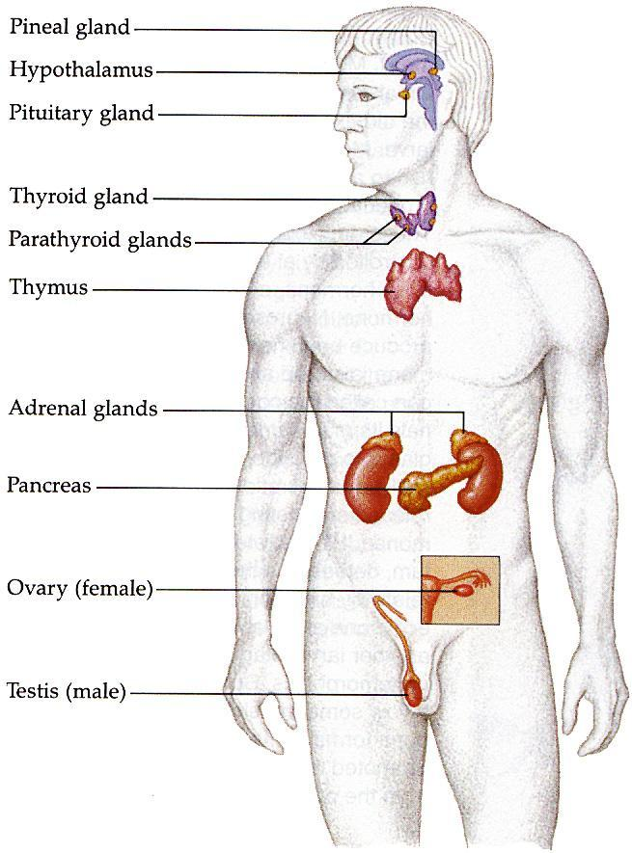
Nervous vs. Endocrine
Nervous System
Electro-Chemical messenger
Fast
Specific
Endocrine System
Hormone messenger
Long-term
General

Slide 4
Types of Glands
Endocrine glands release their hormones directly into the blood stream.
Exocrine glands release products into ducts first.
Prostaglandins: hormones which are released by mediator cells, and have effect only on the cells immediately around them.

Slide 5
Glands of the Endocrine Sys

Slide 6
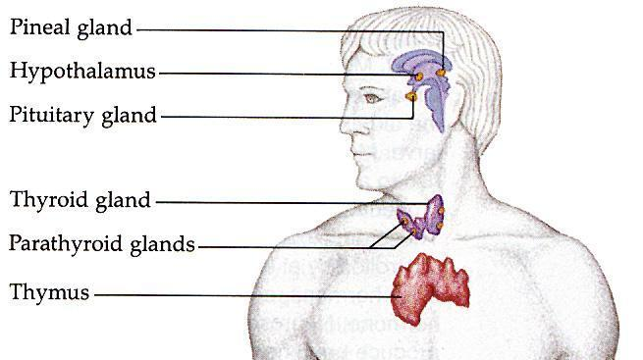
Glands of the Endocrine Sys
Name of Gland Hormone(s) Produced
1. Hypothalamus Oxytocin, Anti-diuretic hormone (ADH)
2. Pituitary (6 hormones, more later)
3. Thyroid Thyroxin (T4), Calcitonin
4. Parathyroid Parathormone (PTH)
5. Thymus white blood cells into T lymphocytes

Slide 7
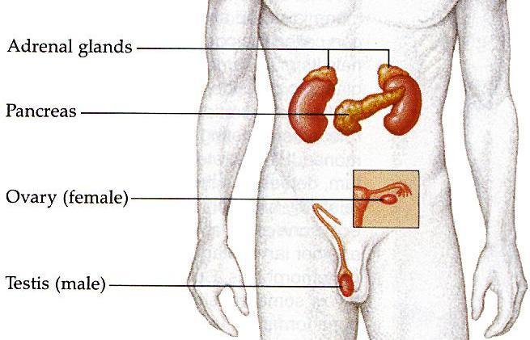
Glands of the Endocrine Sys
Name of Gland Hormone(s) Produced
6. Adrenal cortisol and aldosterone (cortex)
epinephrine (medulla)
7. pancreas glucagon and insulin
8. ovaries estrogen and progesterone
9. testes testosterone

Slide 8
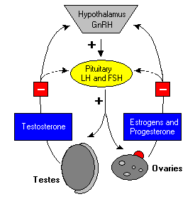
Negative feedback control
Almost all hormones use Negative feedback to control release.
A stimulating hormone is released into the blood first.
The target gland releases desired hormone.
Product hormone reaches pituitary or hypothalamus and stops stimulating hormone.

Slide 9
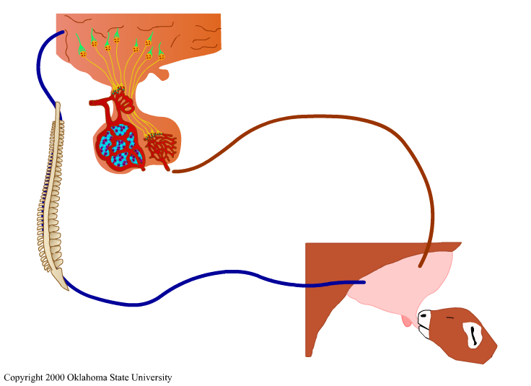
Neuro-endocrine cooperation

Slide 10
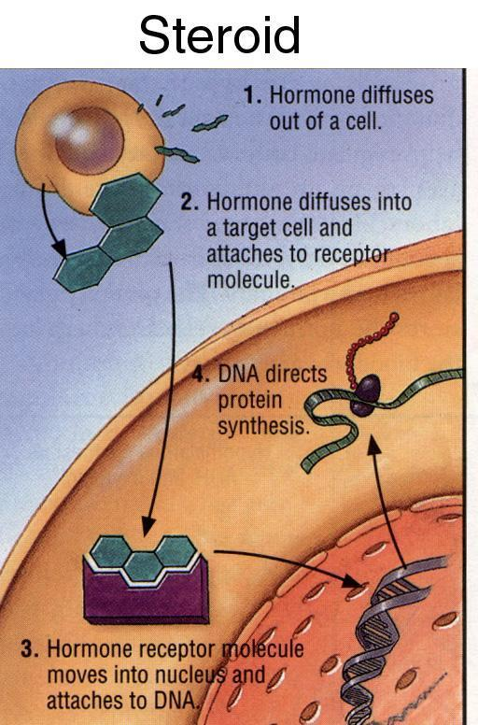
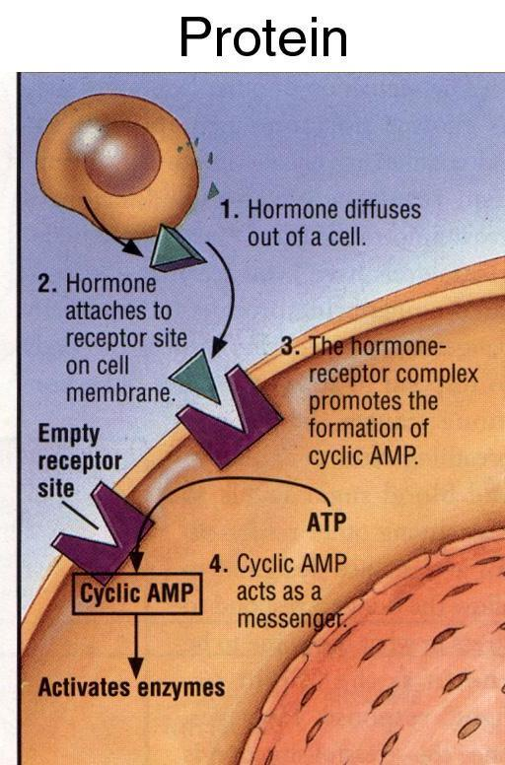
The messengers
Steroid Hormones
Can pass-through cell membranes
Affect many different cells and organs
Protein Hormones
Bind only to specific receptors on membrane
Target specific organs

Slide 11
Hypothalamus
Regulates the anterior pituitary
Produces hormones that are stored in the posterior pituitary
Oxytocin
ADH
Releases hypothalamic releasing and inhibiting hormones

Slide 12
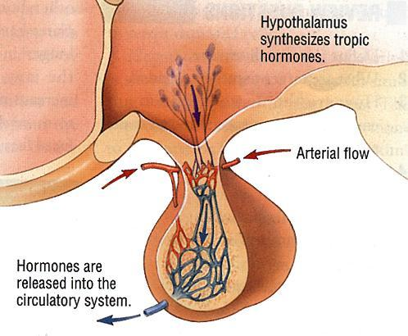
Pituitary Gland
Is broken into two parts: Anterior and Posterior
It is approximately the size of a pea and is located directly below the hypothalamus.

Slide 13
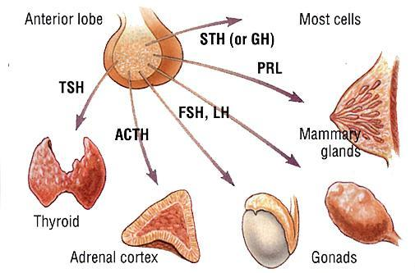
Pituitary Gland (anterior) – the MASTER GLAND

Slide 14
TSH – Thyroid Stimulating Hormone
Target
Thyroid Gland
Primary Function
Stimulate release of tyroxin which regulate metabolism
Malfunction
Hyperthyroidism – too much
Symptoms:
Heat intolerance
Weight loss
Nervousness
insomnia
breathlessness

Slide 15
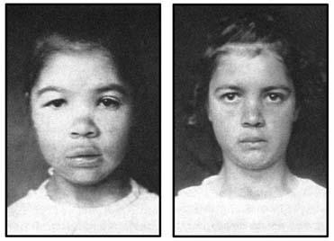
TSH – Thyroid Stimulating Hormone
Hypothyroidism – too little
Symptoms
Fatigue
Weakness
Weight gain
Slow heart rate
Cold intolerance

Slide 16
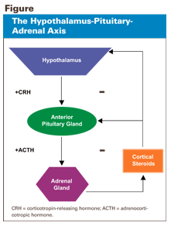
ACTH – Adenocorticotropic Hormone
Target
Adrenal Cortex
Primary Function
Stimulates release of hormones involved in stress – cortisol

Slide 17
LH – Luteinizing Hormone
Target
Ovaries or testes
Primary Function
In females – stimulates ovulation and formation of corpum luteum
In males – stimulate production of testosterone
Malfunction
Failure of gonadal function (hypogonadism)
Males – decrease sperm production
Females – cessation of reproductive cycle

Slide 18
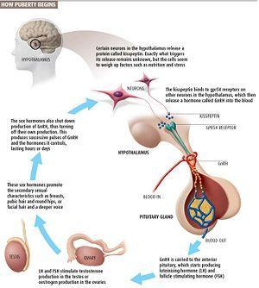

Slide 19
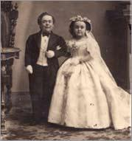
HGH – Human Growth Hormone
Target
Most Cells
Primary Function
Promotes growth of body and skeleton as a whole
Malfunctions
Dwarfism – hyposectretion

Slide 20
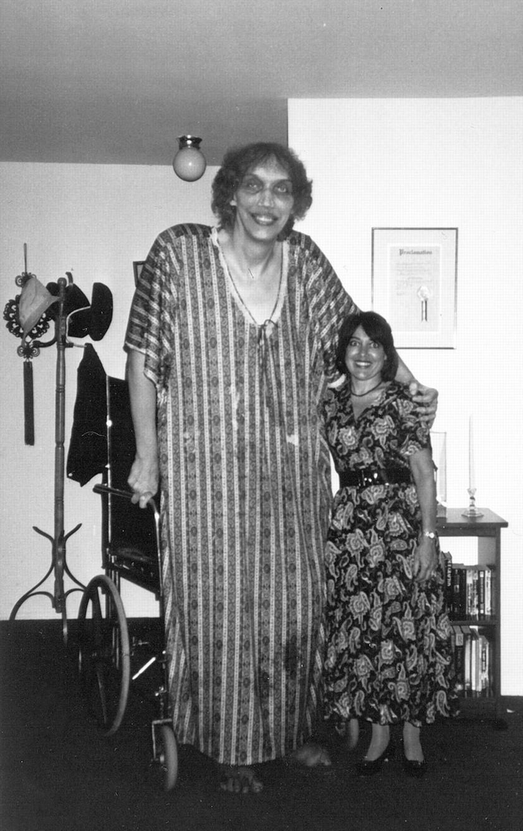
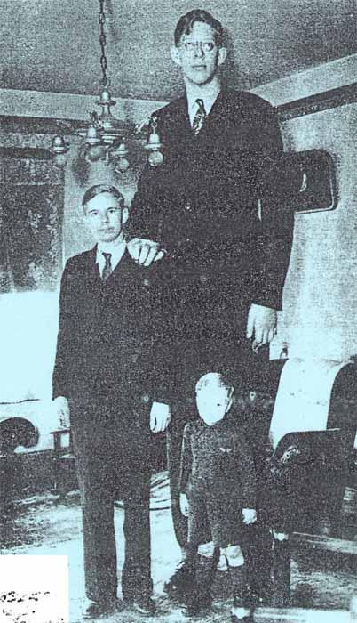
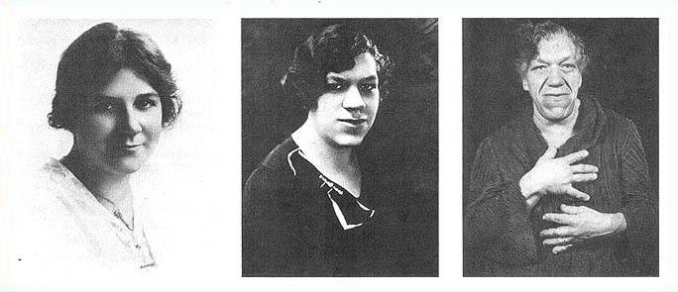
Gigantism – hypersecretion
Acromegaly – hypersection in adulthood

