Slide 1
Taste: Smell: Touch

Slide 2
Chemoreception
Chemo reception
Taste (tongue) – Smell (olfactory cells in nose)
Taste buds contain many taste receptors that sense dissolved chemicals.

Slide 3
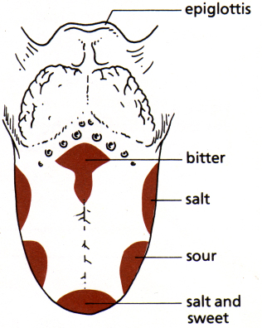
Taste
Why is bitter near the back? Or sweet near the front?
- Poison is usually bitter which stimulates the gag reflex; preventing the substance from being swallowed.

Slide 4
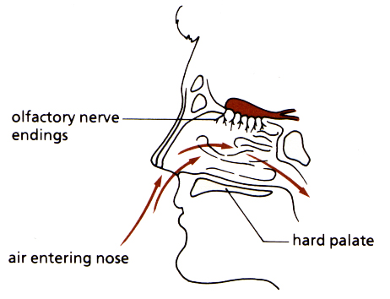
Smell
Olfactory cells sense airborne chemicals.
Located in the nasal passages.
Work with taste buds.
Sends input to olfactory bulb in brain and then to the emotional centres of the brain and the frontal lobe

Slide 5
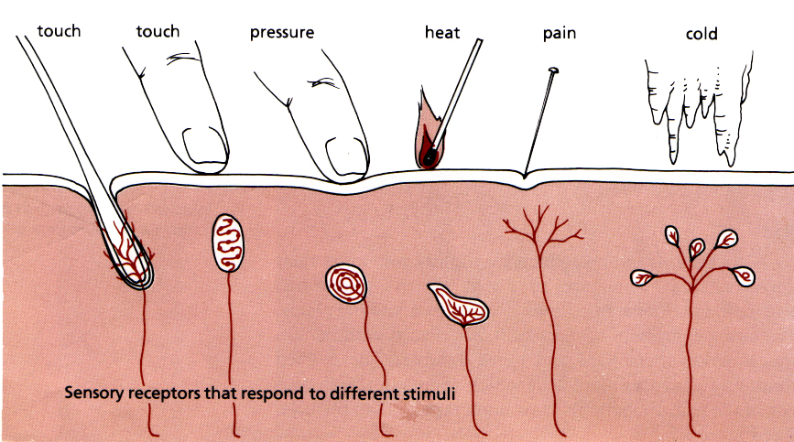
Sensory Receptors in the Skin
Sensory receptors are modified ends of sensory neurons.
Skin has several types of receptors to help you feel: light touch, pressure, pain, change in temperature.

