Slide 1
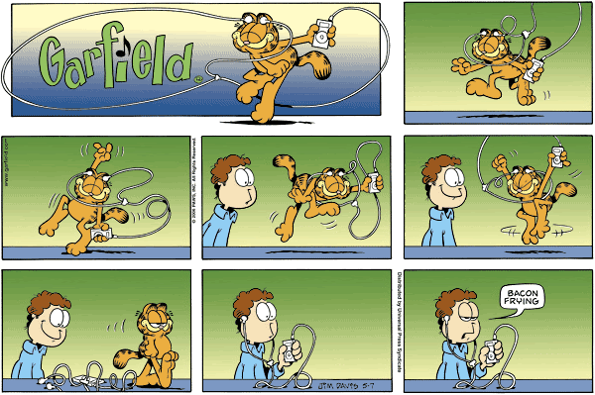
The Ear

Slide 2
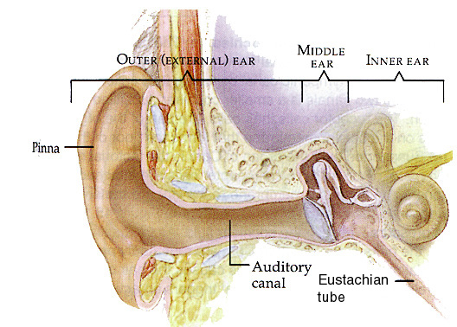
Large Divisions

Slide 3
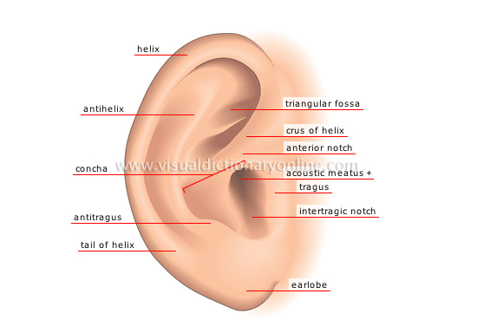
Protection and Health
Pinna
collects sound waves
Auditory Canal
funnels sound to tympanic membrane
prevent infection by secreting ear wax
Eustachian Tube
equalizes pressure in the middle ear

Slide 4
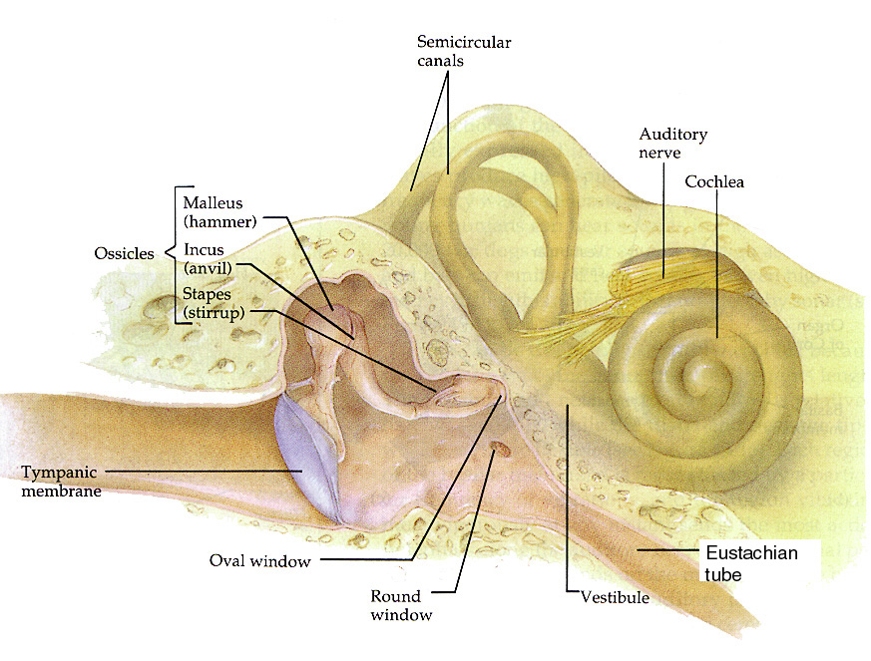
Detail Ear Structure

Slide 5
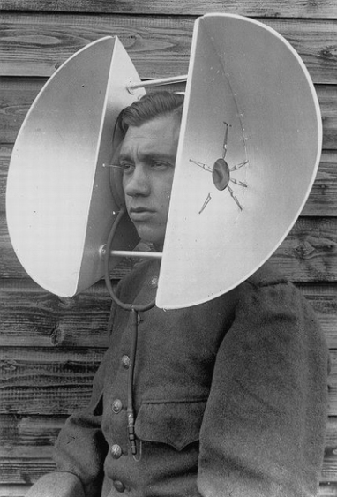
Hearing
Round window
relieve fluid pressure (liquids can not be compressed)
Cochlea
mechanical energy (or sound) is converted into nerve impulses
Auditory Nerve
carries impulses to the temporal lobe
Tympanic Membrane (ear drum)
converts sound waves into mechanical vibrations
Ossicles (hammer, anvil, stirrup)
transfer vibrations from ear drum to oval window
protect inner ear from loud sound (pull away from drum)
Oval Window
barrier between middle ear (air) and inner ear (fluid)

Slide 6
Hearing
outer
middle
Sound wave hit pinna and aplify through the auditory canal
Wave hit eardrum, which cause ossicles to vibrate
Vibration passed onto oval window into inner ear
inner
On the base of the organ of Corti is the basilar membrane where the hair cells (receptors) are located
Vibrations travel down the cochlea to the organ of Corti
The vibrations change to pressure waves because of fluid in the inner ear
The hair cells contain stereocilia
The stereocilia bend against the tectorial membrane
The hair cells sense the bending of the stereocilia and relay this message to the nerves.
The hair cells synapse with the auditory nerve and an impluse is made

Slide 7
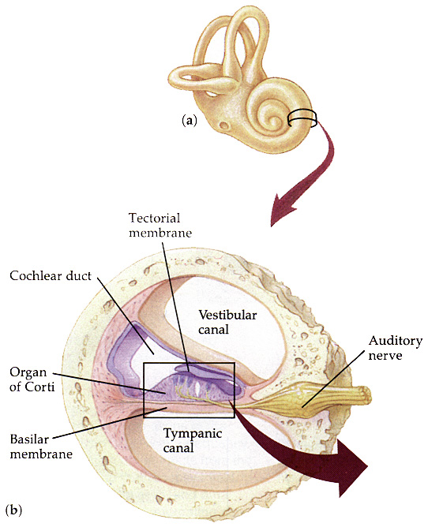
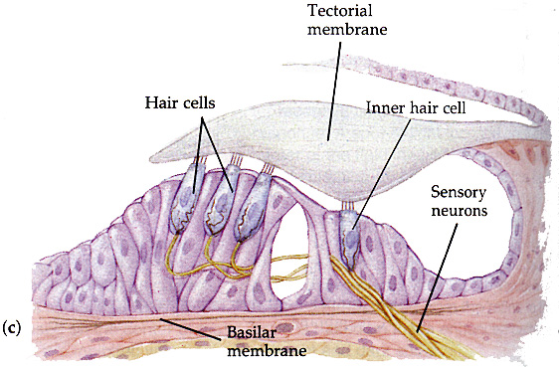
Cross Section of Organ of Corti
-A membrane (sail) moves with vibrations in fluid.
-This brushes hair cells attached to sensory neurons.
-If enough hair moves, an impulse will begin.

Slide 8
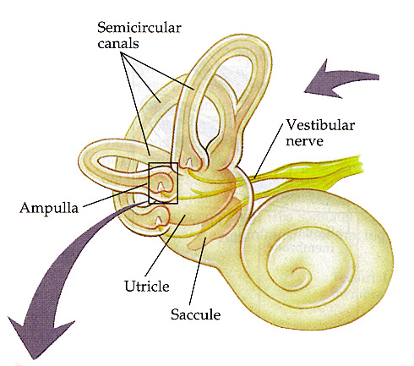
Dynamic Equilibrium (motion)
Semicircular Canals
Three, one for each plane of motion
Fluid in a canal will move with motion, and push on a cupula attached at the bottom.
The cupula moves and this fires the nerve impluse

Slide 9
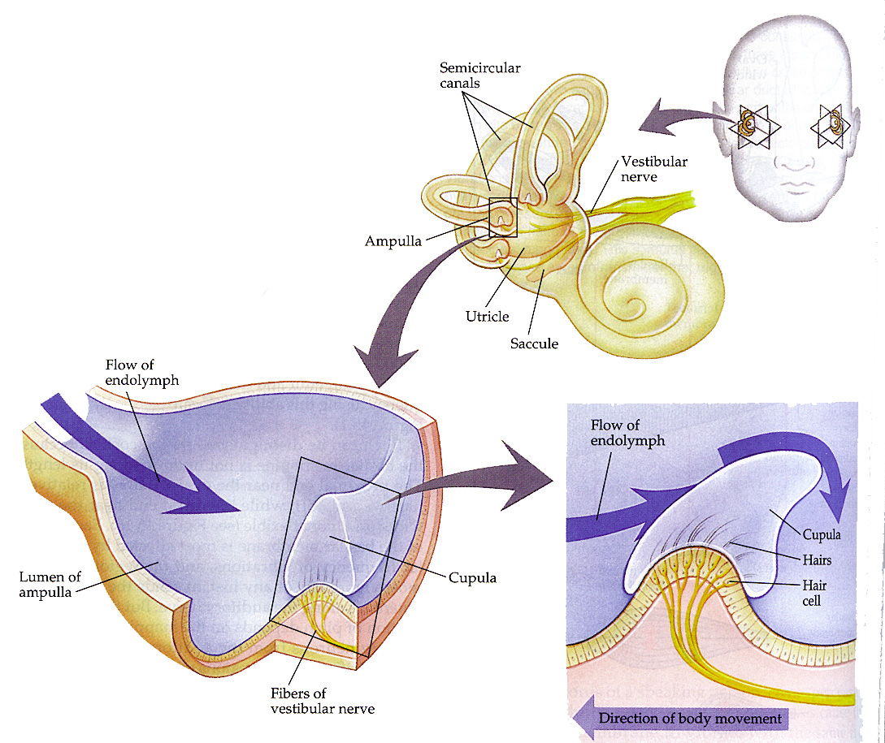
Semicircular Canal

Slide 10
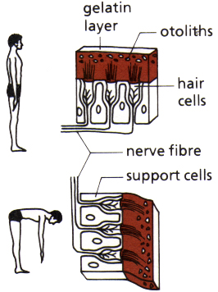
Static Equilibrium (position)
Vestibule
The saccule and utricle contain a gel filled with otoliths, that move when we tilt our head.
Otoliths- are calcium carbonate, gravity pulls on these molecules then sends impulse to brain as to position of head

Slide 11
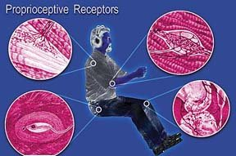
Proprioceptors
Found in
Muscles
Tendons
Joints
They send information to brain about body position
ex. they allow you to be able dress in the dark

