Slide 1
HOW WE SEE!

Slide 2
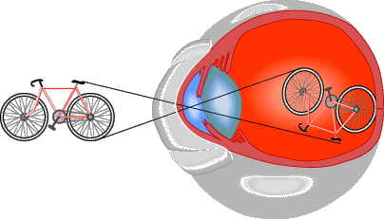
Objects focus on Retina
The image is focused on the fovea centralis is:
Smaller
Upside down
Reversed left and right

Slide 3
Vision (cont.)
Retina
Converts light energy to nervous impulses
Rods
detect shades of black and white, excellent with motion, can work in low light. (peripheral)
Cones
Detect colour, excellent with detail, require lots of light. (central vision) - http://wimp.com/colorblind/
Fovea Centralis (Macula)
Filled with only cones (for detail vision)

Slide 4
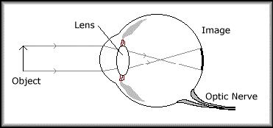
Vision (cont.)
Retina (cont.)
Blind Spot
Area where optic nerve leaves eye. No room for sensory receptors.

Slide 5
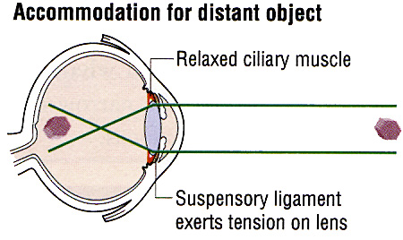
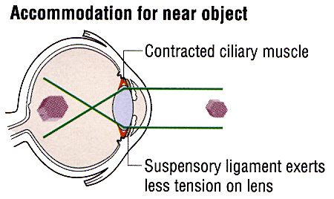
Reflexes of Sight
Light reflex
bright light causes the iris to enlarge and the pupil to get smaller, while low light causes the opposite.
Accommodation Reflex
pupil size and lens shape changes with distance. For far objects the lens is stretched flat, while for close objects it bulges out.

Slide 6
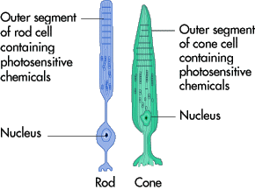
Chemistry of Sight
Rods and Cones contain rhodopsin pigments.
Rhodopsin is made up of Vitamin A and Opsin.

Slide 7
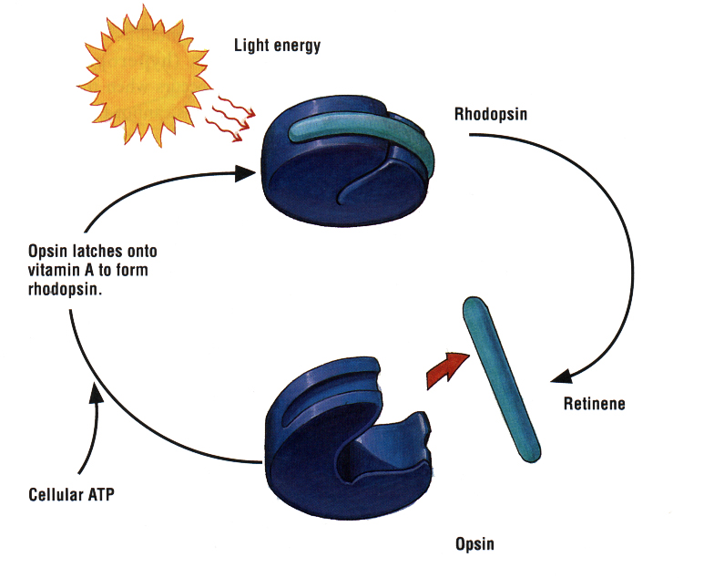
Chemistry (cont.)
When rhodopsin is struck by light it splits and alters the cell chemistry, causing the neuron to fire.

Slide 8
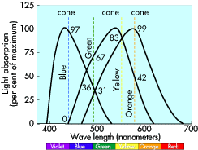
Chemistry (cont.)
Cones see color by using three types of rhodopsin; one for each primary color (Red, green, blue).
If you are colour blind, you have deficiency in a specific cone type.

Slide 9
Depth Perception
Memory (brain)
The size a known object has on your brain.
Moving parallax (diff distances, diff speed)
When you move your head from side to side, objects that are close to you move rapidly across your retina. However, objects that are far away move very little.
Stereo vision (overlapping fields of view)
Each eye receives a different image of an object on its retina because each eye is about 2 inches apart.

Slide 10
Brightness Perception
The brightness of an object depends on the light reflected from itself and its background.

Slide 11
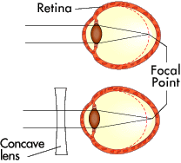
Nearsightedness (Myopia)
Able to see near objects well and has difficulty seeing objects that are far away
The image is focused infront of the retina
Corrected with concave lens

Slide 12
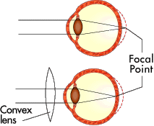
Farsightedness (Hyperopia)
Is present, a person is able to see distant objects well and has difficulty seeing objects that are near.
Image is focused behind the retina
Corrected with a convex lens.

Slide 13
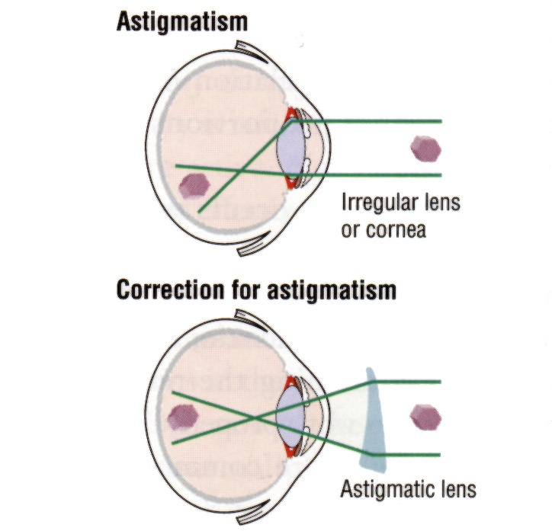
Astigmatism
Uneven curvature of the cornea and causes a distortion in vision.
Corrected with a shaped lens.

Slide 14
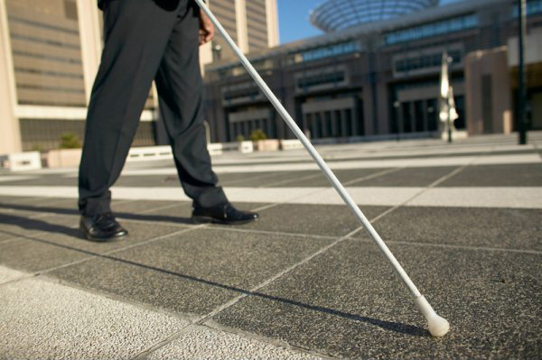
Blindness
Night Blindness
severe vitamin A deficiency leads to a lack of rhodopsin.
Cataracts
Glaucoma
Diabetic Retinopathy

Slide 15
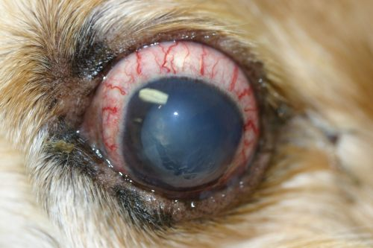
Glaucoma
increased pressure within the eyeball.
aqueous humor builds up and increases pressure within the eye.
damage the optic nerve directly or restrict blood flow, thus damaging the optic nerve indirectly.
lead to blind spots in the visual field.
can cause permanent blindness.

Slide 16
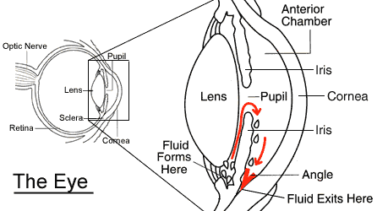
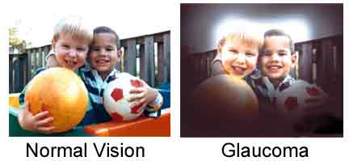
Glaucoma

Slide 17
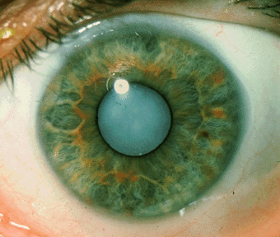
Cataracts
the lens becomes cloudy.
Cataracts are caused by changes in the chemical makeup of the lens.
With age, the lens becomes thicker and less clear.

Slide 18
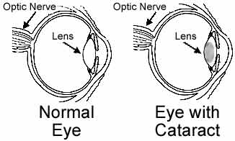
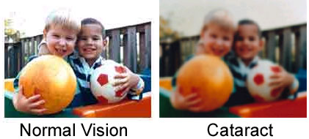
Cataracts

Slide 19
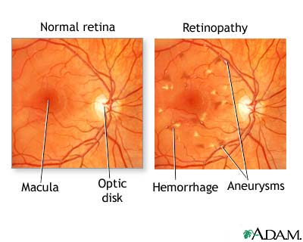
Diabetic Retinopathy
Diabetic retinopathy refers to damage to the blood vessels of the retina caused by diabetes.
As new blood vessels grow on the retina, blurred vision or temporary blindness can result.
Scare tissue can form and cause blindness where old blood vessles were attached to the retina.

Slide 20
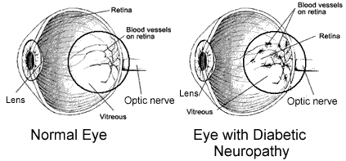
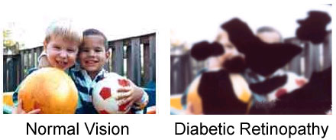
Diabetic Retinopathy

Slide 21
FOR FUN!

Slide 24
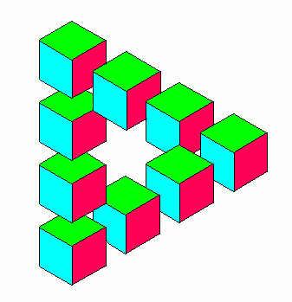

Slide 25
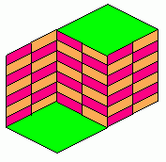
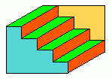

Slide 26
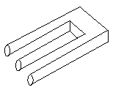
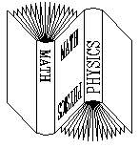
Connectivity

Slide 27
