Slide 1
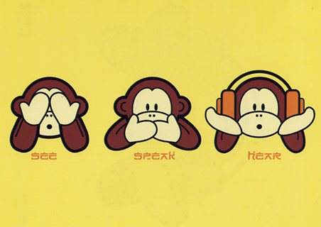
Sensory Reception

Slide 2
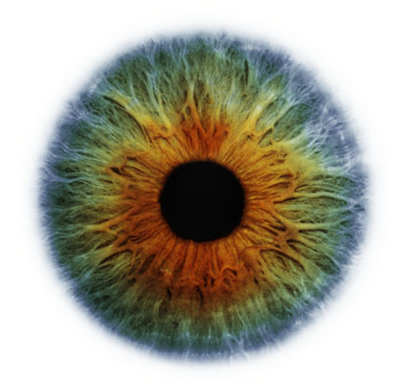
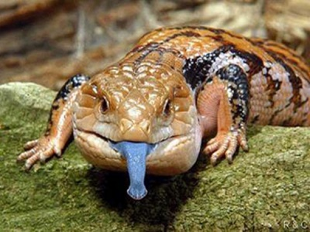
How you sense.
Sensory Receptors – nerve endings that gather sensory information
Sensation – when neural impulses arrive at cerebral cortex
Perception – how cerebral cortex interprets the sensory information.

Slide 3
Sensory Adapation
Large amounts of sensory information is being sent to the brain
The brain filters out insignificant information this is called SENSORY ADAPATION.
Example:
You brain telling you that there is pressure on your feet from the ground.
Your brain telling you that the room temperature is cool or warm.

Slide 4
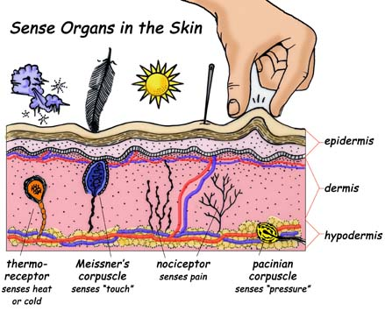
Receptors
Four types
Photoreceptors – react to light
Chemoreceptors – chemical reactions
Mechanoreceptors – physical contact
Thermoreceptors - temperature

Slide 5
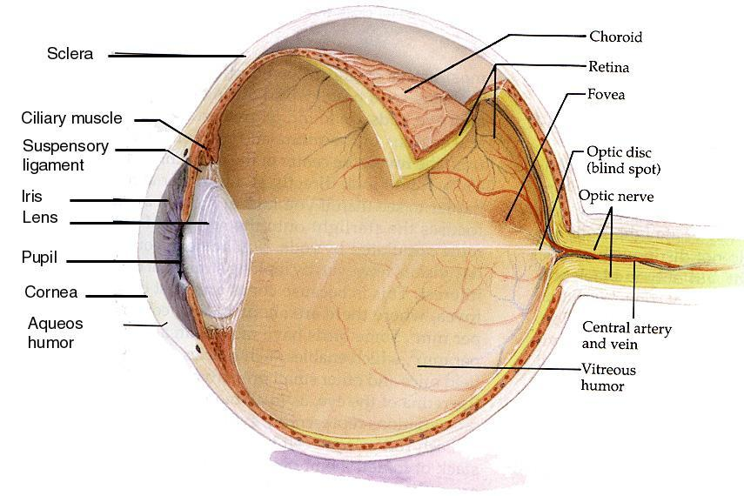
Eye Structure

Slide 6
External Layer

Slide 7
Eye Protection
Conjunctiva
membrane lining the inside of eyelids and across the front of the eye. Prevents objects from moving behind the eye.
Fat Deposits
Cushioning the eye during impacts.
Sclera
Strong outer membrane. Gives shape to eye, and helps with accommodation.

Slide 8
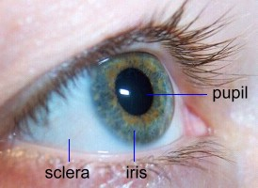
Intermediate Layer
Choroid – absorbs scatter light, inludes blood vessels (food)
Iris – regulates amount of light entering
Pupil – opening of light
Ciliary muscles – change shape of lens to focus

Slide 9
Nourishment
Fat Deposits
a close energy source
Choroid layer
enriched with blood vessels. Brings in nutrients and removes wastes.

Slide 10
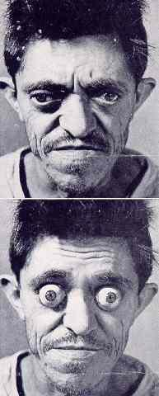
Nourishment (cont.)
Posterior Chamber filled with Vitreous Humour
brings nutrients to the lens.
Pores in the ciliary muscles
allow nutrients to diffuse from the posterior to the anterior chamber.
Anterior Chamber filled with Aqueous Humour
brings nutrients to the cornea and the front of the lens.

Slide 11
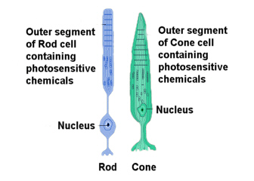
Internal Layer
Rods – light receptors
Cones – color receptors
Fovea centrailis – high density of cones, provides acute vision

Slide 12
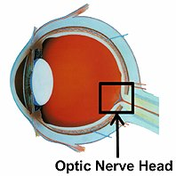
Other Noteable Stuctures
Lens – focuses light
Humours -support eyeball with pressure of fluids
Optic nerve – transmitter to brain
Optic disc – blind spot, where nerve connets with eye

