Slide 1
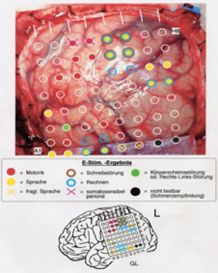
Brain Mapping

Slide 2
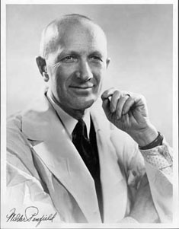
History
Scientists first learned about brain function through brain injuries or diseases.
ex. soliders with brain injury survive and scientists would study how the individual changed
Wilder Penfield, pioneer in motor and sensory areas of the brain

Slide 3
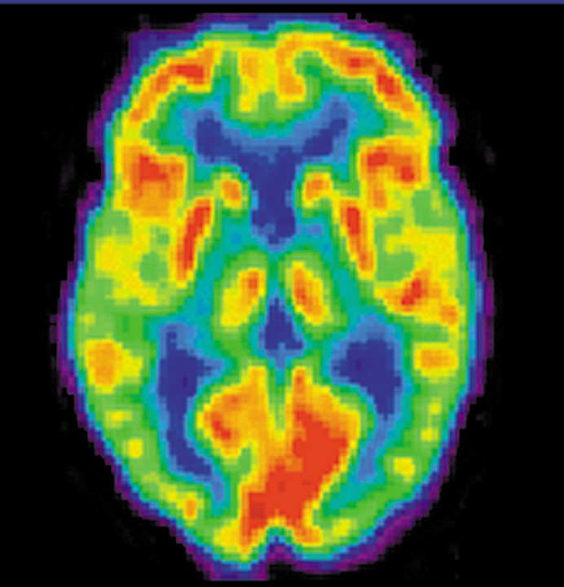
PET (Positron-emission tomography)
More active areas emit more energy
Patient injected with radioactive glucose and scanners moniter glucose consumption
Good for diagnosing
Stroke
Alzheimer's

Slide 4
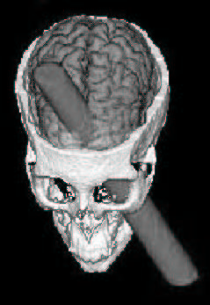
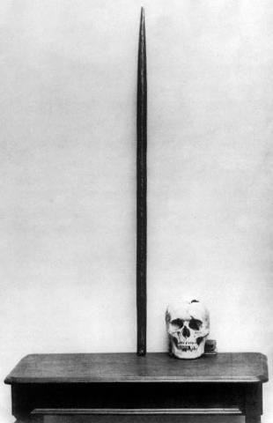
Phineas Gage, FYI
Explosion 1848 drove a metal bar through the frontal lobes
Survived, but doctors noticed difference in personality
Once considered resonable, conscientious
Later considered thoughtless, fitful

Slide 5
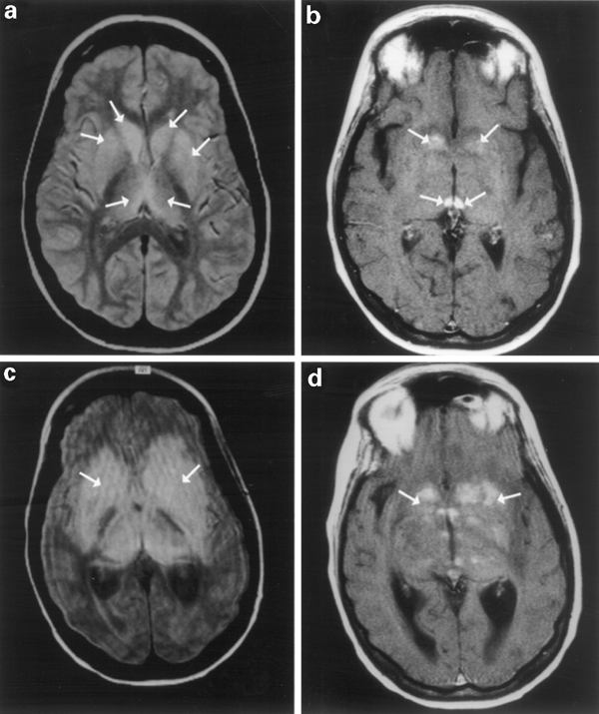
MRI (Magnetic Resonance Imaging)
Provides clear detailed image of brain
Large magnet surrounds persons head, gets hydrogen ions in brain to emit radio waves
Good for diagnosing
Tumors
BSE like diseases, where brain tissue is destroyed

Slide 6
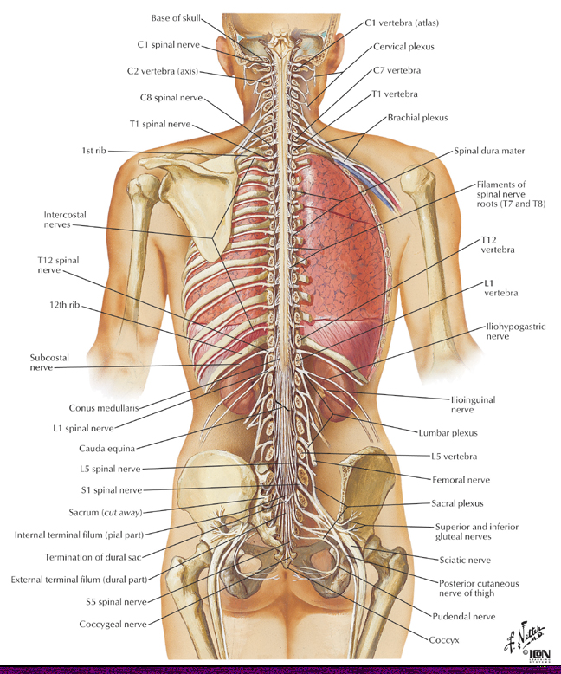
The Peripheral Nevous System
Connects the brain and spinal cord to the rest of the body:
Made up of two division which have opposing functions.
Two divisions:
Somatic system
Autonomic system

Slide 7
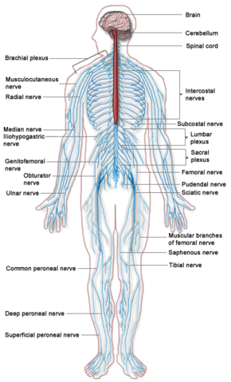
Somatic System
Largely under voluntary control
Neurons service head, trunk, limbs
Inlcudes vagus nerve
Connected to many internal organs (heart, lung, bronchi, digestive tract, liver, pancreas)

Slide 8
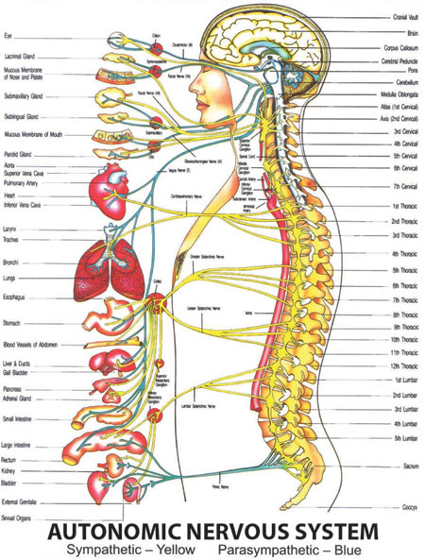
Autonomic System
Involuntary control
Stimulate or inhibit
Glands
Cardiac muscle
Smooth muscle
Controlled by hypothalamus & medulla oblongata

Slide 9
Autonomic Sytem Breakdown
Sympathetic Nerves:
prepare the body for action or eme rgency (fight-or-flight response).
many nerves
branch directly off the spine
Parasympathetic nerves:
calm the body back down (rest-and-digest response)
everyday processes
Few main nerves from skull and pelvis

Slide 10
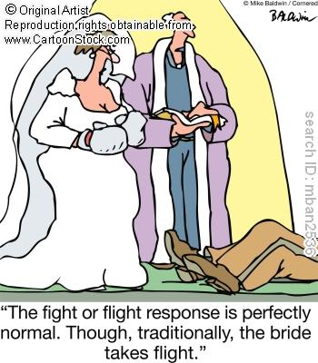

Slide 11
