Slide 1
The Synapse

Slide 2
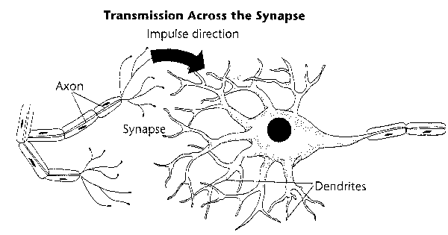
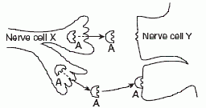
Synapse: space between a neuron’s axon and it’s target. Also called synaptic cleft.
Presynaptic neuron: before cleft Postsynaptic neuron: after cleft
Presynaptic Endplate: contains vesicles which hold neurotransmitters, which are released into the syanpse.
Postsynaptic Receptors: receive neurotransmitters and allow ions to enter neuron.

Slide 3
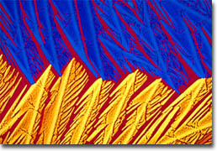
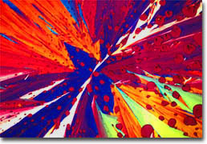
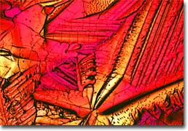
Example Neurotransmitters
Ex | Pathway | Location
Acetylcholine | skeletal muscles | PNS
Dopamine | Reward pathway, also pain pathway | CNS
Serotonin | Mood | CNS

Slide 4
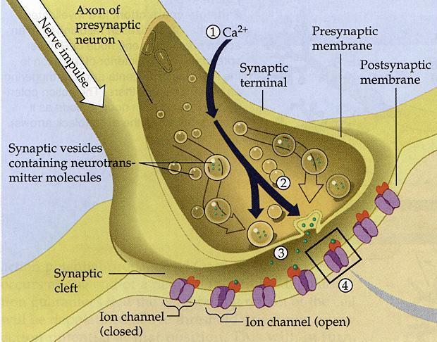
Steps To Carry Impulse Across
Impulse reaches endplate
Ca+ is absorbed
Vesicles release Neurotransmitters(ex acetylcholine)
Bind and trigger an in-rush of Na+ ions
New action potential

Slide 5
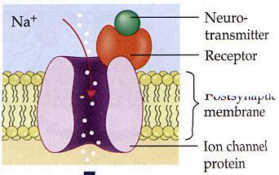
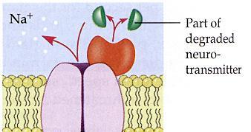
6. Clean up
After acetylcholine has moved across the membrane it needs to be re-absorbed, or broken down by cholinesterase.

Slide 6
Block or stop impulses
Some neurotransmitters cause the postsynaptic neuron to stop or not send the impulse along.
These Inhibitory transmitters cause K+ to leak out, hyperpolarizing the membrane.

Slide 7
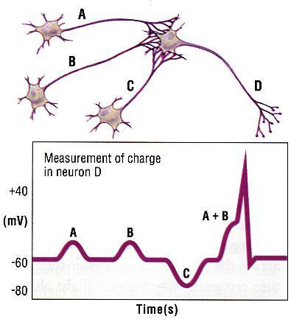
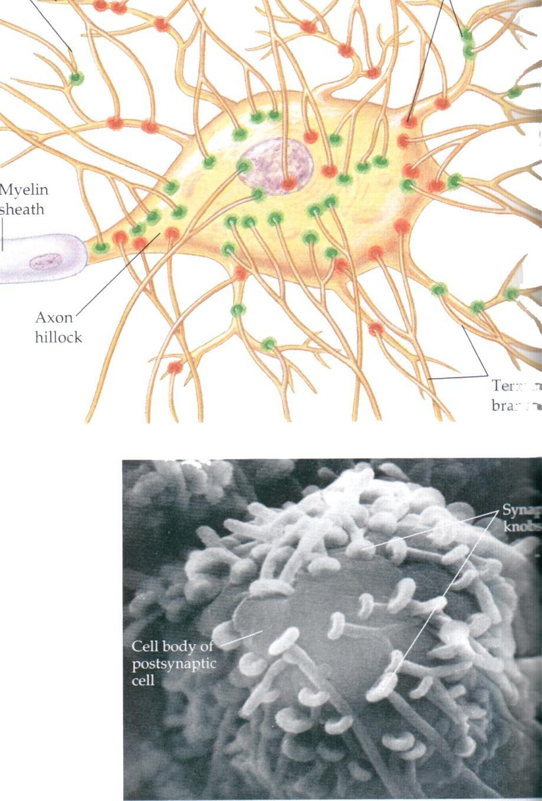
Summation: the sum effect of all neurotransmitters acting on an neuron.

Slide 8
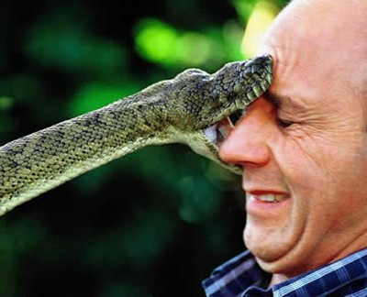
Blocking Nerve Transmission
Decreasing the membranes permeability to Na+. Examples: procaine, tetracaine & cocaine. All local freezing and loss of sensation because of decreased ability to depolarize.
Blocking Na channels in membrane. Examples: poisons like puffer fish. This stops neural activity and paralysis muscles.
Chemicals that irreversibly bind to specific receptors on dendrites and muscle fibers. Examples: snake venom and Peruvian poison darts (red frogs). Causes paralysis of muscles, but sensory neurons still work!
Prevent release of Acetylcholine from presynaptic knobs. An example is botulism food poisoning. Result is paralysis, including the heart muscle.

Slide 9
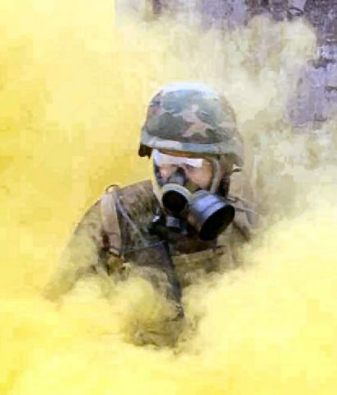
Stimulatory Nerve Transmission
Inhibit cholinesterase. Examples: pesticides, flea collars, and Sarin gas. Continual nerve impulses, muscle contractions, spasms and death.
Inhibit other exhibitory transmitters. Example: Strychnine poison. Again causes continuos stimulation therefore sever convulsions.
Lower membrane threshold potential by increasing Na+ permeability. Example: Caffeine. Increases neural activity, can cause jumpy or edgy feeling.

Slide 10
Pain Killers
Natural
Chemicals secreted by the brain; endorphins & enkephalins
They work by attaching to the receptors that receive pain neurotransmitters, thus preventing the pain impulse from continuing (at the neuron or injured tissue level). OR the stimulate the release of inhibiting neurotransmitters.
Can be stimulated to release by: exercise, music, altruistic actions, laughter, sex, or any strong emotional response.
Described as a “natural high”, or feeling of euphoria!

Slide 11
Artificial ....Narcotics
Chemicals like opiates, codeine, morphine, Demerol, etc.
Again, they work by binding to receptors on the neurons or damaged tissue, and block the pain neurotransmitters (also block natural pain killers).
Often when stopped, the transmitters become suddenly open, and there is an over abundance of pain neurotransmitters ready to “fire”.
Artificial ....Non-narcotic
Chemicals like Tylenol and aspirin.
Work by blocking the release of certain pain transmitters in the first place (like prostaglandins).

Slide 12
... drugs worth mentioning.
Depressant drugs: like valium.
These enhance the action of inhibitory transmitters chemicals which decrease the impulses at the synapses.
Alcohol
Acts on the membrane by increasing the threshold levels (therefore harder for impulse to depolarize). It does this by decreasing the membrane’s permeability to Na+.

