Slide 1
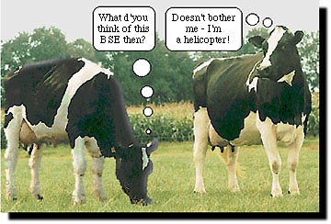
The Nerve Impluse

Slide 2
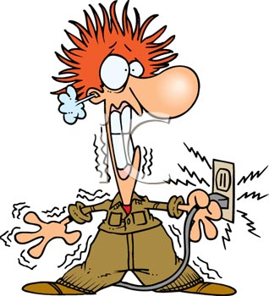
History
For years scientists thought that nerves had electrical impulses, but research has shown the difference between electricity and nerve impulses
Electricity
Current travels very quickly
Current diminishes over the length of wire
External energy to move current
Nerve Impulses
Much slower than current
Remains the same strength throughout the neuron
Uses cellular energy to move through the neuron

Slide 3
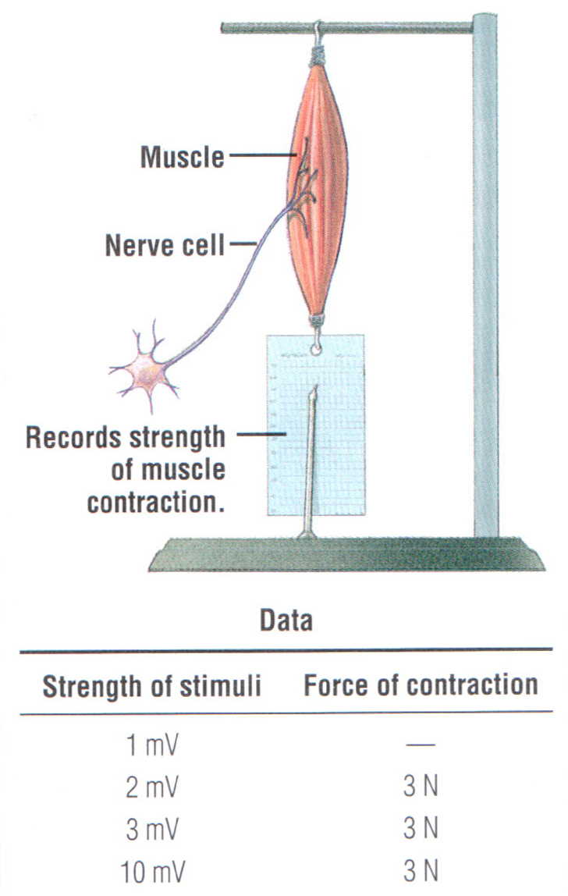
Neural Circuits: Reception Detail
RECEPTION:
Threshold stimuli: minimum level of stimulus required to start an action potential.
Self-Propagating: once started, and impulse or action potential will move down the entire axon till the end plate (like a fuse).
All-or-None Theory: the neuron either responds fully (threshold was reached) or not at all!
If all or none, how do we sense differences in pain or heat?

Slide 4
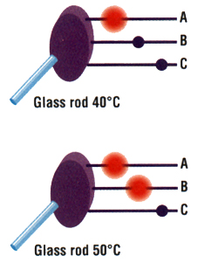
Neural Circuits: Degrees of Stimulation
Sense different degrees of stimuli:
The number of neurons that fire. Either different threshold levels or different physical locations (like pressure and skin).
Neurons may fire more rapidly (Increase frequency).
40ºC
50ºC

Slide 5
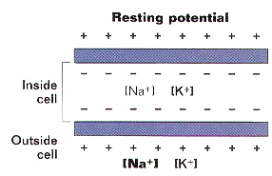
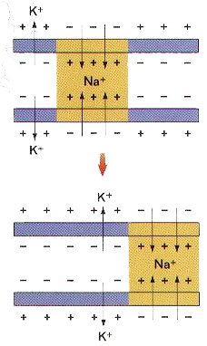
Neural Circuits: Transmission Detail
TRANSMITTING THE SIGNAL
Resting membrane: the charge difference at rest across the axon membrane (usually a net charge of -70mV inside). Membrane is polarized.
Action Potential: rapid reversal of charge across the axon membrane (membrane depolarization).
Repolarizing: after the action potential moves through, the axon must restore the ion balance.

Slide 6
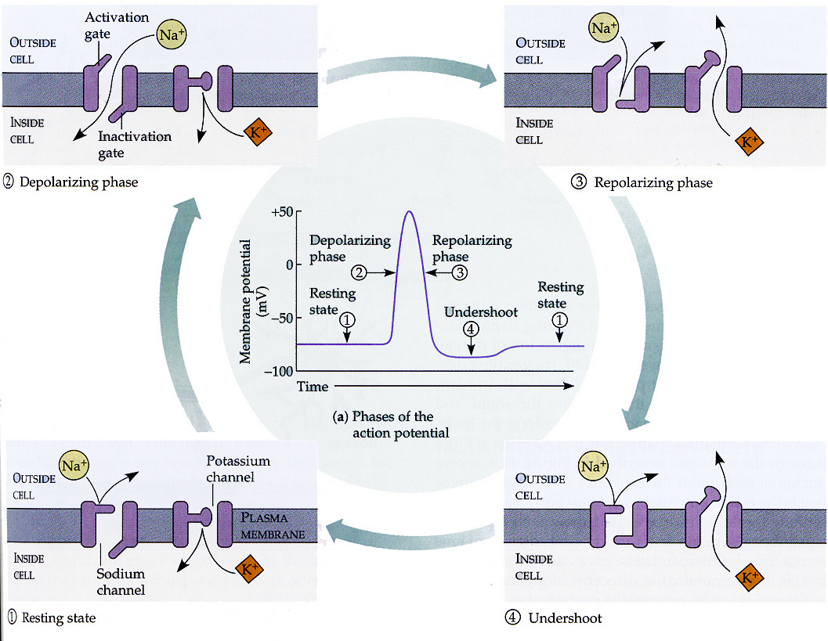
Neural Circuits: Transmission Detail, Movement of Ions

Slide 7
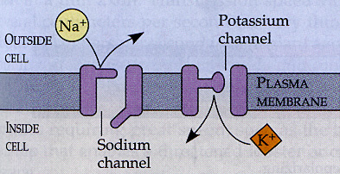
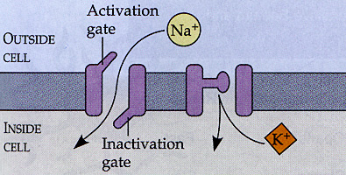
Neural Circuits: Transmission Detail, Movement of Ions
Resting State: setup by a sodium potassium pump. Causes high concentration of Na+ outside and K+ inside. But gates are closed!
Depolarizing Phase: Neuron is stimulated enough to cause Na+ gates to open. Causes an in-rush of Na+.

Slide 8
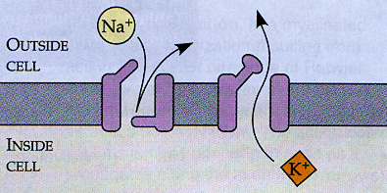
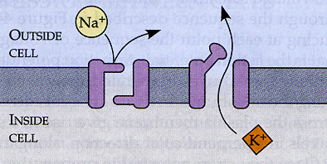
Neural Circuits: Transmission Detail, Movement of Ions
Repolarization Phase: once the membrane is fully depolarized (+40mV), Na+ gates close and K+ gates open causing K+ to rush out!
Undershoot: K+ continues to leave till membrane is just beyond resting state. It is overpolarized (-90mV).

Slide 9
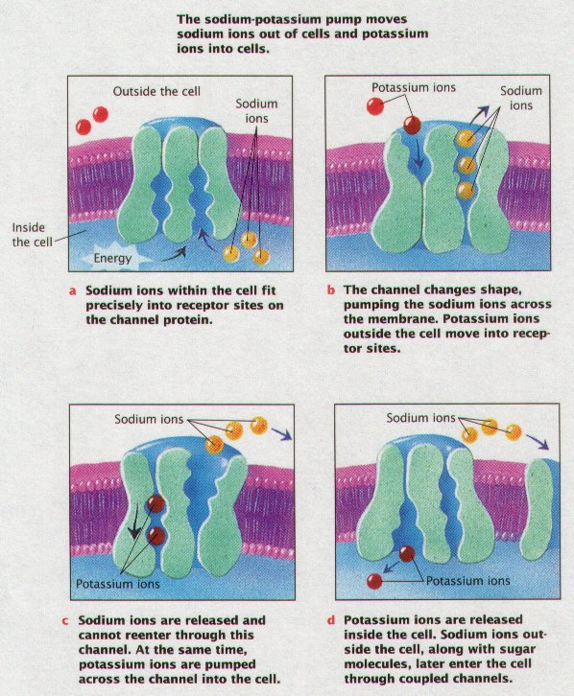
Sodium-Potassium Pump

Slide 10
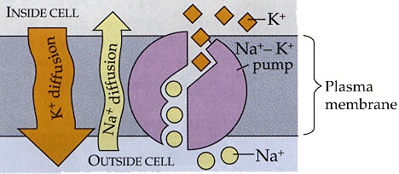
Things to Note:
Transmission Detail ... how the charges and ions work ... just listen
First the membrane builds up a resting net charge of -70 mV. It does this by transporting Na+ ions out of the cell, and K+ into the cell. This sets up a concentration gradient.
K+ ions then move down this gradient by flowing to the outside. That creates more positives outside than in.
Some Na+ charges do wander back in, but at a much slower pace, so they can be ignored here at rest.
So at rest, there are more “+” ions outside than in ...

Slide 11
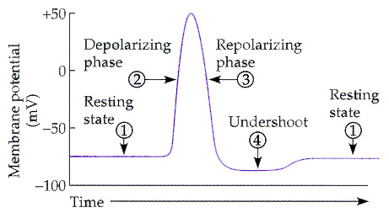
Neural Circuits: oscilloscope
Last, all gates close, and the pump/diffusion reestablishes the original concentrations of ions (refractory period).
Oscilloscope Graph:
End Show

