Slide 1
Chapter 11: Nervous System
NS Organization
Neurons
Reflex Arcs

Slide 2
Nervous System Control vs. Hormonal Control
Nervous system (NS) rapid responses.
Endocrine system longer term adjustments.
Both work together in danger responses and in maintaining homeostasis.

Slide 3
Nervous System
Central Nervous
System (CNS)
Perepheral Nervous System (PNS)
Sensory Pathways
Motor Pathways
Brain
Spinal Cord
Interneurons
Somatic Nervous System
Autonomic Nervous System
Motor Neurons
Sensory Neurons
Sypathetic Nervous System
Parasympathetic Nervous System

Slide 4
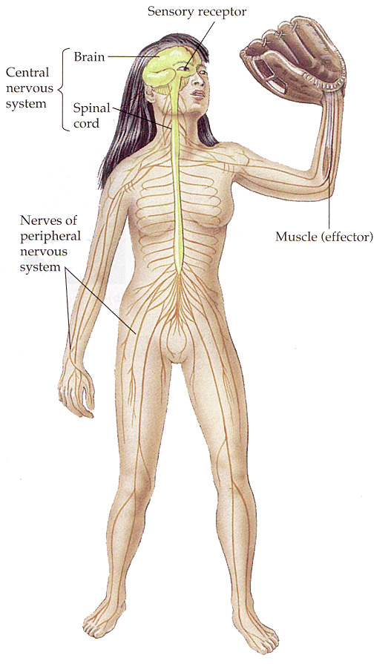
Summary
central nervous system or CNS
Contains interneurons
Brain and the spinal cord.
Coordination and processing of all nerve impulses.
peripheral nervous system or PNS
Contains sensory and motor neurons
somatic nerves control skeletal muscle bones and skin.
autonomic nerves control internal organs muscles and glands.
Notes:
4

Slide 5
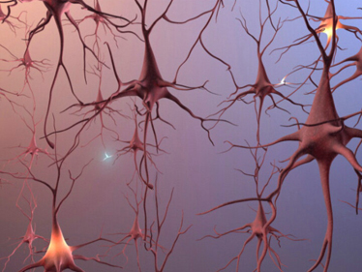
Neural Structures and Cells
Two types of cells:
Neurons (main)
Glial cells (supporting)
Neurons conduct nerve impulses along pathways.
Electrochemical in nature
Nerves are bundles of neurons groups for a specific function.

Slide 6
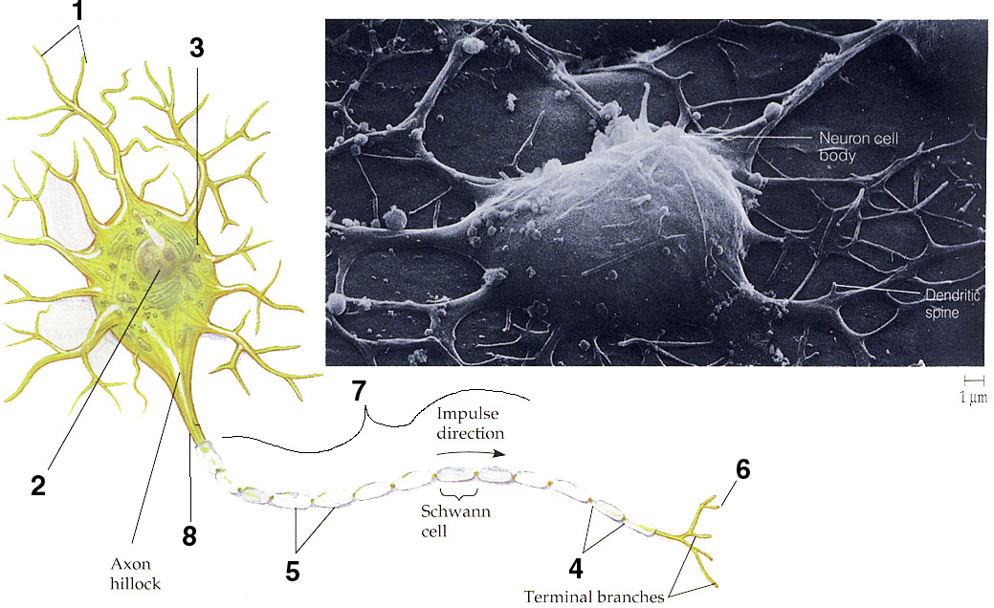
General Neuron Diagram
Dendrites
Nucleus
Cell body
Node of Ranvier
Myelin Sheath
End Plate
Axon
Neurilemma
Notes:
6

Slide 7
3. Structures: Brief Definitions
Dendrites receive information and always travel toward the cell body
Cell Body: contains nucleus and cytoplasm to sustain and coordinate cell.
Axon carries impulse to other neurons or to effectors; always travel away from the cell body.
• Myelin sheath is formed by the Schwann cells and insulates the axons. This speeds up transmission, found in the PNS and mature CNS axons (White matter).
• Nodes of Ranvier are gaps between Schwann cells in myelin sheath that speed up transmission
• Neurilemma is a protective membrane that helps in re-generation of a neuron. Not found in Grey matter.
Notes:
7

Slide 8
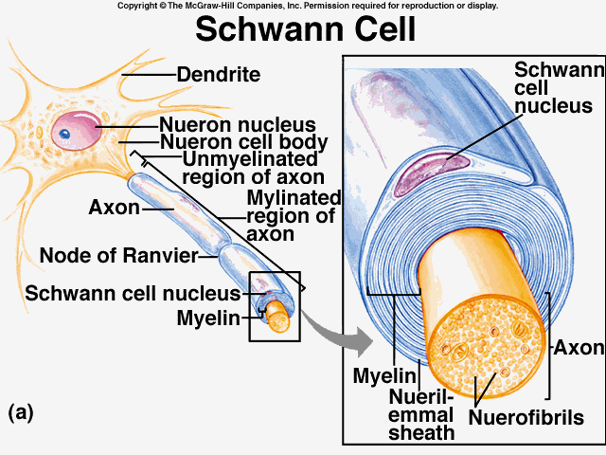
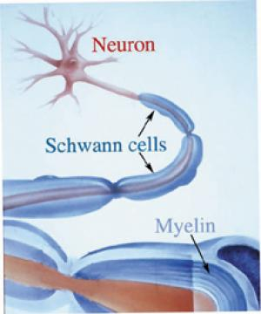
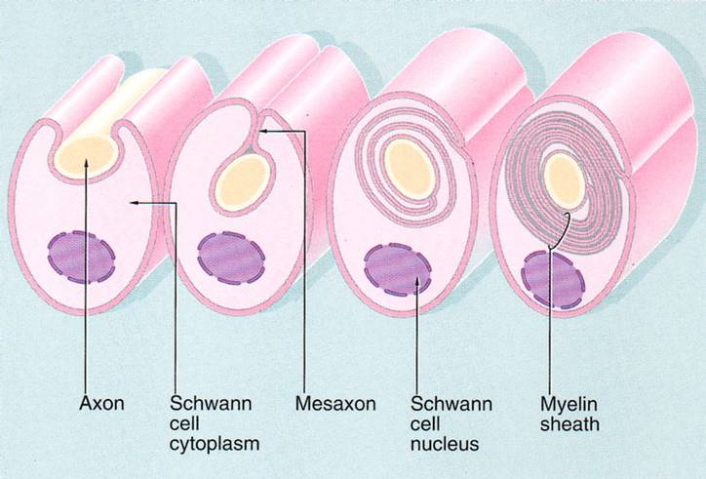
Schwann cells grow in a rolling pattern around axons.
Contain lipids, they act as electrical insulations.
This prevents impulses from moving off the pathway, and speeds up their transmission.

Slide 9
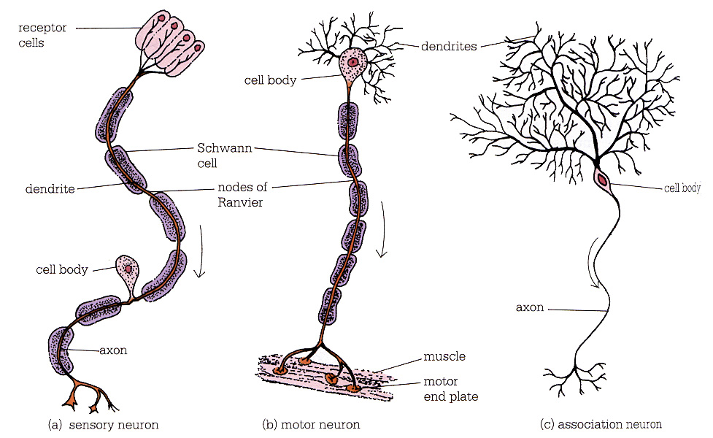
Three types of neurons
Three classes of neurons; sensory neurons, interneurons or association neurons, and motor neurons
Notes:
9

Slide 10
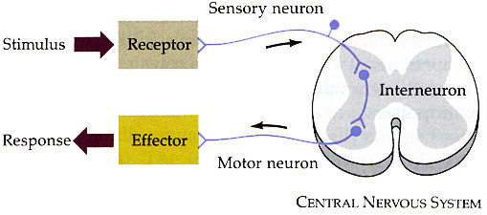
Three types of Neurons
sensory neurons begin with sense organ or receptor and carry impulses to the CNS (spinal cord and/or brain)
interneurons connect neurons together (ex. sensory to motor). They are found in the CNS
motor neurons receive impulses from the CNS and carry them to effectors like muscles or glands.
End Show
Notes:
10

Slide 11
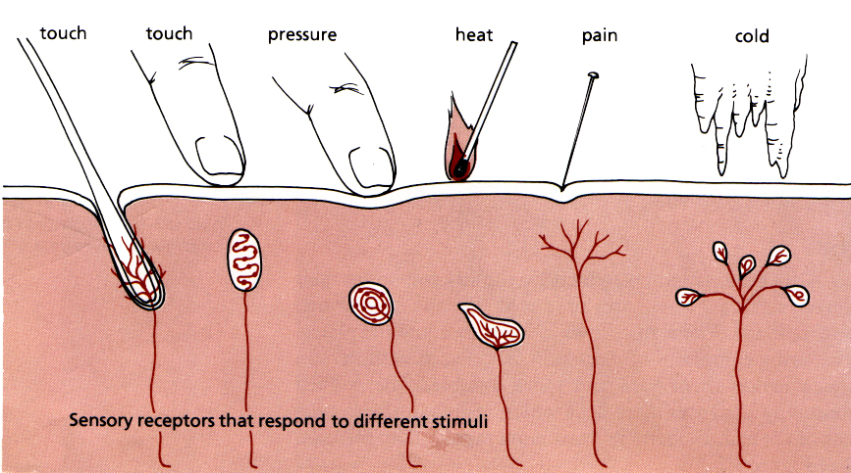
Neural Pathways
All pathways must include;
a) Reception b) Transmission c) Processing
a) Reception refers to dendrites being stimulated by an environment factor and starting an impulse.

Slide 12
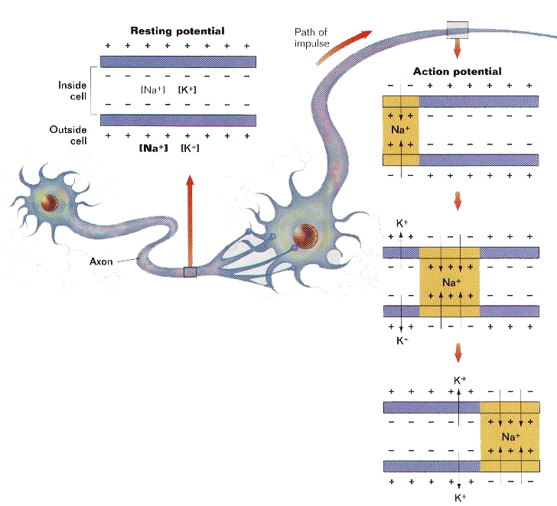
b) Transmission is the passage of the electro-chemical impulse from dendrites to the end plate along the axon.

Slide 13
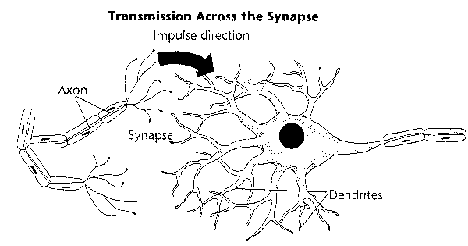
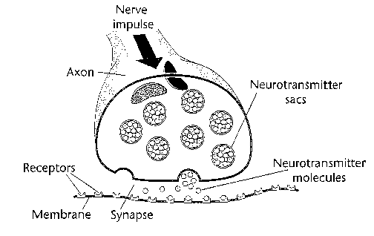
c) Processing refers to the transmission or the non-transmission of the impulse once it reaches the end plate (across a synapse).

Slide 14
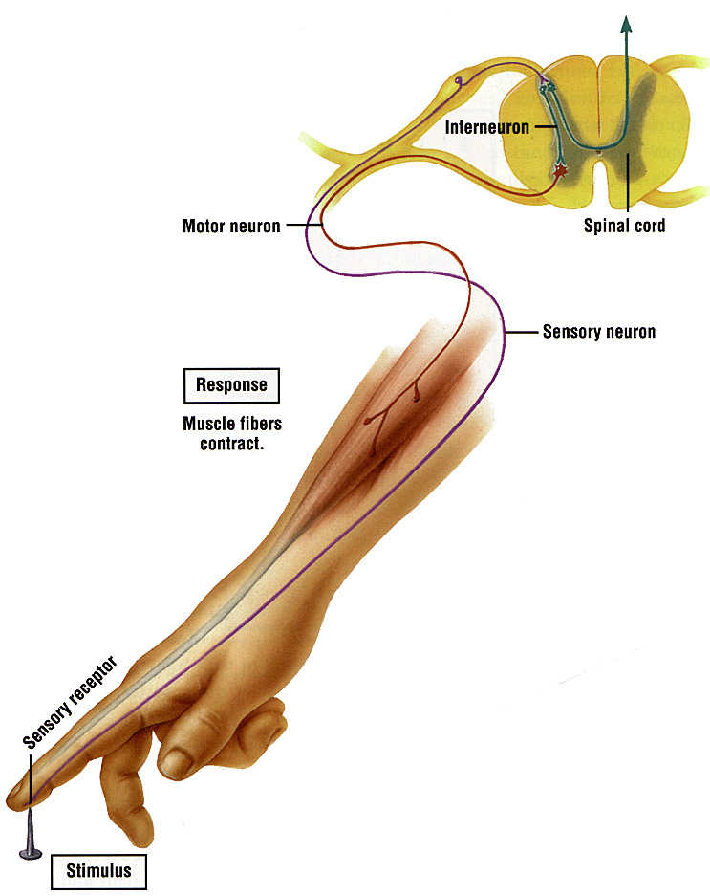
The simplest neural pathway is called the reflex arc.
A reflex arc occurs without brain coordination, therefore it is very fast! Five main components:
a) receptor
b) sensory neuron
c) interneuron in spinal cord
d) motor neuron
e) the effector (muscle or gland)

Slide 16
